Slide 1
Casts and Impressions
SFS1. Students will recognize and classify various types of evidence in relation to the definition and scope of Forensic Science
SFS2. Students will use various scientific techniques to analyze physical and trace evidence.
SFS4 Students evaluate the role of ballistics, tool marks and arson in forensic investigation.
Recognize the forensic significance of tool marks, footwear and tire impressions in an investigation.

Slide 2
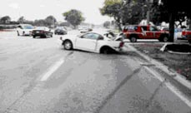
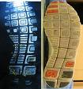
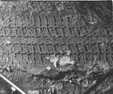
Introduction
People, vehicles, and objects leave evidence of their presence at an accident or crime scene.
Patent impressions are two-dimensional.
Latent impressions are hidden to the eye.
Plastic impressions are three-dimensional.

Slide 3
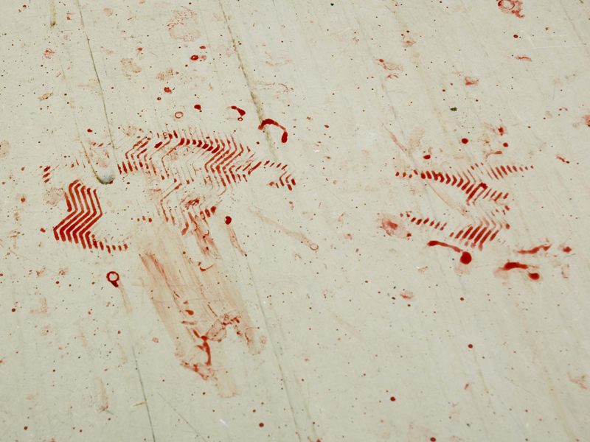
Photography Paul Ricketts, 2006

Slide 4
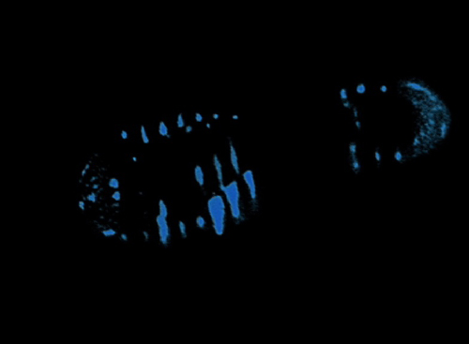
Photography Paul Ricketts, 2006

Slide 5

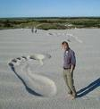

Individual or Class?
How can impressions be class evidence?
How can they be classified as individual evidence?

Slide 6

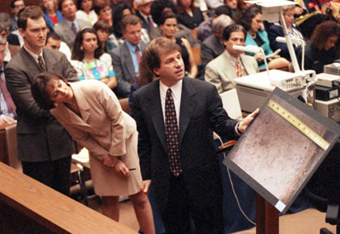
Footprint evidence at the OJ trial.

Slide 7
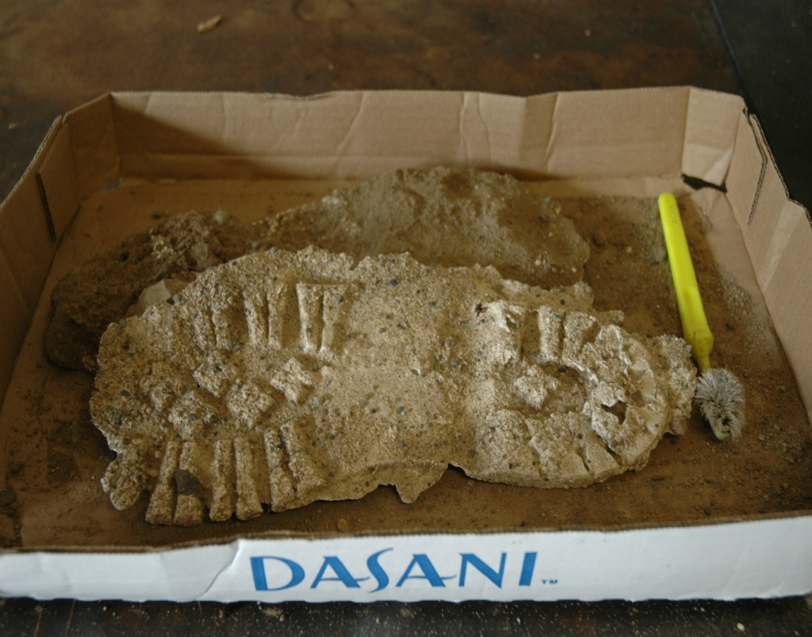
Shoe Impressions
The size of a shoeprint can tell the size of foot of the person.
The depth of a foot or shoe impression can tell something of the person’s weight.
The type of shoe can tell something of the person’s job or personality.
Database SoleMate contain the names of specific manufactures and tread patterns.
Database TreadMark contains impressions from criminals and crime scenes.

Slide 8
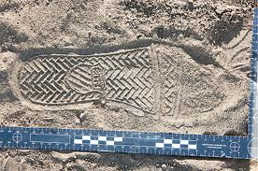
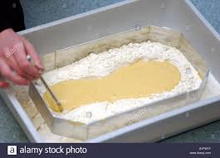
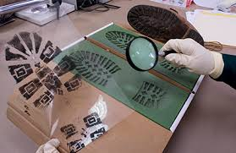
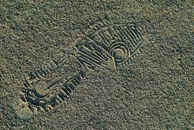


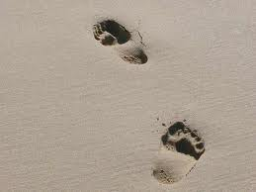

Slide 9
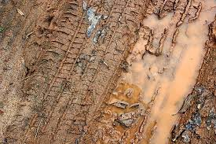

Recording Tread Impressions
Ridges and grooves of discovered tire impressions are counted across the entire width.
Unique characteristics such as wear or pebbles embedded in the grooves are noted.
A print of a suspect’s tire impressions (through one revolution) is taken.
Comparison with impressions from the crime scene, then, can be made.

Slide 10
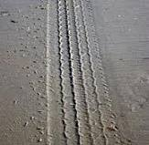
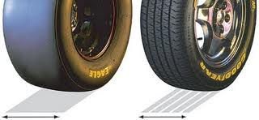
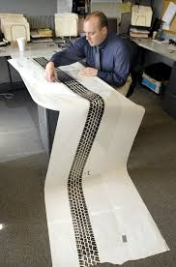
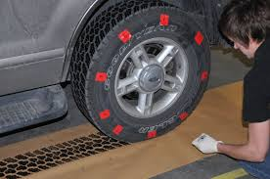
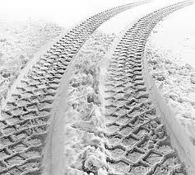
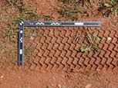

Slide 11
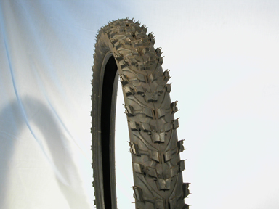
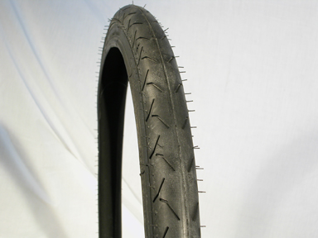
Tire tread
Photography Paul Ricketts, 2006

Slide 12
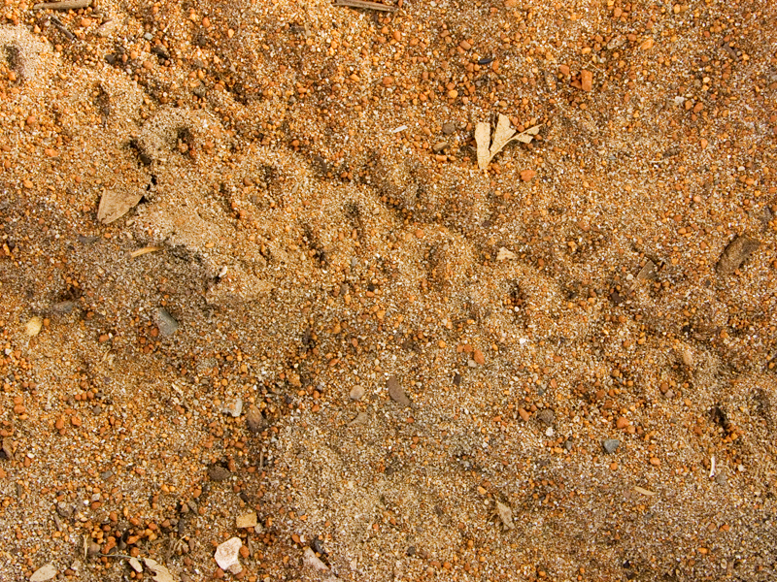
Tire tread on ground
Photography Paul Ricketts, 2006

Slide 13
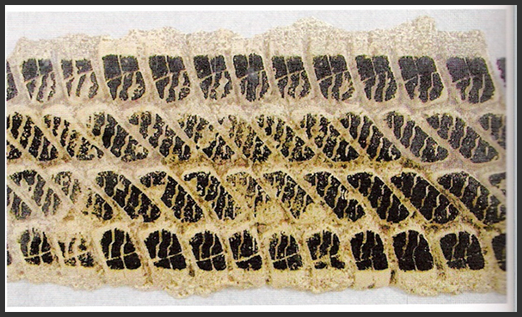

Slide 14
Collection of Shoe or Tire Impression Evidence
Why would the following steps be important?
Take photos as soon as possible.
Take multiple photos of the impression from at least two different orientations.
Place an identifying label and a ruler in position with the impression for the photo.
Use oblique (not bright) lighting when possible.

Slide 15
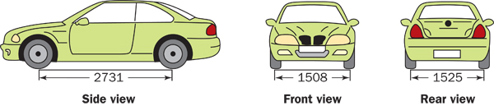
Identifying a Vehicle
Track widths—
From center of tire to center of tire
Wheelbase length—
From center of front axle to center of rear axle

Slide 16
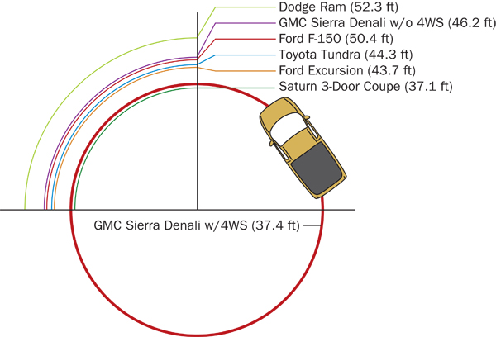
Identifying a Vehicle
Turning diameter
The database TreadMate can be checked to find the vehicle with these specifications

Slide 17
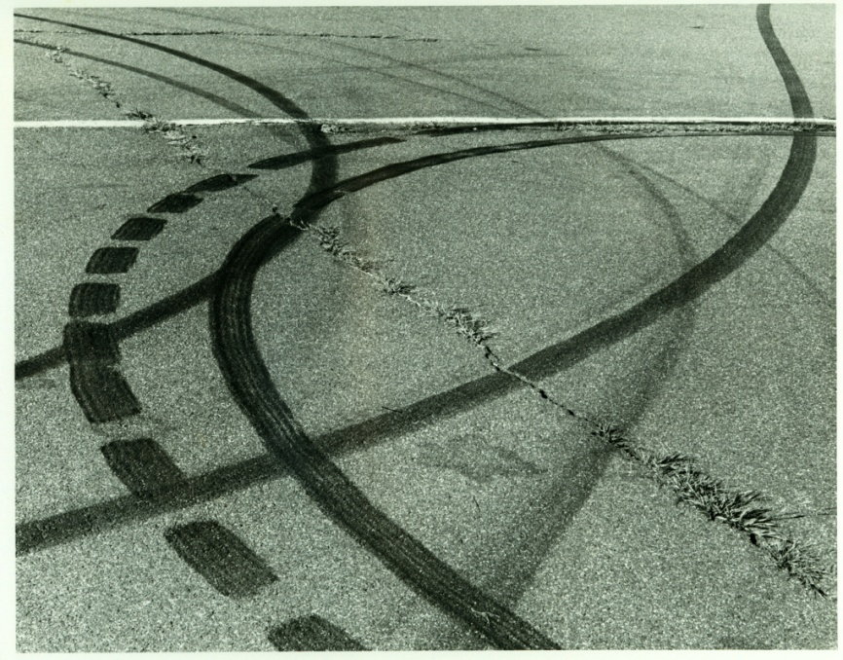
Establishing Car Movements
Direction of travel can be determined by:
Vegetation disturbed
Debris cast off
Splash patterns
Substance transfer
Tire marks

Slide 18
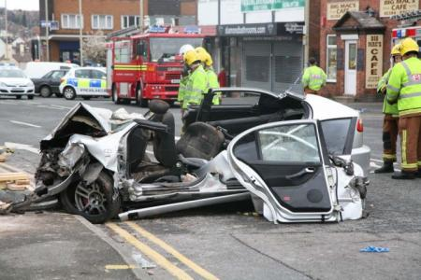
Accident Reconstruction
Using tire marks to determine:
  What happened?
  Where?
  When?
  Why?
  How fast the cars were moving
  Who was involved?
  Who was at fault?

Slide 19
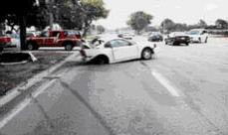
Accident Reconstruction
Drivers may not recall the exact series of events before, during, and after an accident
People, vehicles, and objects, however, can leave evidence of their actions at the scene of an accident
Debris patterns and tire marks can be clues to speed, direction, and vehicle identification

