Slide 1
UNIT 3: DNA and RNA
SB2Aa: Distinguish between DNA and RNA
How is the genetic code contained in DNA used to make proteins?
-The DNA code (original template) controls a cell’s activities by telling the cell which proteins to make.
There are 2 steps to making proteins: transcription and translation.

Slide 2
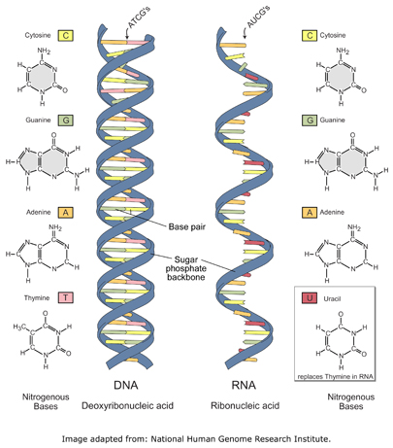
DNA VS. RNA
DNA BOTH RNA
1. Double stranded 1. nucleic 1. single stranded
2. A-T, C-G acids 2. A-U(uracil), C-G
3. Instructions for 2. nucleotides 3. recipe to make
life proteins
4. Deoxyribose 4. Ribose

Slide 3
Steps of transcription
1. Transcription- An RNA(Ribonucleic acid) copy is made from a DNA strand
-writing the recipe-RNA DNA→RNA
-DNA is the head chef and before his cooks can make the food on his menu, he has to write the recipes down!
DNA(Head chef) is stuck in the nucleus(office), so the recipes have to get delivered to the ribosome(kitchen)

Slide 4
tRANSCRIPTION
http://www.learnerstv.com/animation/animation.php?ani=326&cat=biology
After the recipe is written, mRNA-the messenger, carries the coded information (recipe) from the nucleus and delivers the recipe to the ribosome.
Once the recipe is delivered to the ribosome, it has to be followed by the cooks!

Slide 5
tRANSlaTION
How is the recipe going to be followed?
2. Translation
-mRNA has codons which are 3 letters that represent an amino acid.
-Every 3 letters on the recipe, represents a different ingredient!
DNA--→RNA-→Protein
Head chef→Recipe→Foods!

Slide 6
Codon charts
The Messenger RNA (mRNA) protein synthesis code
1st base | 2nd Base |  |  |  | 3rd Base
U | U | C | A | G
 | Phenylalanine | Serine | Tyrosine | Cysteine | U
 | Phenylalanine | Serine | Tyrosine | Cysteine | C
 | Leucine | Serine | Stop | Stop | A
 | Leucine | Serine | Stop | Tryptophan | G
C | Leucine | Proline | Histidine | Arganine | U
 | Leucine | Proline | Glutamine | Arganine | C
 | Leucine | Proline | Glutamine | Arganine | A
 | Leucine | Proline | Asparagine | Arganine | G
A | Isoleucine | Threonine | Asparagine | Serine | U
 | Isoleucine | Threonine | Lysine | Serine | C
 | Isoleucine | Threonine | Lysine | Arginine | A
 | Methionine; Start | Threonine | Aspartate | Arginine | G
G | Valine | Alanine | Aspartate | Glycine | U
 | Valine | Alanine | Aspartate | Glycine | C
 | Valine | Alanine | Glutamate | Glycine | A
 | Valine | Alanine | Glutamate | Glycine | G

Slide 7
Translation
tRNA(transfer RNA) are the cooks that read the recipes to make the proteins(FOODS!)
tRNA is responsible for translating the instructions to make the protein by dropping off the correct amino acids**Every 3 letters in the recipe calls for a different ingredient (amino acid)!
Amino acids bond together with peptide bonds to make a protein a.k.a. polypeptide)

Slide 8
Protein Synthesis
Nuclear
membrane
DNA
Transcription
mRNA
Ribosome
Translation
Protein

Slide 9
Protein synthesis
Let’s make a protein:
TRANSCRIPTION – copying the DNA instructions to make proteins into mRNA DNA→RNA
DNA strand - GCC TGG ATC
mRNA strand- ________ _________ _________
TRANSLATION – protein synthesis a.k.a. making a protein RNA-→Protein
amino acids - ___________ ________ __________

Slide 10
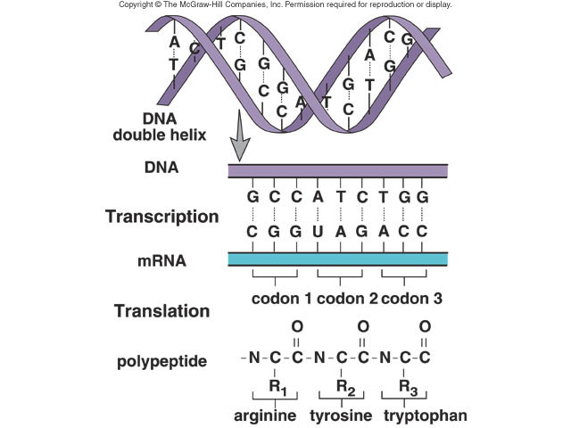
Transcription
Translation

