Slide 1
Population Ecology
Population Density
The number of organisms per unit area
Spatial Distribution
Dispersion is the pattern of spacing of a population.

Slide 2
Population growth
Available resources such as food, water, shelter and mates regulate (control) population growth
Populations grow fastest when there are unlimited (extra) resources available;
Populations stop growing when the resources start to run out, because the resources are scarce(not enough available) and competition occurs.
These resources are called limiting factors, which are any resources in the environment that could keep a population from growing out of control

Slide 3
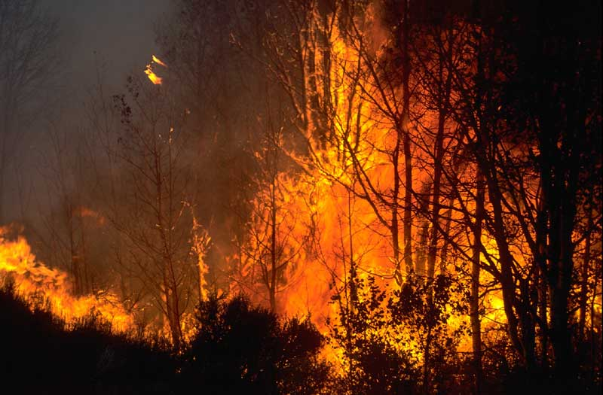
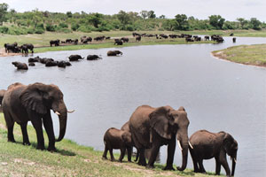
Population growth
Density independent Density dependent
Doesn’t matter the size of Size of the population
the population determines the effect
Examples Example
Fires Disease
Storms Competition
Human alterations of the landscape Parasites
Air, land, and water pollution
Weather events

Slide 4
Population growth
Logistic Model-Normal Growth Curve-S curve
Initial Growth Stage
Exponential Growth: occurs when the number of organisms keeps increasing at a fast rate because nothing stops the population from growing(no limiting factors)
Steady State: population remains about the same
Carrying Capacity: the maximum number of individuals in a population that can survive on available resources (food, space, water, etc…). An environment can support only a certain number of individuals.

Slide 5
Population growth

Slide 6
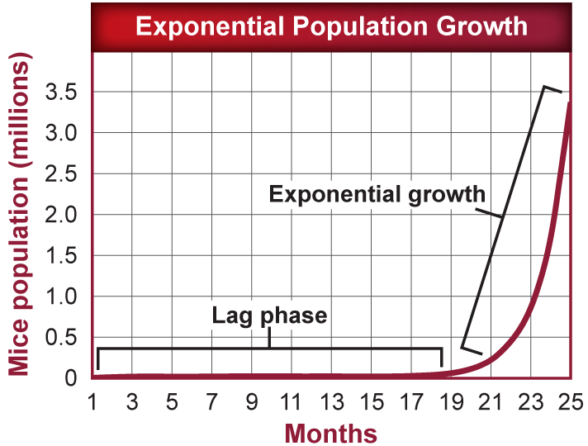
Population Ecology
Exponential Growth Model
Occurs if it has the perfect environment. Limited to short periods and small areas.
Population multiplies quickly.
All populations grow exponentially until some limiting factor slows the population’s growth.
J-Curve
This is mostly unrealistic.

Slide 7
Population Ecology
Zero Population Growth
Zero population growth (ZPG) occurs when the birthrate equals the death rate.

Slide 8
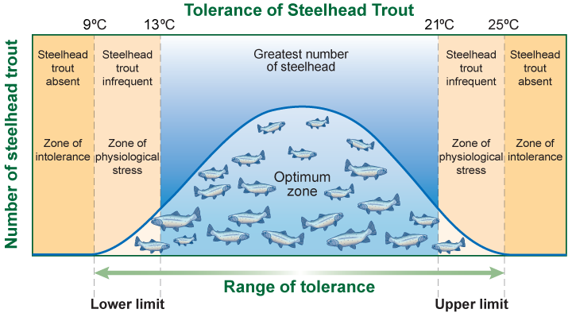
Range of tolerance
For any environmental factor, there is an upper limit and lower limit that define the conditions in which an organism can survive known as the Range of Tolerance.
Steelhead Trout live in clear, cool coastal rivers and streams from California to Alaska. The ideal range of water temperature for Steelhead trout is between 13ºC and 21ºC. However, they can survive water temperatures from 9ºC to 25ºC, but can experience physiological stress such as the inability to grow or reproduce.

