Slide 1
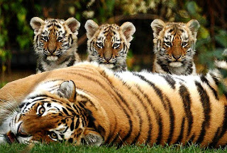
UNIT 7: Evolution How do populations grow?
Genetic Change and Variation
Genes are a source of random variation in a population.
Mutations cause some variation
Crossing over causes variation

Slide 2
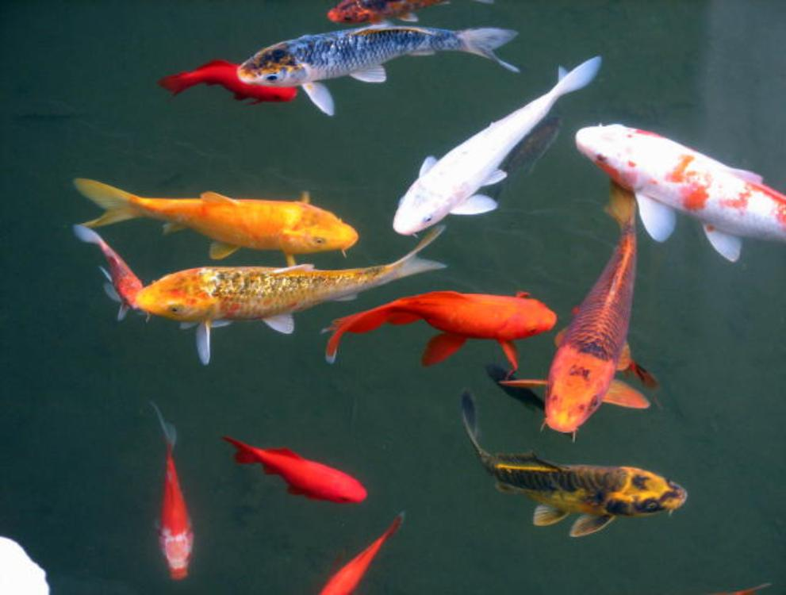
Evolution as Genetic Change
Populations: collection of individuals of the same species in a given area whose members can breed with one another.
Ex. All the fish of a certain species in a single pond= 1 population; individuals in a separate pond would be another population.

Slide 3
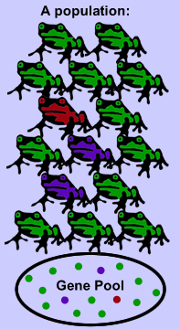
Population growth
Because all members of a population can interbreed, they and their offspring share a common group of genes,
called a gene pool.
each contains a certain
amount of alleles for each
trait.

Slide 4
Population growth
Number of times an allele occurs in a gene pool compared with the number of times other alleles for the same gene occur is relative frequency.
Ex. Deck of cards: shuffling and reshuffling produce a lot of variety of different hands. Shuffling alone will not change the number of aces, kings, queens etc

Slide 5
Population growth
Species: group of similar looking organisms that breed with one another and produce fertile offspring in a natural environment.
They share a common gene pool
Genetic change in one individual can spread through the population as they mate.
If it increases fitness, that gene will be found in many individuals
Many organisms can evolve together with their environment.

Slide 6
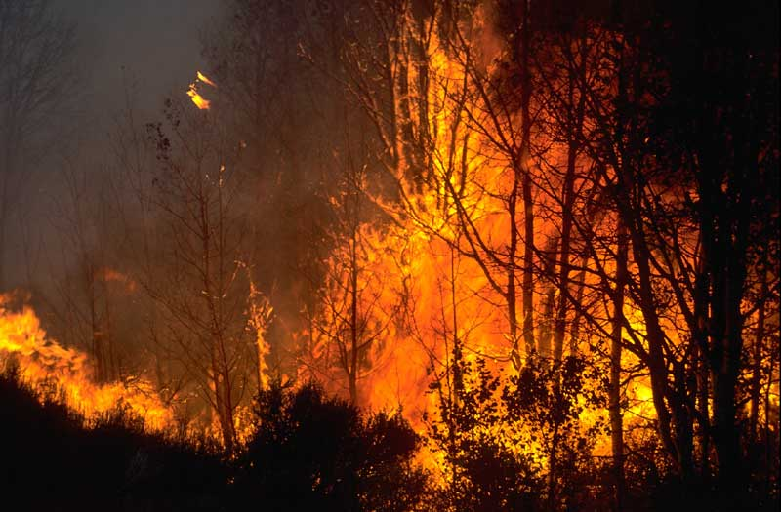
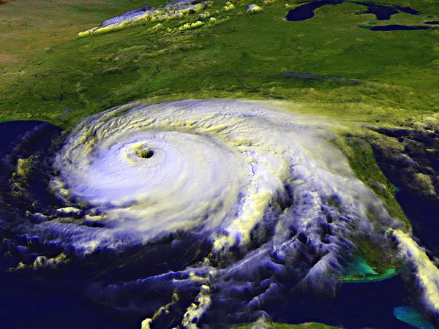
What causes population growth?
Density independent Density dependent
Doesn’t matter the size of Size of the population
the population determines the effect
Examples Example
Fires Disease
Storms

Slide 7
Population growth
Biotic Potential: rate at which a population will grow if all individuals survive and reproduce at maximum capacity!
In nature, most don’t reach their biotic potential b/c of shortage of food, space, predators or too much waste.
Organisms reach a maximum then start to decline until there’s a balance between individuals and resources.

Slide 8
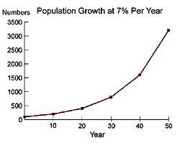
Population growth
Growth Curve: used to study patterns of population growth=# of individuals and resources.
J shape curve=tracks 2 phases of growth
a. exponential-increase rapidly
b. lag phase-little or no growth occurs

Slide 9
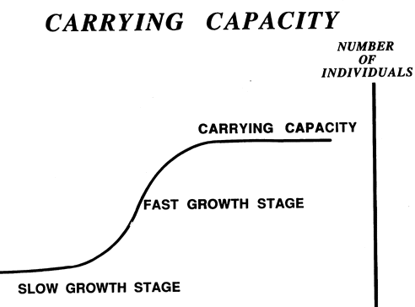
Population growth
S shape Curve: period of stability,
gives carrying capacity-maximum # of individuals in a population
Predators, disease etc. keep population in check.
Ex. Rabbits in Australia; there was no disease or predators therefore the population of rabbits reproduced at a high rate and there was an overpopulation of rabbits.

Slide 10
Hardy-Weinberg Principle
a control for measuring evolution.
States that allele frequencies in a population will remain constant unless one or more factors cause those frequencies to change.
5 conditions are required to maintain genetic equilibrium (allele frequencies remain constant) from generation to generation

Slide 11
Hardy-Weinberg Principle
Random mating-ensures that each individual has an equal chance of passing on its alleles to offspring.
Large population-genetic drift has less effect on large populations.
No movement in or out of the population-to ensure no new alleles are brought into the population.
No mutations-mutations would change allele frequency in the population.
No natural selection-all genotypes must have equal probabilities of survival and reproduction and no phenotype can have a selective advantage over another.

Slide 12
Hardy-Weinberg Principle
Two Equations: p² + 2pq + q² = 1 AND p + q =1
(HD + Hetero + HR=1)
p = frequency of dominant allele (A)
q = frequency of recessive allele (a)
p² = frequency of Homozygous Dominant genotype (AA)
(% of Homozygous Dominant individuals)
2pq = frequency of heterozygous genotype (Aa)
(% of Heterozygous individuals)
q² = frequency of Homozygous Recessive genotype (aa)
(% of Homozygous Recessive individuals)

Slide 13
Hardy-Weinberg Principle
Practice:
If 98 out of 200 individuals in a population express the recessive phenotype, what percentage of the population would you predict to be heterozygotes?
(1) I have given you information on the frequency of the homozygous recessive (or q2). So start by determining q2 and then solving for q.
q² = (98/200) = 0.49 (or 49%)
q = square root of 0.49 = 0.7 (70%)

Slide 14
Hardy-Weinberg Principle
(2) Now that you have q, you can solve for p. Remember there are only two alleles in the population, so if you add the frequency of the two alleles, you have accounted for all possibilities and it must equal 1. So p + q = 1.
p = 1-q
p = 1 - 0.7 = 0.3 (30%)

Slide 15
Hardy-Weinberg Principle
(3) Now that you have figured out the % of heterozygotes, can you figure out the % of homozygous dominant? Does the % of homozygous dominant, heterozygotes and homozygous recessive individuals add up to 100%? If not, you have made an error. Those are the only three genotypes possible with only two alleles and a simple dominant and recessive relationship.
p2 = (0.3)(0.3) = 0.09 (or 9%)

Slide 16
Hardy-Weinberg Principle
(4) Now what is the formula for heterozygotes? Think back to the Hardy-Weinberg equation -- it is dealing with the genotypes of individuals in the population.
p2 + 2pq + q2 = 1
so.....2pq = frequency of heterozygotes
frequency of heterozygotes = 2 (0.3)(0.7) = 0.42 or 42%
Now, plug in all of your numbers and make sure they equal 1!!
p2 + 2pq + q2 = 1
0.09 + 0.42 + 0.49 = 1.0

