Slide 1
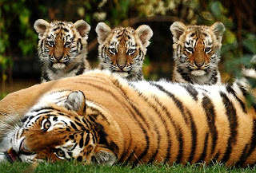
UNIT 4: Evolution How do populations grow?
Quick Review: How do you know a group of individuals belong in the same population? Answer- The individuals live in the same place, at the same time; They are of the same species, which means they can reproduce and produce fertile offspring(fertile-able to reproduce). They compete for food, water, shelter and mates.

Slide 2
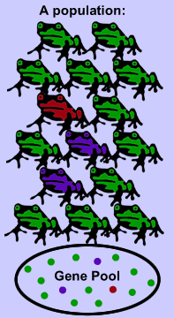
Population growth
Gene pool-the entire collection of genes in a specific population
Remember: Different forms of a gene are called alleles, so a gene pool
is the available alleles in a
specific population

Slide 3
Population growth
Available resources such as food, water, shelter and mates regulate (control) population growth
Populations grow fastest when there are unlimited (extra) resources available;
Populations stop growing when the resources start to run out, because the resources are scarce(not enough available)
These resources are called limiting factors, which are any resources in the environment that could keep a population from growing out of control

Slide 4
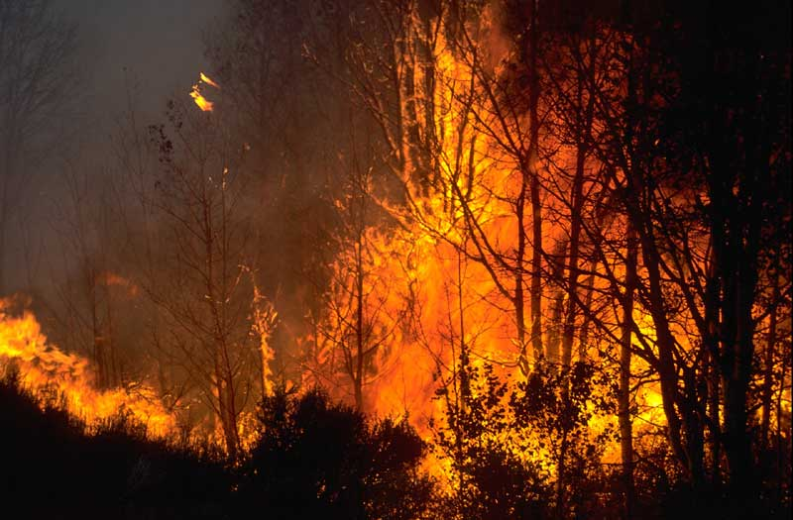
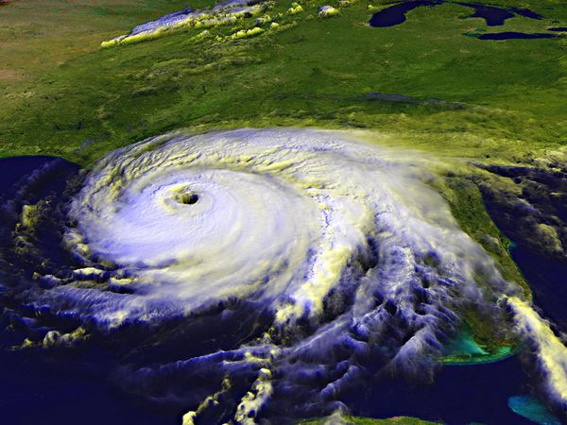
Population growth
Density independent Density dependent
Doesn’t matter the size of Size of the population
the population determines the effect
Examples Example
Fires Disease
Storms

Slide 5
Population growth
Normal Growth Curve
Initial Growth Stage
Exponential Growth: occurs when the number of organisms keeps increasing at a fast rate because nothing stops the population from growing(no limiting factors)
Steady State: population remains about the same
Carrying Capacity: the maximum number of individuals in a population that can survive on available resources (food, space, water, etc…). An environment can support only a certain number of individuals.

Slide 6
Population growth

Slide 7
Population growth
Decline: A decrease in a population due to a decrease in birthrate or an increase in deathrate
Extinction: A continuing decline in the population until no more individuals are left to reproduce. This is a disappearance of a species.

