Slide 1
UNIT: Evolution How do changes in the environment lead to changes in populations?
What is evolution?
A change in a species over a long period of time
Newer species form from older species

Slide 2
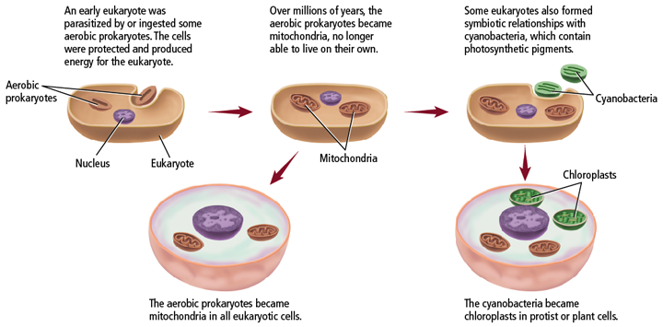
Endosymbiont theory-Eukaryotes evolved from Prokaryotes

Slide 3
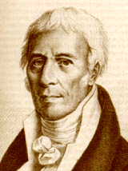
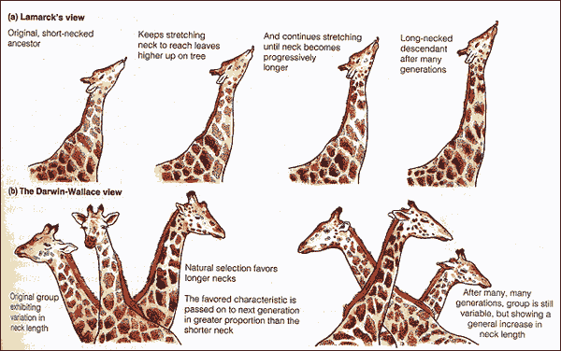
Lamarck’s Theory
Pre-Darwin scientist
Inheritance of acquired traits
Organs used a lot could grow and change shape
Organs not used would shrivel and disappear
Theory was incorrect but significant because he was the first scientist to recognize that organisms had changed over time

Slide 4
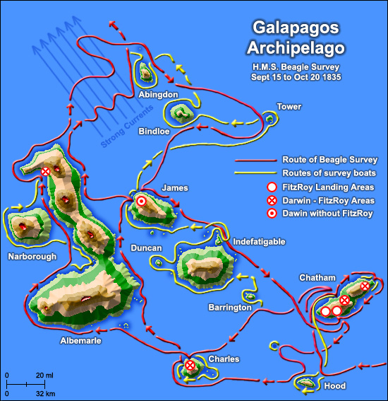
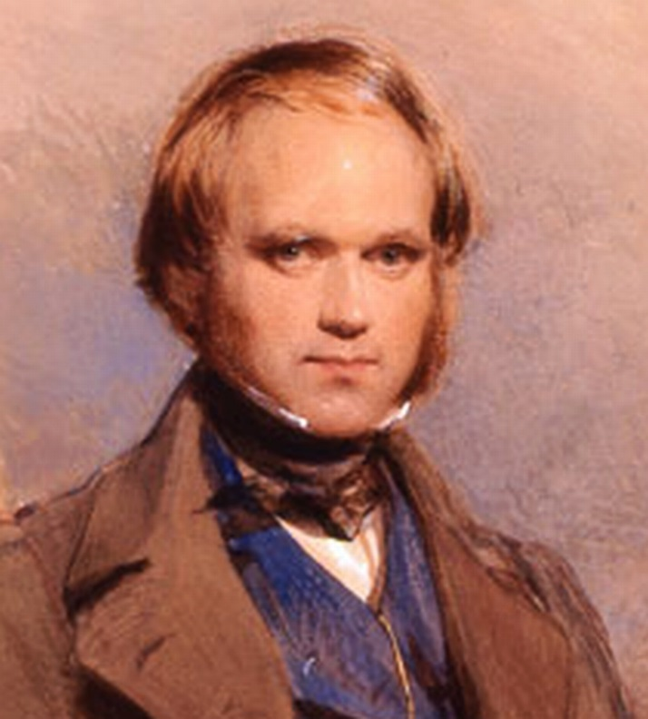
Natural selection
Who attempted to explain evolution?
A scientist, Charles Darwin is considered to be the founder of modern evolutionary theory
His research studied finches and the different shapes of their beaks, depending on which island they lived on and what resources they had to survive.

Slide 5
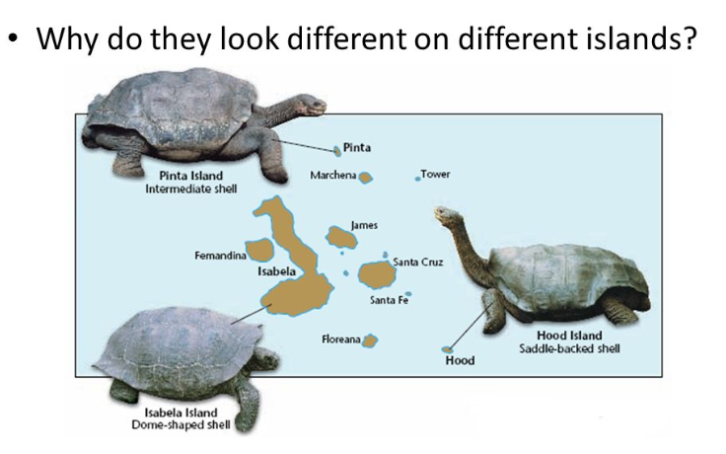
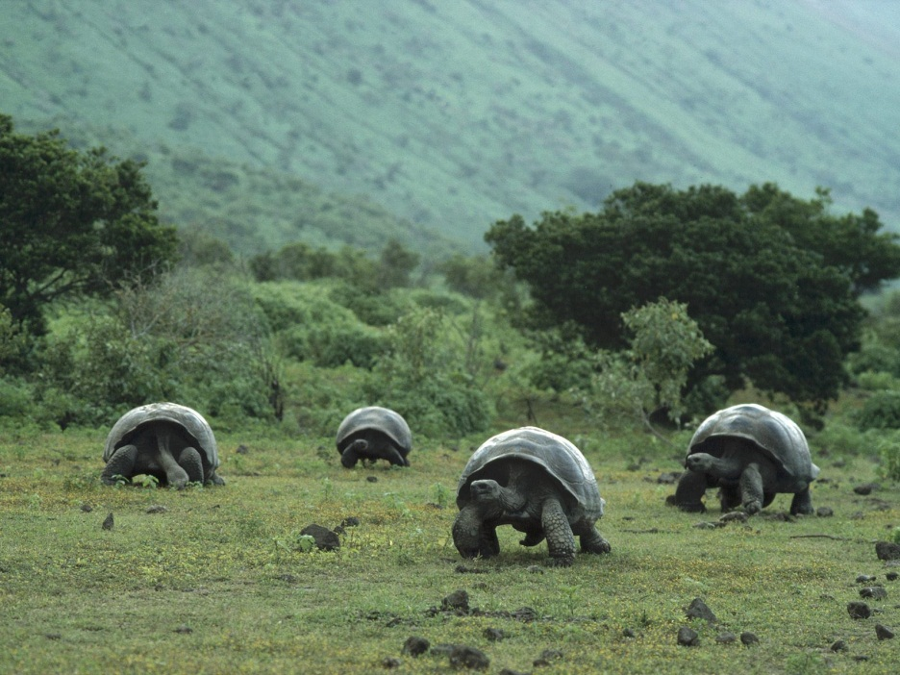
Natural selection
Darwin developed the theory of natural selection, which is a process by which organisms with favorable variations, caused by mutations for a particular environment survive, reproduce and pass these variations on to the next generation “Survival of the fittest”

Slide 6
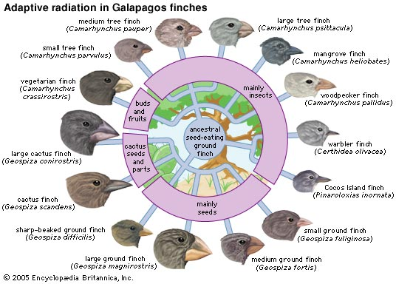
Adaptive Radiation- the emergence of many species from one common ancestor; Darwin’s finches are an example

Slide 7
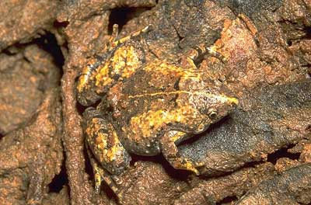
More Terms
Fitness – ability of an individual to survive and reproduce in a specific environment
Adaptation – inherited characteristic that increases an organism’s chance of survival
Can be physical traits as well as behavioral traits
Behavioral-
Birds’ calls
Mating dances
and
migration

Slide 8
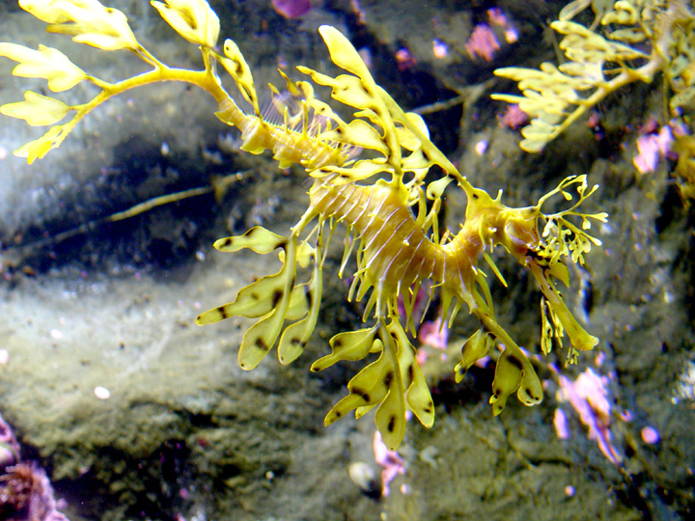
Physical Adaptation: Camouflage
Allows organisms to become almost invisible to predators
Leafy sea dragon

Slide 9
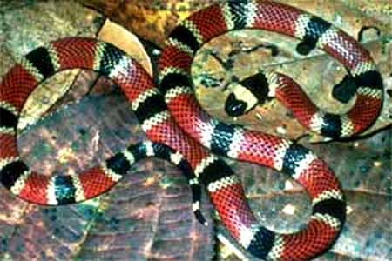
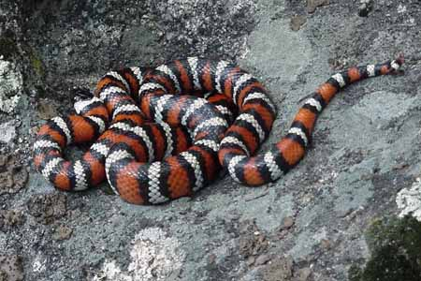
Physical Adaptation-Mimicry
One species evolves to resemble another species.
Western coral snake
California kingsnake

Slide 10
Darwin’s Theory of Natural Selection
Natural Selection
Individuals in a population show variations.
Variations can be inherited.
Organisms have more offspring than can survive with available resources.
Variations that increase reproductive success will have a greater chance of being passed on.
“Survival of the Fittest”

Slide 11
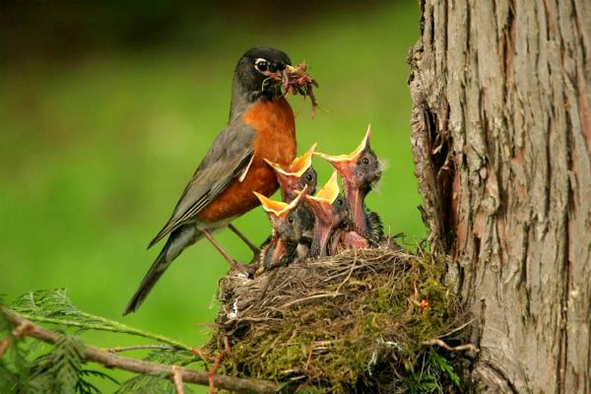
Natural selection
3 Principles that explain how natural selection occurs
1. Overproduction
Populations produce more offspring than the environment can support (or carry)

Slide 12
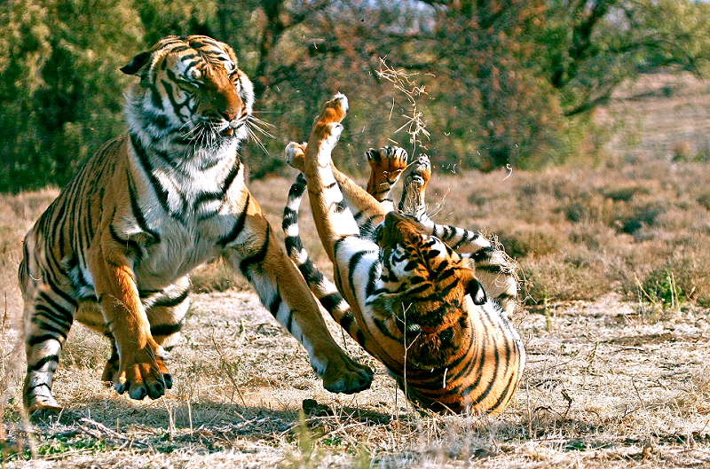
Natural selection
2. Reproductive Advantage
When the environment cannot support the overproduction of offspring, this leads to a competition/struggle, with only a portion of the offspring surviving (survival of the fittest)

Slide 13
Natural selection
3. Variation
There is great variation(diversity) among individuals in a population
The individuals that have the BEST traits for their environment survive and produce more offspring-fitness

Slide 14
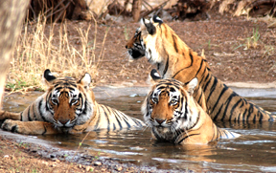
Natural selection
* Population: a group of organisms of 1) one species 2) living in the same place, 3) at the same time4) that have the ability to reproduce (mate)
* members of the same population compete with one another for food, water, shelter, and mates

Slide 15
Natural selection
What determines the rate at which a species evolve?
An unequal ability of individuals to survive and reproduce leads to a gradual change in a population
The more quickly a species reproduces, the more quickly it can evolve.
http://www.youtube.com/watch?v=gEwzDydciWc

Slide 16
Natural selection
THE ORGANISM: Biston betularia is the scientific name for a moth that lives in forested areas of England. The moth is commonly known as the “Peppered Moth.” Usually most moths are light in color, with a few black specks. However, a few individuals show a different color pattern, being dark gray in color. The moth frequently becomes the prey of various types of birds.
THE ENVIRONMENT: The Peppered Moth usually lives in forests where the tree trunks are heavily covered with light colored lichens (plant-like organisms), which makes the bark of the tree appear to have a very light color. However, since the start of the Industrial Revolution, burning large amounts of coal and oil has coated forests near urban areas with a layer of dark soot.

Slide 17
Evolution practice
In a specific population of salmon, one variety that exists is larger teeth, which allows some individuals in the population of salmon to survive better than others. The population density for the salmon with this adaptation is shown to be increasing each year, whereas the population of the small teeth salmon appear to be decreasing.
Using Darwin’s theory of evolution, how did natural selection cause changes in the salmon population?

