Slide 1
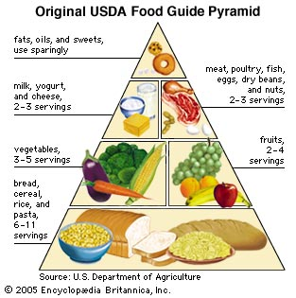
UNIT: Biochemistry What are the structures and functions of the 4 major macromolecules?

Slide 2
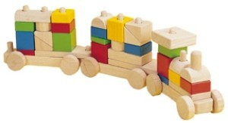
Macromolecules( macro=big)
Organic→ has carbon
Means “large” molecule, it is a Polymer
Made up of smaller molecules called monomers.
Think of a train-each car of the train is the monomer, the entire train is a polymer.
monomer
polymer

Slide 3
Macromolecules
There are four main macromolecules
Proteins: made up of amino acids (monomer)
Lipids: made up of a glycerol and 3 fatty acids (monomer)
Carbohydrate: made up of a monosaccharide-means 1 sugar (monomer)
Nucleic Acid: made up of nucleotides (monomer)

Slide 4
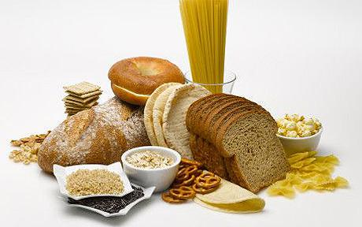
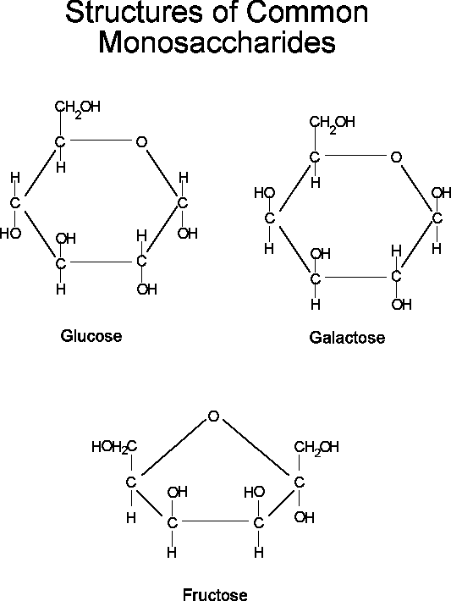
Carbohydrates
Sugars like glucose
Made up of simple sugars called monosaccharides-1 SUGAR!
Ex. Glucose, galactose, fructose
Contains LOTS of QUICK energy in the Carbon-Hydrogen bonds
Disaccharides-2 sugars Example: sucrose-table sugar

Slide 5
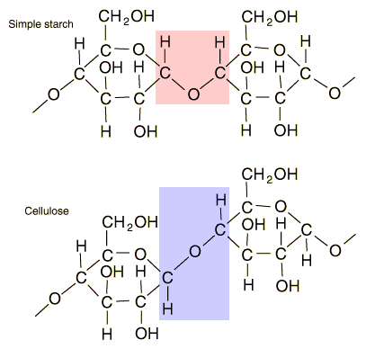
Macromolecules
Carbohydrates
Polysaccharides-means many sugars
Examples-Starch-energy storage, found in potatoes Cellulose-found in the cell walls of plants
Glycogen-animal energy storage

Slide 6
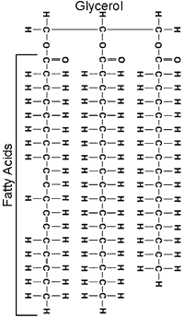
Macromolecules
Lipids-Fats
Waxes, cholesterol,
oils and fats
b. 3 major roles in living
things
1. Store energy in carbon-hydrogen bonds
2. form CELL membranes
(phospholipid bilayer)
3. chemical messengers (steroid hormones)
c. Made of 1 glycerol and 3 fatty acids

Slide 7
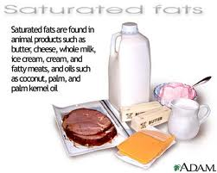
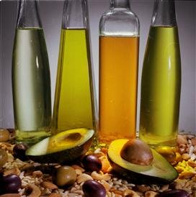
lipids
Saturated
Contains maximum # of Hydrogen Atoms (H⁺)
Found in meat and dairy, solid at room temp.
Unsaturated
Doesn’t have maximum # of H⁺ atoms
Oils; liquid at room temperature.
Unsaturated fats

Slide 8
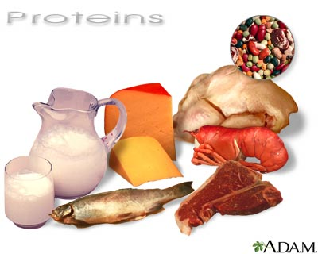
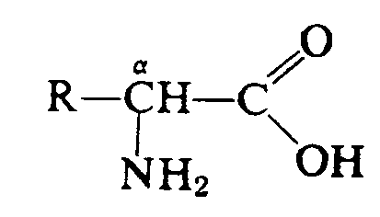
macromolecules
Proteins-A.K.A. Polypeptides
Made up of amino acids connected by peptide bonds
More than 20 different amino acids
Examples: Muscle, hair, nails, enzymes, hemoglobin
Uses
Speed up chemical reactions (Enzymes)
Pump small molecules in and out of cells
help cells and organisms move
Provide structure
Structure of a Protein

Slide 9
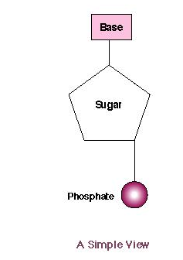
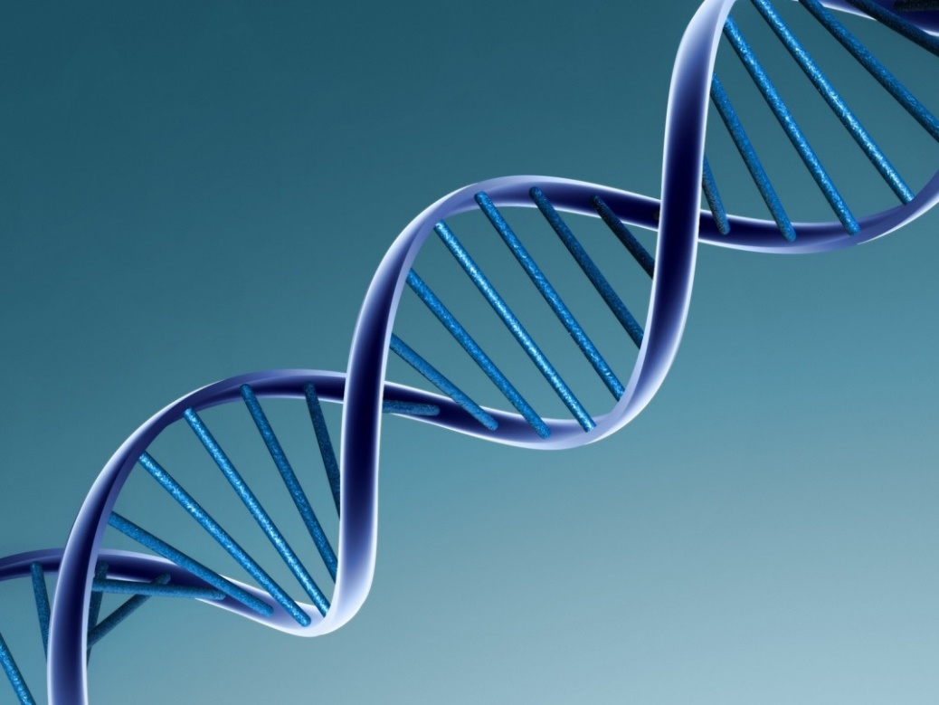
macromolecules
Nucleic Acids
Made up of nucleotides
3 basic parts 5 carbon sugar
Phosphate
nitrogenous base
2 types
RNA-ribonucleic acid
Single stranded
DNA-deoxyribonucleic acid
Double helix
Functions
Store and transmit hereditary
information

Slide 10
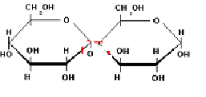
Macromolecules
How to join or separate sugars
Dehydration synthesis-join 2 monosaccharides to create a polysaccharide
**water is released
Hydrolysis-split apart a polysaccharide to create a monosaccharide
**Water is added or consumed

Slide 11
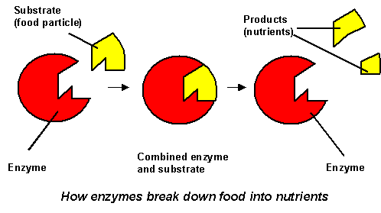
Enzymes
Enzymes are biological catalysts that speed up chemical reaction
Sample cells can have more than 2000 different enzymes
Enzymes bond with substrates at the active site like a lock and key to either break bonds or make bonds, depending on the enzyme!
lock
key

Slide 12
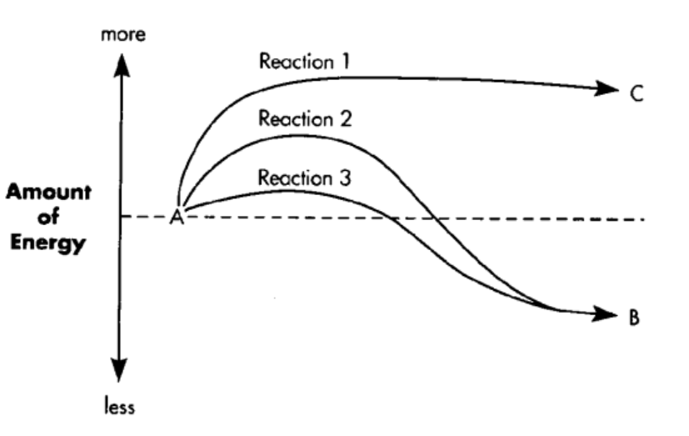
Enzymes work by lowering the activation energy, which is the amount of energy needed to start the reaction!

Slide 13
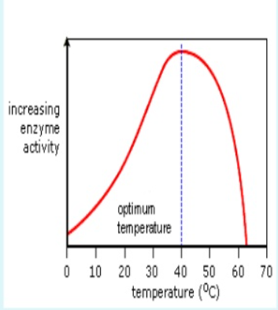
Enzymes can be affected by temperature, pH and enzyme concentration. Enzymes operate at an ideal temperature and pH.
For example, most enzymes in the human body operates their best at 98.6 degrees. Temperatures higher will destroy the enzymes, denaturing or changing the shape of them so they can no longer function!

