Slide 1
UNIT 8: Ecology What are the levels of organization in ecology?
ORGANISMS AND THEIR ENVIRONMENT
LOTS OF VOCABULARY!!!
* Ecology: the study of the interactions between organisms and their environment

Slide 2
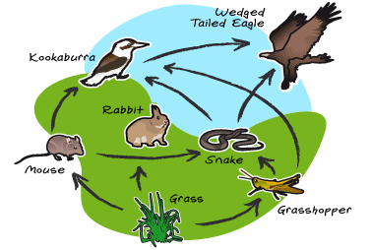
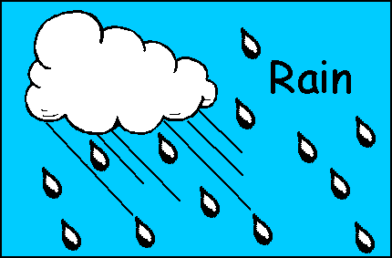
Ecology
2 types of factors in an organisms’ environment:
* Biotic factors (bio - _____ ) * Abiotic factors
- all the living - all the nonliving
organisms in an parts of the
environment environment
Ex. Plants and animals that affect organisms Ex. Temperature, water, Oxygen, rocks, rain and sun

Slide 3
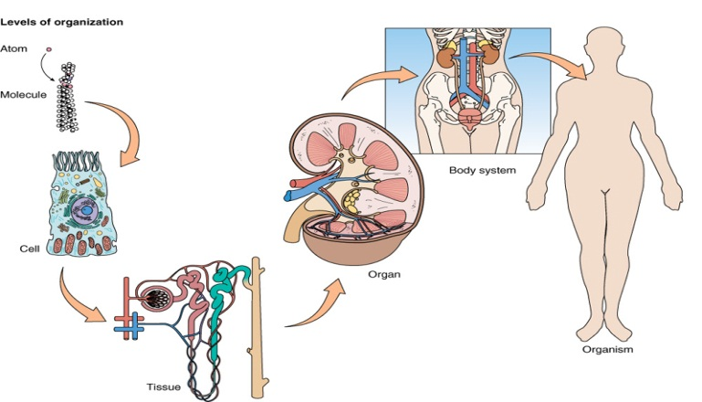
Levels of Organization
Levels of Organization: The Organization of Life
**All living matter is organized into levels: (from lowest to highest)
1) Organism: a _living_ thing Ex. Human
- Multicellular organisms are complex. They are composed of body systems made of organs, which are made of tissues, which are made of cells, which have organelles made of molecules.

Slide 4
Levels of Organization
2) Population: a group of organisms of a) one species b) living in the same place, c) at the same time, d) that interbreed
Ex. Human population

Slide 5
Levels of Organization
3) Community: several interacting species that live in the same place
Ex. Humans and pets

Slide 6
Levels of Organization
4) Ecosystem: all the biotic factors and abiotic factors in a community.
Ex. pond
- 2 types of ecosystems: terrestrial & aquatic

Slide 7
Levels of Organization
5) Biosphere: the highest level of organization.
- made up of the entire Earth and its living and nonliving parts
WHERE AND HOW ORGANISMS LIVE
* Niche: the role a species plays in a community.
* Habitat: the place where an organism lives out its
life

