Slide 1
UNIT 6: Cell Division What is a karyotype and how is it used to detect genetic disorders?
Karyotype
Orderly display of magnified images of an individuals chromosomes.
Detects genetic abnormalities caused by mutations.
Usually use blood (WBC)

Slide 2
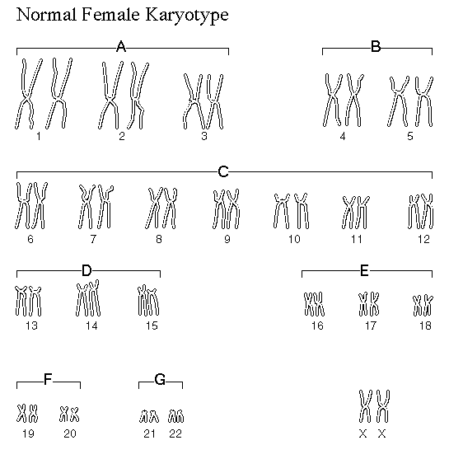
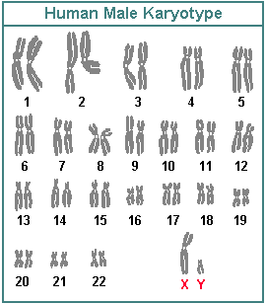
Karyotypes
Typical Karyotypes

Slide 3
Karyotypes
Abnormalities
Alterations in chromosomes ex. Down Syndrome
Extra copy of chromosome 21
Most common chromosome number abnormality
1 out of 700 children affected in U.S.
Can also have a mutation occur during meiosis which affects sex chromosomes, X and Y
Ex. XXY, XXX
XXY-Klinefelter Syndrome-sterile male
XXX-Metafemale-Limited fertility
http://www.mwit.ac.th/~bio/assets/karyotype_mutation.swf

Slide 4
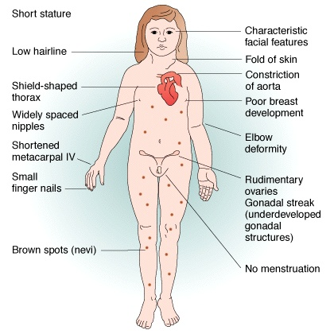
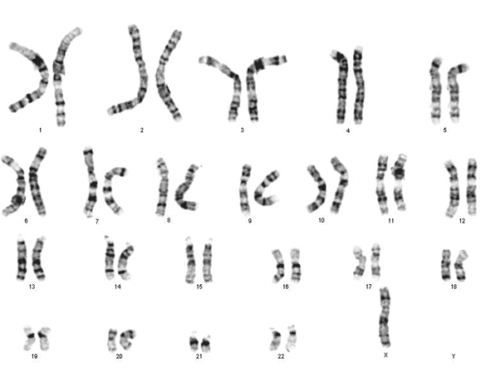
Turner’s Syndrome

Slide 5
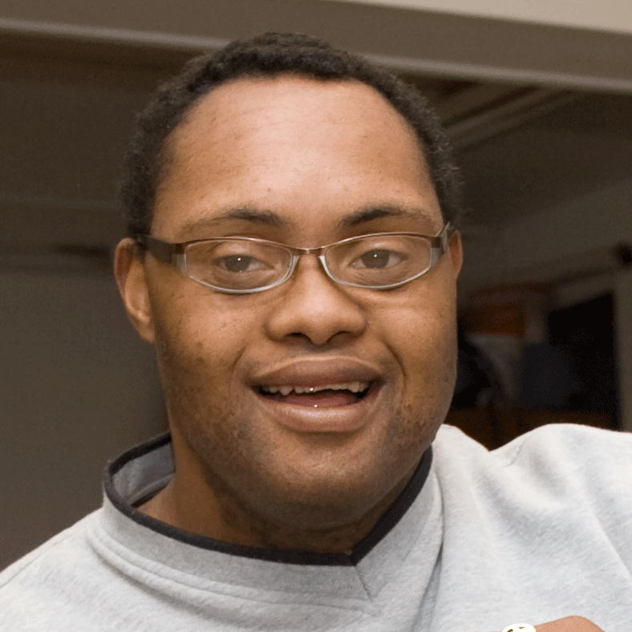
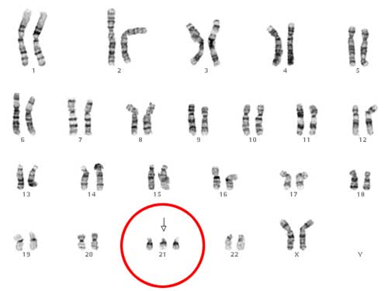
Down’s Syndrome
Most children with Down syndrome have mild to moderate cognitive disability. About half of the children who have Down syndrome are born with a heart defect. Children with Down syndrome are also prone to developing other health problems. For example, respiratory infections, hearing problems, and dental problems are common.

Slide 6
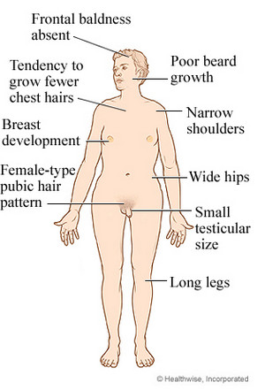
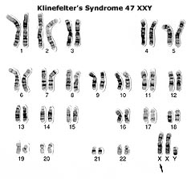
Klinefelter’s
Many men who have Klinefelter syndrome do not have obvious symptoms. Some boys with Klinefelter syndrome have language and learning problems.

Slide 7
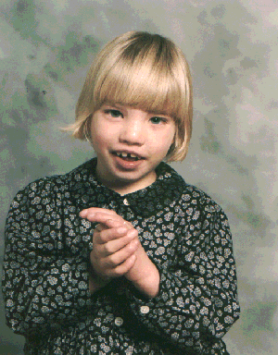
Cri du Chat
Cry that is high-pitched and sounds like a cat
Downward slant to the eyes
Low birth weight and slow
growth
Intellectual disability
Partial webbing or fusing of
fingers or toes
Slow or incomplete development of motor skills
Small head
Small jaw
Wide-set eyes

