Slide 1
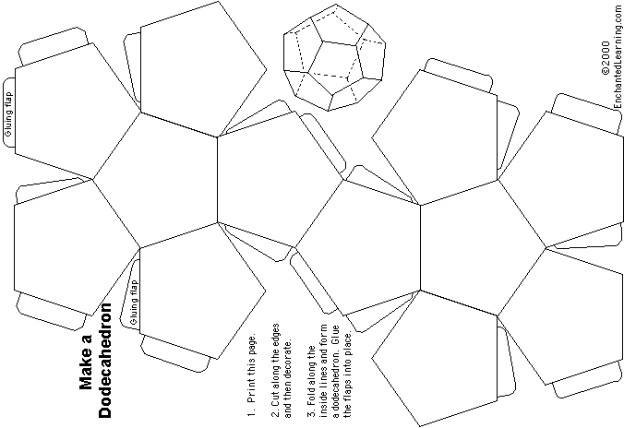

Slide 2
1 Names, due date, block and impact topic

Slide 3
2 Pictures of your impact

Slide 4
3 Pictures of your impact

Slide 5
4 Pictures of your impact

Slide 6
5 Description of your impact

Slide 7
6 The impact it has on the environment

Slide 8
7 Possible solutions. Include laws in place for conservation

Slide 9
8 Identify a specific species

Slide 10
9 Food Web

Slide 11
10 Cause/Source(s) of Threat

Slide 12
11 Biogeochemical cycles

Slide 13
12 Resources (APA format)

