Slide 1
Food and Agriculture
Chapter 15 Notes

Slide 2
Feeding the World
Famine is the widespread malnutrition and starvation in an area due to a shortage of food, usually caused by a catastrophic event.
By 2050, the world’s farmers will need to feed about 9 billion people – about 50% more than they currently feed!

Slide 3
Humans and Nutrition
The human body uses food both as a source of energy and as a source of materials for building and maintaining body tissues.
The amount of energy that is available in food is expressed in Calories. One Calorie is equal to 1,000 calories or one kilocalorie.
The major nutrients we get from food are carbohydrates, proteins, and lipids. Our bodies need smaller amounts of vitamins and minerals to remain healthy.

Slide 4
Malnutrition is a disorder of nutrition that results when a person does not consume enough of each of the nutrients that are needed by the human body.
There are many forms of malnutrition. For example, humans need to get 8 essential amino acids from proteins. This is easily done if a variety of foods is eaten. However, in some parts of the world, the only sources of food may be corn and rice, which contain protein, but lacks one of the essential amino acids. Amino acid deficiency can result from such a limited diet.

Slide 5
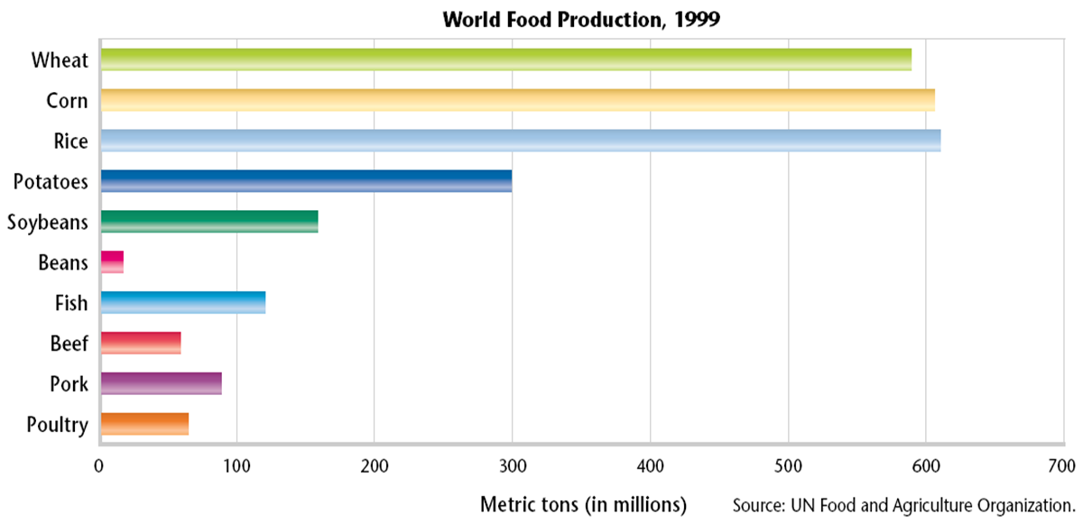
Sources of Nutrition
Diet is the type and amount of food that a person eats. A healthy diet is one that maintains a balance of the right amounts of nutrients, minerals, and vitamins.

Slide 6
Diets Around the World

Slide 7
The Ecology of Food
Food Efficiency
The efficiency of a given type of agriculture is a measure of the quantity of food produced on a given area of land with limited inputs of energy and resources.
An ideal food crop is one that efficiently produces a large amount of food with little negative impact on the environment.

Slide 8
Old and New Foods
Yield is the amount of crops produced per unit area.
Researchers are interested in organisms that can thrive in various climates and that do not require large amounts of fertilizer, pesticides, or fresh water. Some organisms have been a source of food for centuries, while other sources are just being discovered.

Slide 9
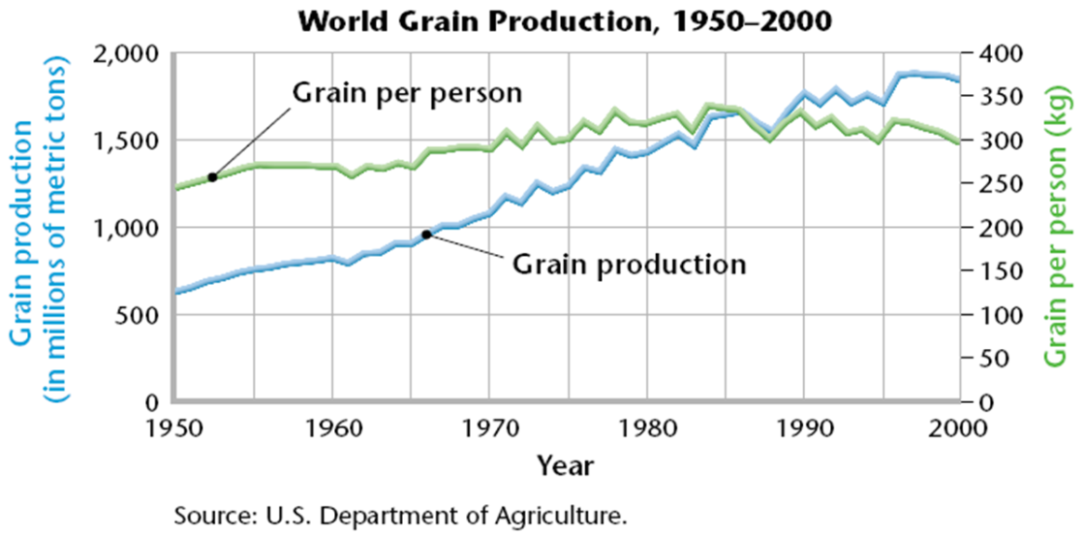
World Food Problems
Some people become malnourished because they simply do not get enough food.
More food is needed each year to feed the world’s growing population.

Slide 10
Poverty
The world’s hungry are nearly all farm workers and subsistence farmers – farmers who grow only enough food for local use.
They work tiny plots of land, trying to produce enough food for their families, with something left over to sell.
Most of these people live in extreme poverty, defined as an income of less than $1 per day.
Live mainly in Africa, Asia, and the mountains of South America.

Slide 11
The Green Revolution
Worldwide, between 1950 and 1970, increases in crop yields resulted from the use of new crop varieties and the application of modern agriculture techniques.
These changes were called the green revolution. Since the 1950s, the green revolution has changed the lives of millions of people.
Works for large farms but has negative effects of water usage, soil degradation, and pollution.

Slide 12
Crops and Soil
Arable land is farmland that can be used to grow crops.
The Earth has only a limited area of arable land.
As the human population continues to grow, the amount of arable land per person decreases.

Slide 13
Agriculture: Traditional
The basic processes of farming include plowing, fertilization, irrigation, and pest control.
Traditionally, plows are pushed by the farmers or pulled by livestock. Plowing helps crops grow by mixing soil nutrients, loosening soil particles, and uprooting weeds. Organic fertilizers, such as manure, are used to enrich soil. Fields are irrigated by water flowing through ditches.

Slide 14
Agriculture: Modern
In most industrialized countries, the basic processes of farming are now carried out using modern agricultural methods.
Machinery powered by fossil fuels is now used to plow the soil and harvest crops. Synthetic chemical fertilizers have replaced manure and plant wastes to fertilize soil.
A variety of overhead sprinklers and drip systems may be used for irrigation. And synthetic chemicals are used to kill pests.

Slide 15
Fertile Soil: The Living Earth
Topsoil is the surface layer of the soil, which is usually richer in organic matter than the subsoil is.
Fertile topsoil is composed of living organisms, rock particles, water, air, and organic matter, such as dead or decomposing organisms. Several layers of soil lie under the topsoil. The bottom layer is bedrock, which is the solid rock from which most soil originally forms.

Slide 17
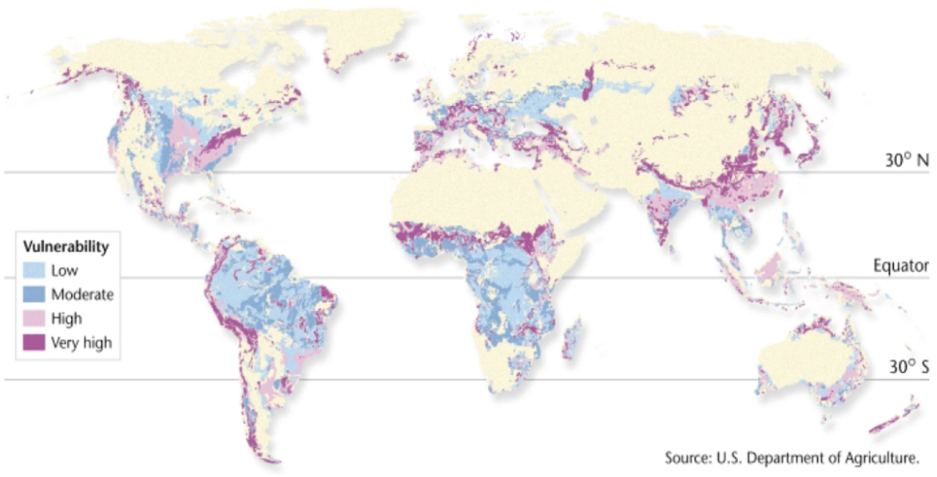
Soil Erosion: A Global Problem
Erosion is a process in which the materials of the Earth’s surface are loosened, dissolved, or worn away and transported from one place to another by a natural agent, such as wind, water, ice, or gravity.

Slide 18
Land Degradation
Land degradation happens when human activity or natural processes damage the land so that it can no longer support the local ecosystem. In areas with dry climates, desertification can occur.
Desertification is the process by which human activities or climatic changes make arid or semiarid areas more desertlike.
This process is causing some of our arable land to disappear.

Slide 19
Soil Conservation
There are many ways of protecting and managing topsoil and reducing erosion.
Soil usually erodes downhill, and many soil conservation methods are designed to prevent downhill erosion.
For example, soil-retaining terraces can be built across a hillside. On gentler slopes, contour plowing, which consists of plowing across the slope of a hill instead of up and down the slope, can be used.

Slide 20
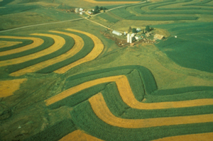
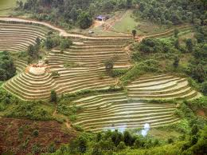
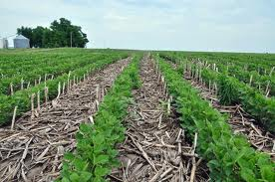
In no-till farming, a crop is harvested without turning the soil over, as in traditional farming.
Later, the seeds of the next crop are planted among the remains of the previous crop. The remains of the first crop hold the soil in place while the new crop develops.

Slide 21
Enriching the Soil
A modern method of enhancing the soil is to use both organic and inorganic materials by adding compost and chemical fertilizers to the soil.
Compost is a mixture of decomposing organic matter, such as manure and rotting plants, that is used as fertilizer and soil conditioner.
Many cities and industries now compost yard and crop wastes. This compost is then sold to farmers and gardeners, and the process is saving costly land fill space.

Slide 22
Salinization
The accumulation of salts in the soil is known as salinization.
Salinization is a major problem in places that have low rainfall and naturally salty soil.
When water evaporates from irrigated land, salts are left behind.

Slide 23
Pest Control
Worldwide, pests destroy about one-third of the world’s potential food harvest.
A pest is any organism that occurs where it is not wanted or that occurs in large enough numbers to cause economic damage.
A pesticide is a poison used to destroy pests, such as insects, rodents, or weeds; examples include insecticides, rodenticides, and herbicides.
Pesticides, however, can also harm beneficial plants and insects, wildlife, and even people.

Slide 24
Pesticide Problems
Pesticide Resistance - Pest populations may evolve resistance, the ability to survive exposure to a particular pesticide.
Human Health Concerns - Pesticides are designed to kill organisms, so they may also be dangerous to humans.
Pollution and Persistance - A pesticide is persistent if it does not break down easily or quickly in the environment.

Slide 25
Biological Pest Control
Biological pest control is the use of certain organisms by humans to eliminate or control pests.
Every pest has enemies in the wild, and these enemies can sometimes be used to control pest populations.
Biological pest control includes the use of
- pathogens
- plant defenses
- chemicals from plants
- the disrupting of insect breeding

Slide 26
Integrated Pest Management
Integrated pest management is a modern method of controlling pests on crops.
Biological methods are the first methods used to control the pest. So, natural predators, pathogens, and parasites of the pest may be introduced.
Cultivation controls, such as vacuuming insects off the plants, can also be used.
As a last resort, small amounts of insecticides may be used. These insecticides are changed over time to reduce the ability of pests to evolve resistance.

Slide 27
Engineering a Better Crop
Genetic engineering is a technology in which the genome of a living cell is modified for medical or industrial use.
Scientists may use genetic engineering to transfer desirable traits, such as resistance to certain pests, from one organism to another.
Plants that result from genetic engineering are called genetically modified (GM) plants.

Slide 28
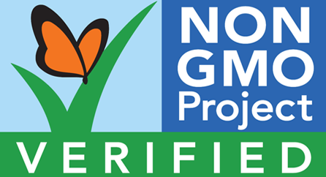
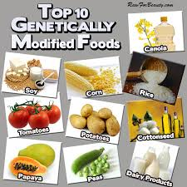
In the United States, we now eat and use genetically engineered agricultural products everyday.
Many of these products, however, have not been fully tested for their environmental impacts.
Some scientists warn that these products will cause problems in the future.

Slide 29
Sustainable Agriculture
Farming that conserves natural resources and helps keep the land productive indefinitely is called sustainable agriculture.
Sustainable agriculture involves planting productive, pest-resistant crop varieties that require little energy, pesticides, fertilizer, and water.

Slide 30
Animals and Agriculture
Our ancestors obtained animal protein by hunting and fishing. Today, most people get animal protein from domesticated species.
Domesticated describes organisms that have been bred and managed for human use.

Slide 31
Food from Water
Because fish are an important food source for humans, the harvesting of fish has become an important industry worldwide.
However, when too many fish are harvested over a long period of time, ecological systems can be damaged.
Overharvesting is the catching or removing from a population more organisms than the population can replace.

Slide 32
Aquaculture
Aquaculture is the raising of aquatic plants and animals for human use or consumption.
Fish and other aquatic organisms provide up to 20 percent of the animal protein consumed worldwide.
Aquaculture may be one solution to the overharvesting of fish and other organisms in the world’s oceans.

Slide 33
There are a number of different methods of aquaculture. Among these are
- Fish farming
- Fish ranching
Fish farms generally consist of many individual ponds that each contain fish at a specific stage of development. Fish grow to maturity in the ponds and are then harvested.
Fish ranches raise fish to a certain age, release them to the ocean, and then harvest the adults when they return to their birthplace to breed.

Slide 34
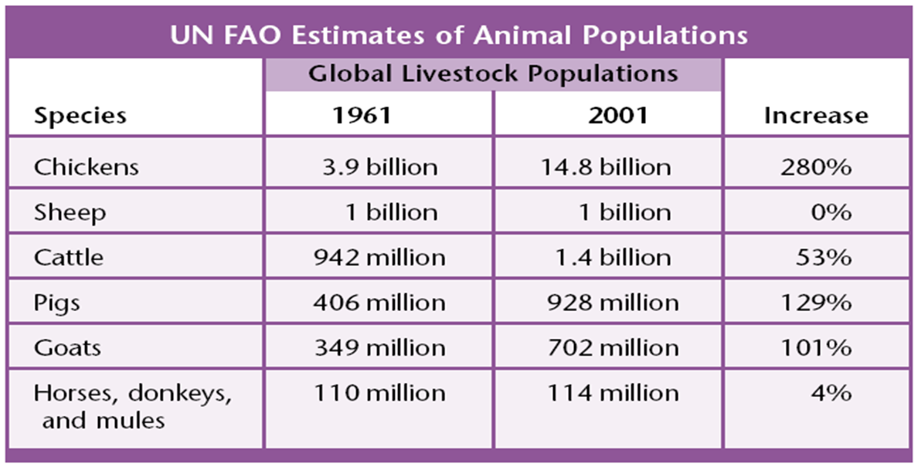
Livestock
Livestock is the term given to domesticated animals that are raised to be used on a farm or ranch or to be sold for profit.

Slide 35
Ruminants
Ruminants are cud-chewing mammals that have a three- or four-chambered stomach.
Cattle, sheep, and goats are examples of ruminants.
Cud is the food that these animals regurgitate from the first chamber of their stomachs and chew again to aid digestion.
When we eat the meat of ruminants, we are using them to convert plant material, such as grass stems and woody shrubs, into food that we can digest—such as beef.

Slide 36
Poultry
Since 1961, the population of chickens worldwide has increased to a greater percentage than the population of any other livestock.
Chickens are a type of poultry, domesticated birds raised for meat and eggs.
In more-developed countries, chickens and turkeys are usually raised in factory farms.

