Slide 1
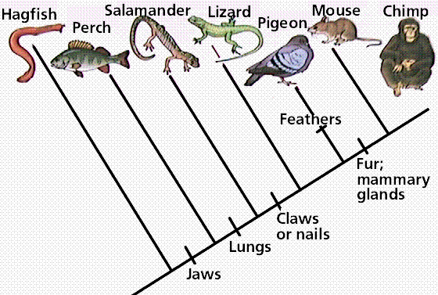
UNIT 8: Evolution What is the evidence that supports evolution?
Quick Review: Evolution is a gradual change that occurs in a population over a long period of time Evolution is a theory, which means it has been proven many times by way of….

Slide 2
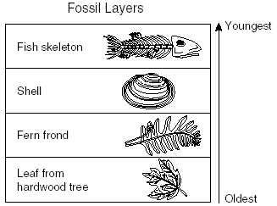
Evidence of Evolution
1. Fossils
18th and 19th century people theorized that the earth was older than people originally though.
James Hutton and Charles Lyell came up with evidence that this was indeed true.
Rain, heat, cold and active volcanoes etc. change rocks, mountains and valleys; which happens slowly over a long period of time (longer then just thousands of years in some cases).
Others found that life has changed over time by examining fossils.
Fossils are preserved remains of ancient organisms.

Slide 3
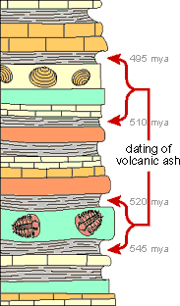
Evidence of Evolution
Geologic Time Scale
This is a record in the rocks
Depending on the position of layers of rock relative to each other determines the age of the rock.
Lower rock layers were deposited before the upper layers.
Lower layers are older than upper layers
provided they have not been disturbed in any
way.
Relative dating-technique to determine the age
of fossils relative to other fossils in different
layers of rock.

Slide 4
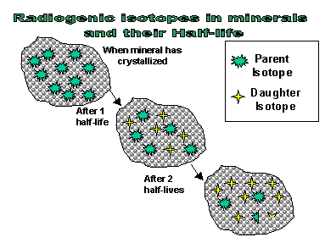
Evidence of Evolution
Rocks are made of various elements, some are radioactive.
Radioactive elements decay (break down) into nonradioactive elements at a very steady rate.
The measurement for decay is Half-Life.
length of time required for half the radioactive atoms in a sample to decay.
*1st picture original amount of isotope; next picture half the isotope left; 3rd picture half of 2nd pictures isotopes left

Slide 5
If the half life of an element is 1 million years…
Time Amt of radioactive element
(millions of yrs) (kg)
4 1
3 .5
2 .25
1 .125
present .0325
each element has a different half life
They provide natural “clocks”
Can help date rocks, and specimens of different ages; called absolute dating.
Earth is about 4.5 billion years old.

Slide 6
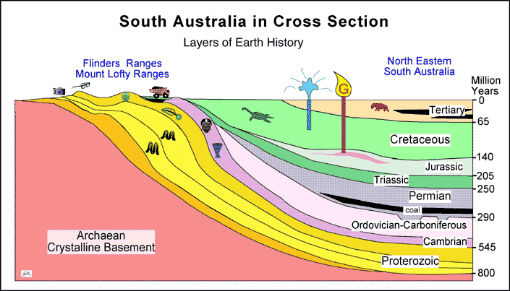
The fossil record shows us that change followed change on Earth due to change in climate etc.
It’s a preserved collective history of the Earth’s organisms.
Shows major changes in earths climate and geography
ex. Shark teeth in Arizona
Show’s that whales once lived on land
Fossils of dinosaurs

Slide 7
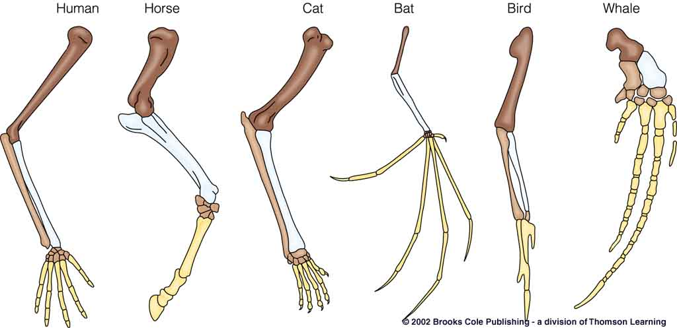
Evidence of Evolution
2. Comparison of the body structures (anatomy) of organisms
a. Homologous Structures
These structures are evidence that suggest different species may have evolved from a common ancestor. These structures are similar in skeletal structure but may be different in their function

Slide 8
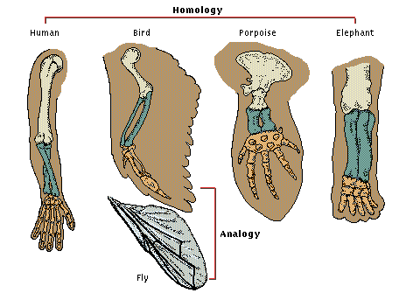
Evidence of Evolution
b. Analogous Structures
These structures are similar in function but may differ in structure

Slide 9
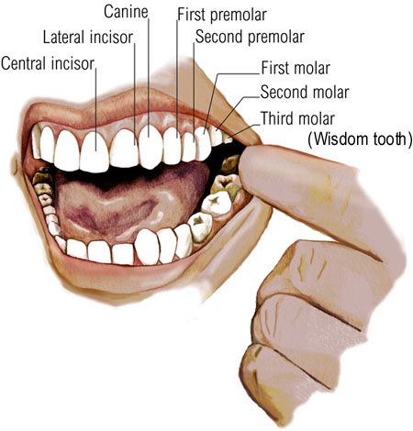
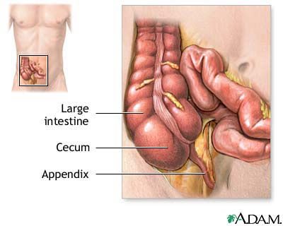
Evidence of Evolution
c. Vestigial Structures
These structures are present in an organism, but are considered to be “left-overs” because they are no longer used or may have a reduced function in the organism today

Slide 10
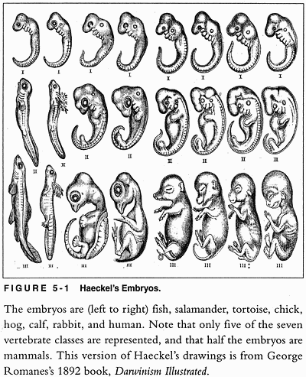
Evidence of Evolution
3. Embryology
Closely related species will have more similarities/ less differences in their
stages of embryological
development.
Distantly related species
will show less similarities/
more differences in their
stages of embryological
development.

Slide 11
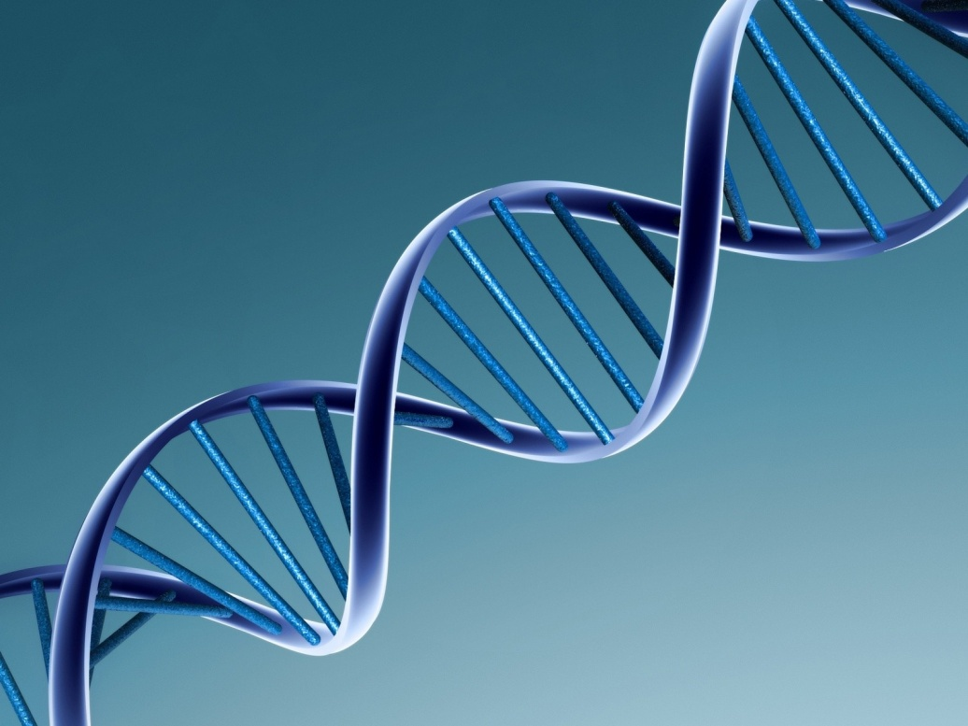
Evidence of Evolution
4. Molecular evidence: DNA
The more closely related you are, the more similar the DNA
DNA→RNA→PROTEIN!

