Slide 1
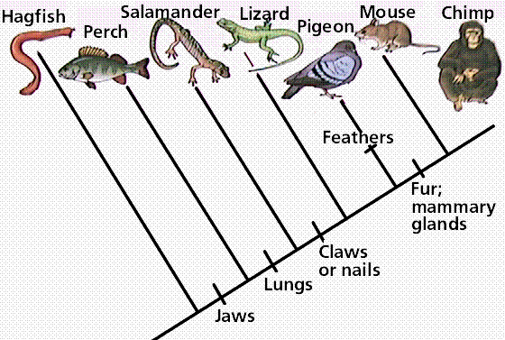
UNIT 4: Evolution What is the evidence that supports evolution?
Quick Review: Evolution is a gradual change that occurs in a population over a long period of time Evolution is a theory, which means it has been proven many times by way of….

Slide 2
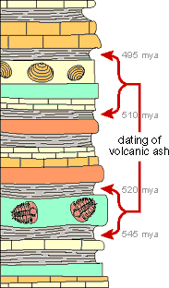
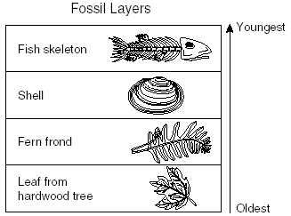
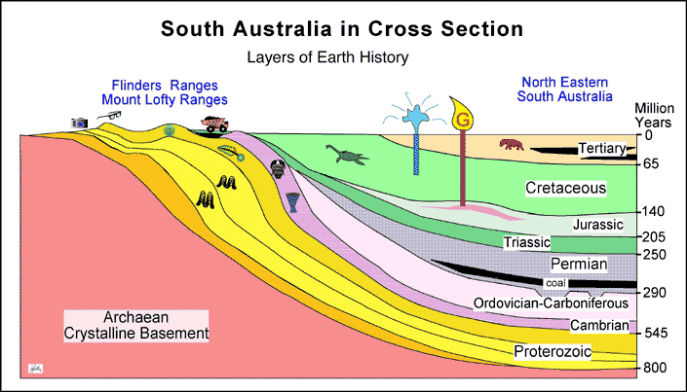
Evidence of Evolution
Evidence of evolution comes from 3 main sources:
1. Fossils – evidence of organisms that lived long ago
**Examining fossils allows scientists to reconstruct a history of life on Earth
What type of rock are fossils usually found in? sedimentary

Slide 3
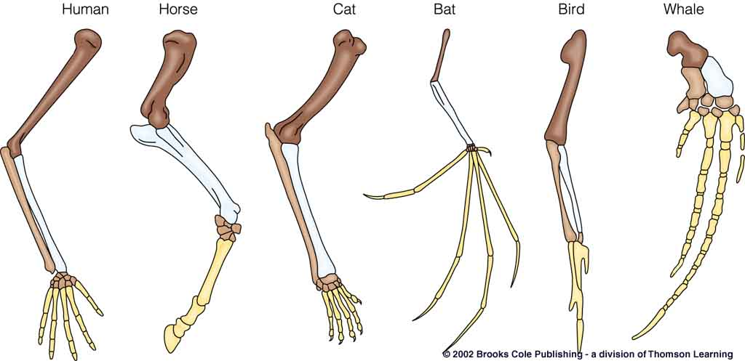
Evidence of Evolution
2. Comparison of the body structures (anatomy) of organisms
a. Homologous Structures
These structures are evidence that suggest different species may have evolved from a common ancestor. These structures are similar in skeletal structure but may be different in their function

Slide 4
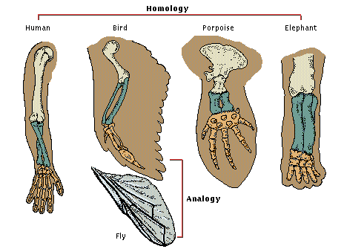
Evidence of Evolution
b. Analogous Structures
These structures are similar in function but may differ in structure

Slide 5
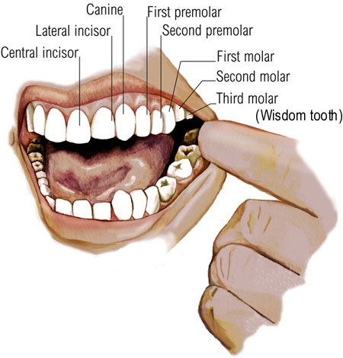
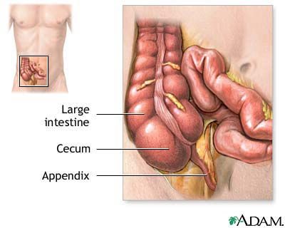
Evidence of Evolution
c. Vestigial Structures
These structures are present in an organism, but are considered to be “left-overs” because they are no longer used or may have a reduced function in the organism today

Slide 6
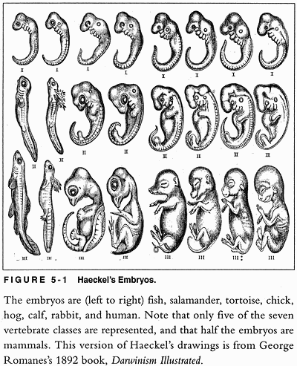
Evidence of Evolution
3. Embryology
Closely related species will have more similarities/ less differences in their
stages of embryological
development.
Distantly related species
will show less similarities/
more differences in their
stages of embryological
development.

Slide 7
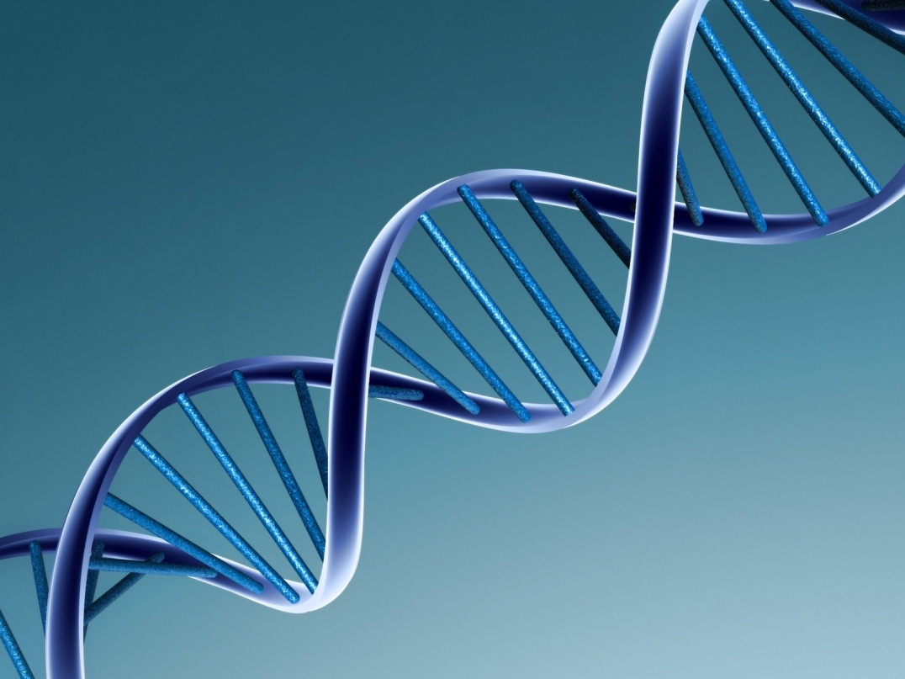
Evidence of Evolution
4. Molecular evidence: DNA
The more closely related you are, the more similar the DNA
DNA→RNA→PROTEIN!

