Slide 1
The Elements and Principles of Art

Slide 2
The Elements of Art
The building blocks or ingredients of art.

Slide 3
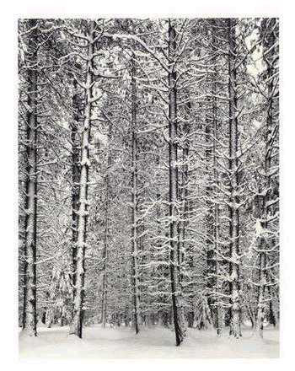
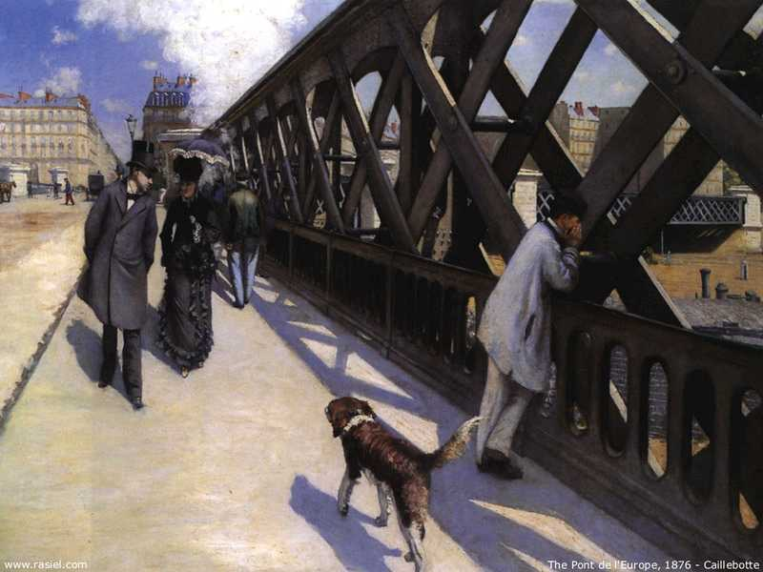
LINE
A mark with length and direction.
A continuous mark made on a surface by a moving point.
Ansel Adams
Gustave Caillebotte

Slide 4
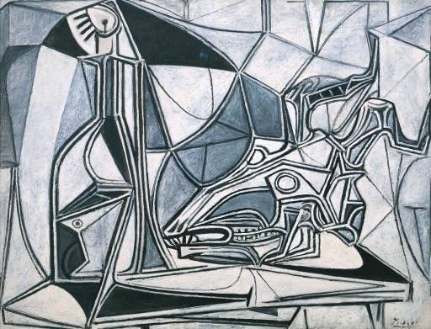
Pablo Picasso

Slide 5
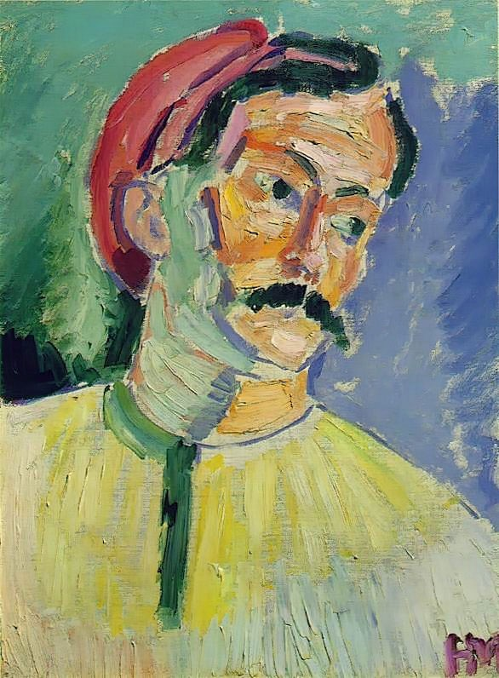
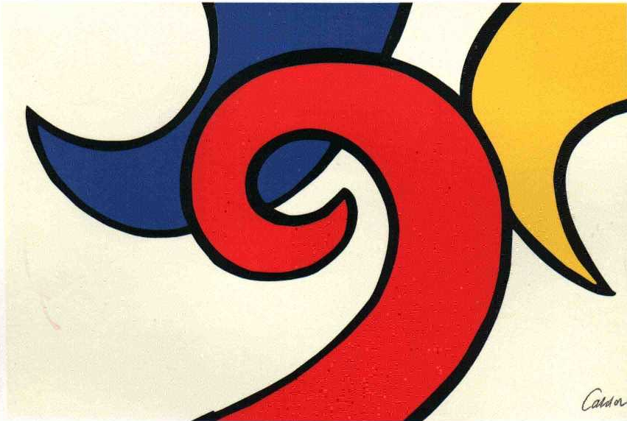
COLOR
Consists of Hue (another word for color), Intensity (brightness) and Value (lightness or darkness).
Alexander Calder
Henri Matisse

Slide 6
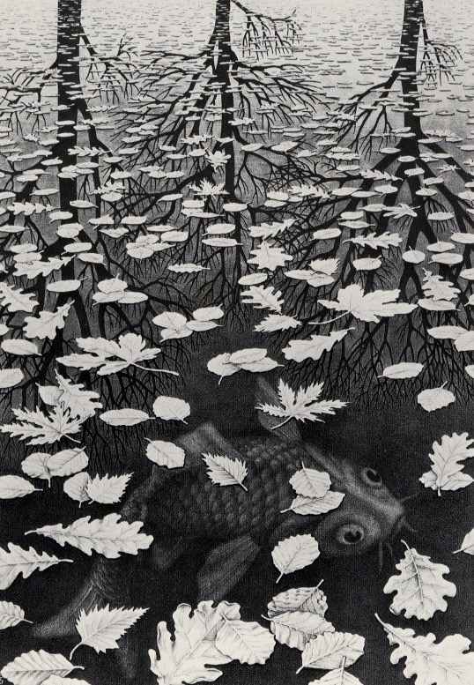
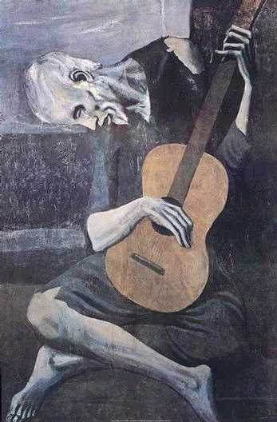
VALUE
The lightness or darkness of a color.
MC Escher
Pablo Picasso

Slide 7
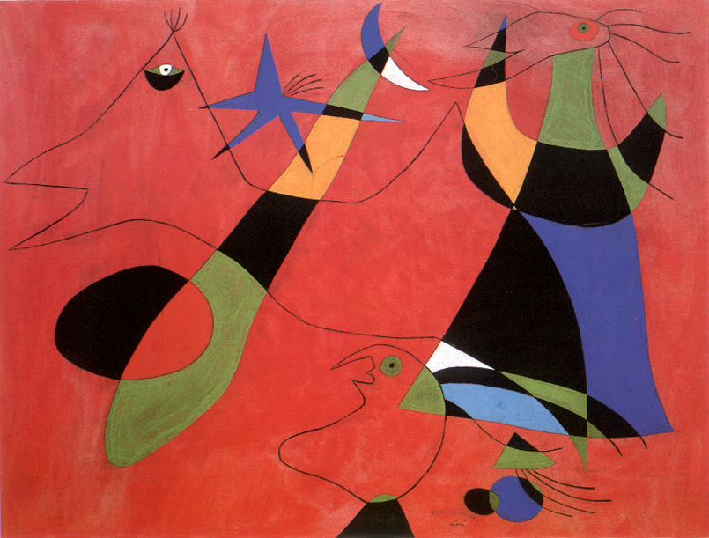
SHAPE
An enclosed area defined and determined by other art elements; 2-dimensional.
Joan Miro

Slide 8
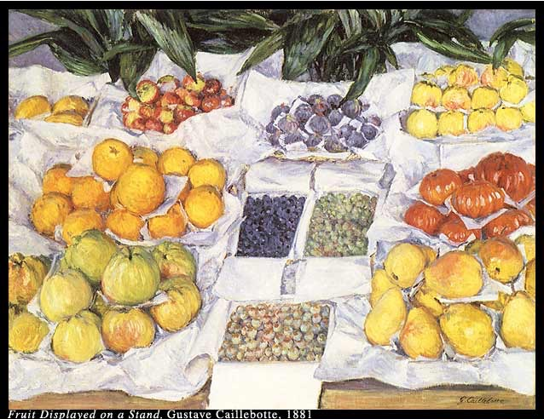
Gustave Caillebotte

Slide 9
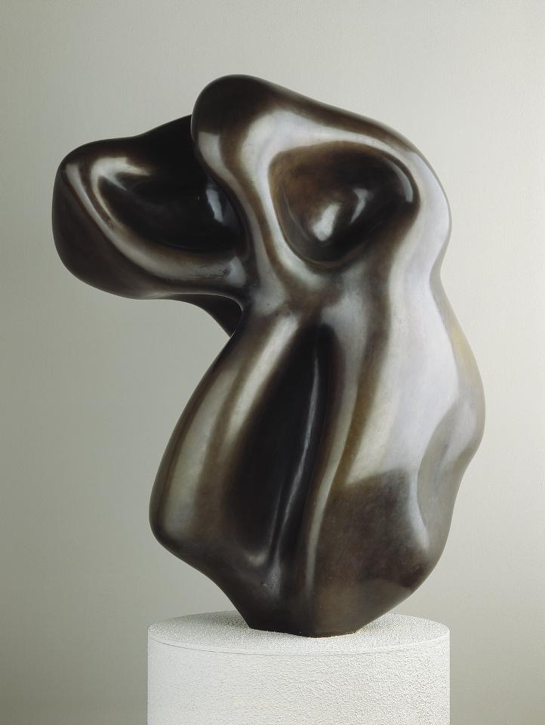
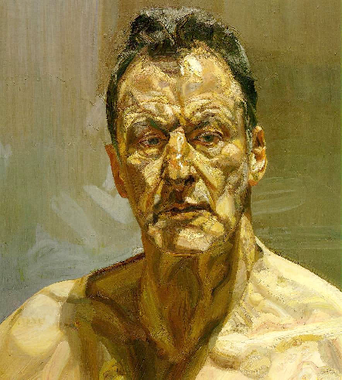
FORM
A 3-dimensional object;
or something in a 2-dimensional artwork that appears to be 3-dimensional.
For example, a triangle, which is 2-dimensional, is a shape, but a pyramid, which is 3-dimensional, is a form.
Jean Arp
Lucien Freud

Slide 10
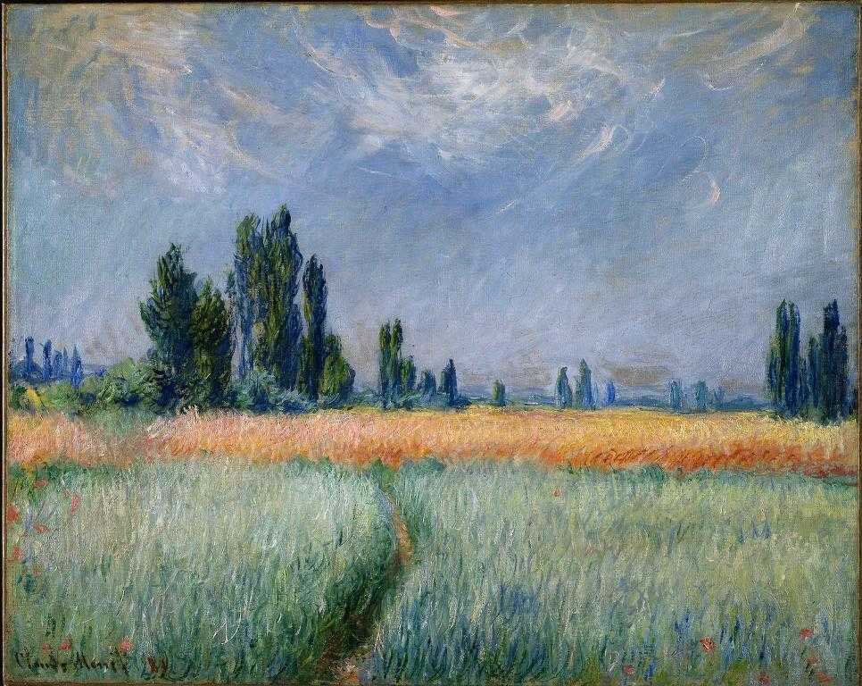
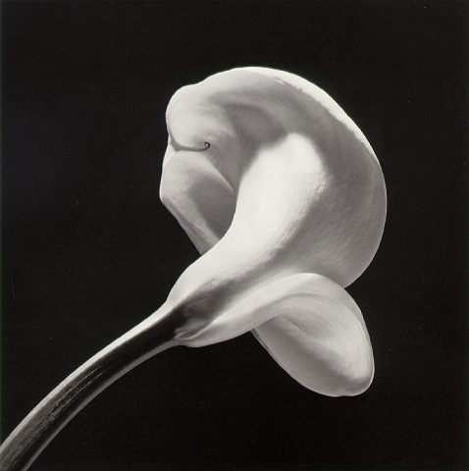
S P A C E
The distance or area between, around, above, below, or within things.
Robert Mapplethorpe
Positive (filled with something) and Negative (empty areas).
Foreground, Middleground and Background (creates DEPTH)
Claude Monet

Slide 11
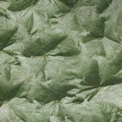
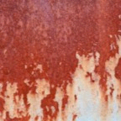
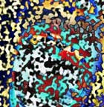
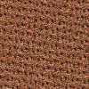
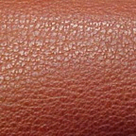
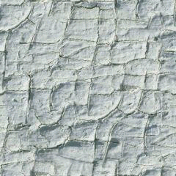
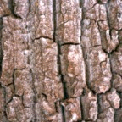
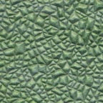
TEXTURE
The surface quality or "feel" of an object, its smoothness, roughness, softness, etc. Textures may be actual or implied.

Slide 12
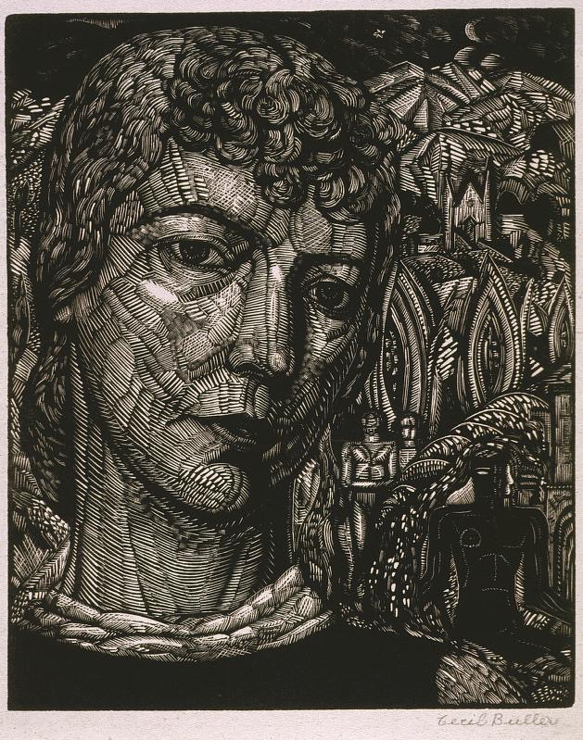
Cecil Buller

Slide 13
The Principles of Art
What we use to organize the Elements of Art,
or the tools to make art.

Slide 14
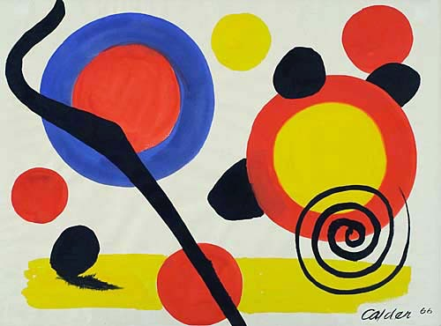
BALANCE
The way the elements are arranged to create a feeling of stability in a work.
Alexander Calder

Slide 15
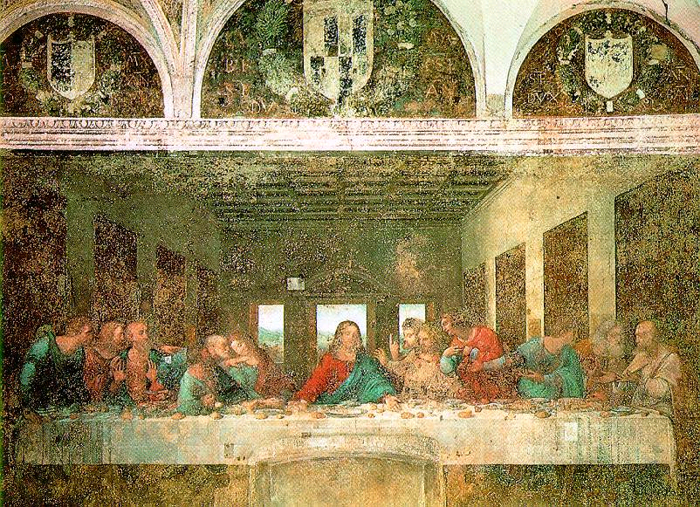
Symmetrical Balance
The parts of an image are organized so that one side mirrors the other.
Leonardo DaVinci

Slide 16
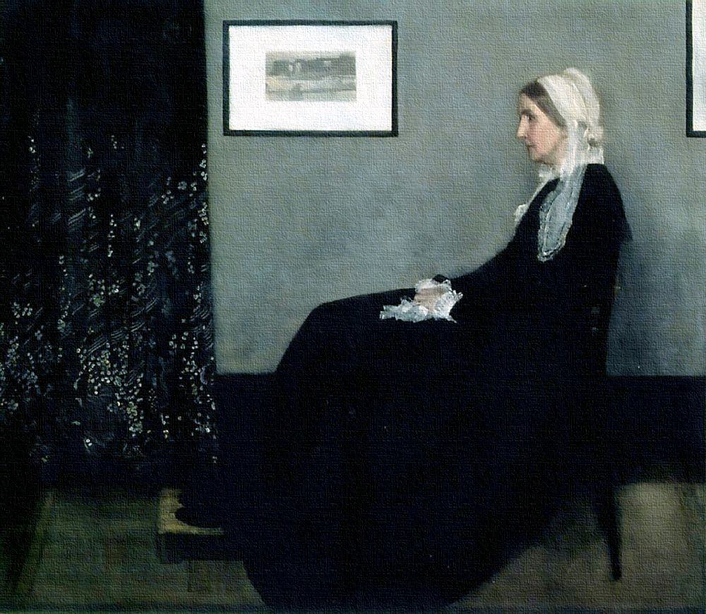
Asymmetrical Balance
When one side of a composition does not reflect the design of the other.
James Whistler

Slide 17
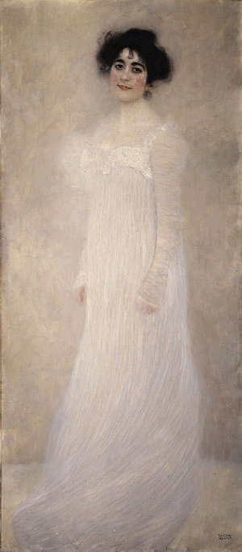
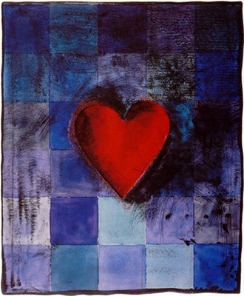
EMPHASIS
The focal point of an image, or when one area or thing stand out the most.
Jim Dine
Gustav Klimt

Slide 18
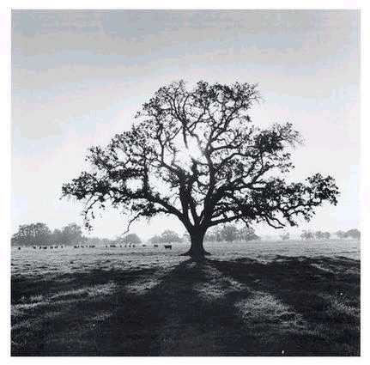
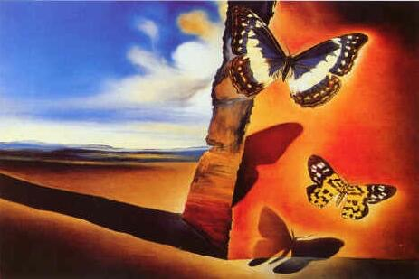
CONTRAST
Salvador Dali
A large difference between two things to create interest and tension.
Ansel Adams

Slide 19
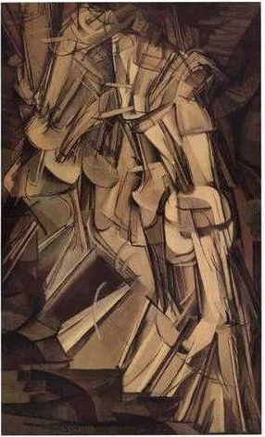
RHYTHM RHYTHM RHYTHM RHYTHM RHYTHM RHYTHM
A regular repetition of elements to produce the look and feel of movement.
and MOVEMENT
Marcel Duchamp

Slide 20
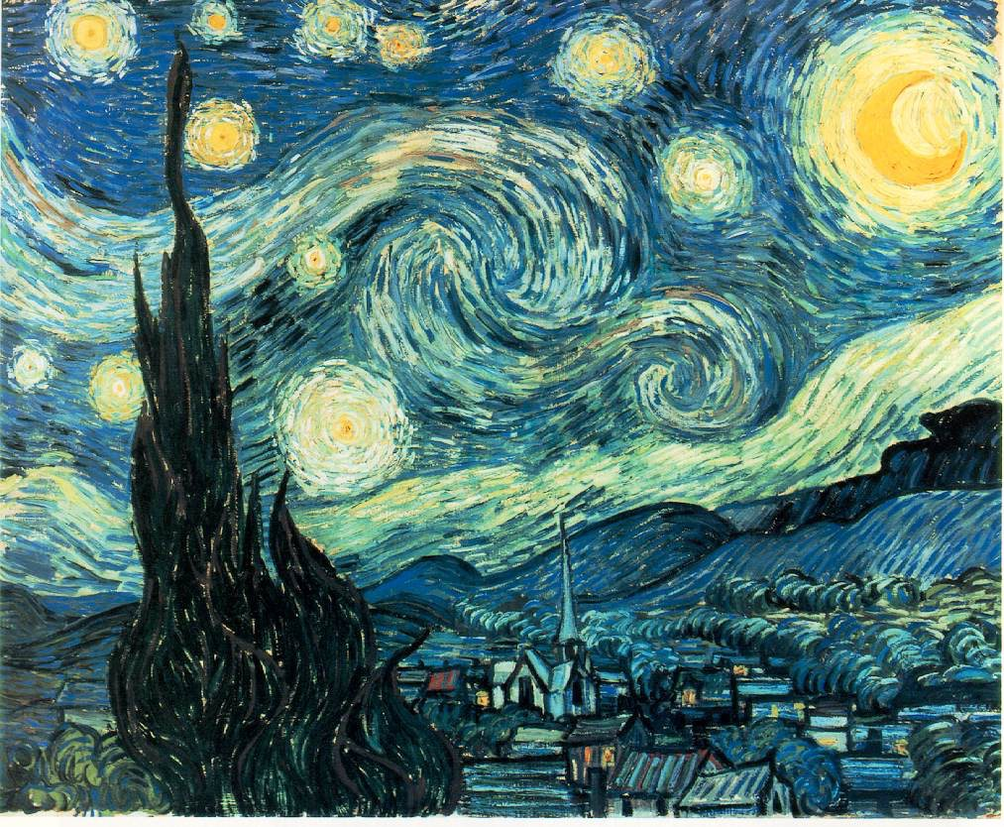
Vincent VanGogh

Slide 21
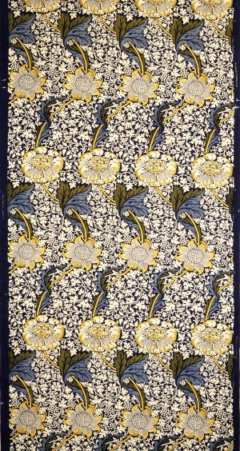
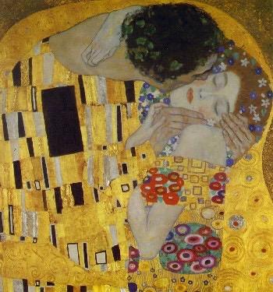
PATTERN and Repetition
Gustav Klimt
Repetition of a design.

Slide 22
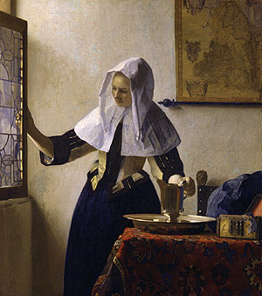
UNITY
When all the elements and principles work together to create a pleasing image.
Johannes Vermeer

Slide 24
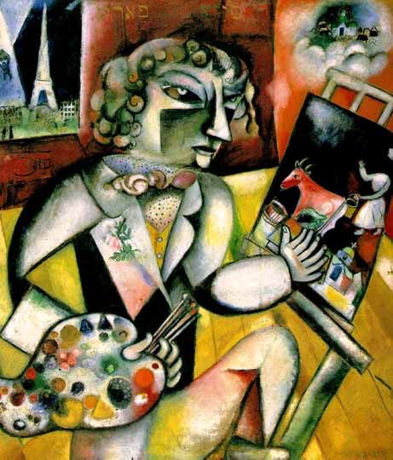
VARIETY
The use of differences and change to increase the visual interest of the work.
Marc Chagall

Slide 25
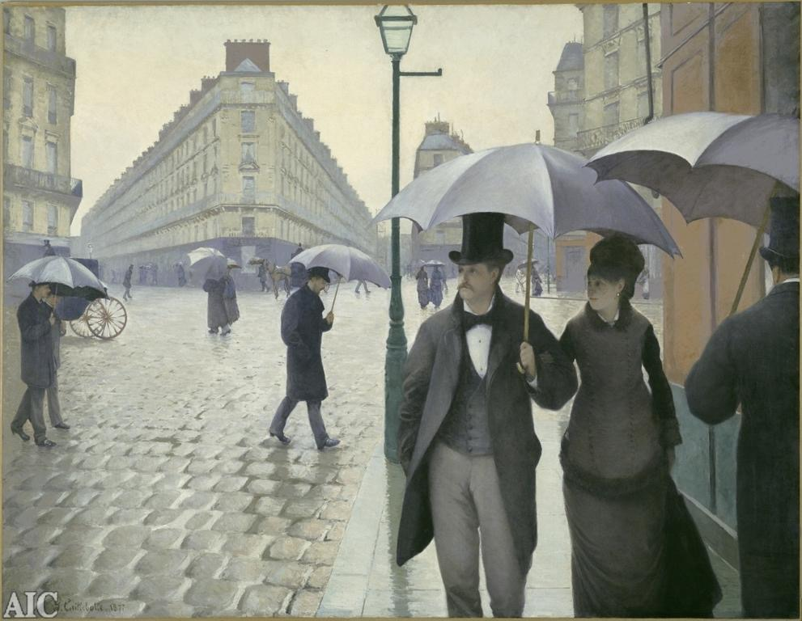
PROPORTION
The comparative relationship of one part to another with respect to size, quantity, or degree; SCALE.
Gustave Caillebotte

