Slide 1
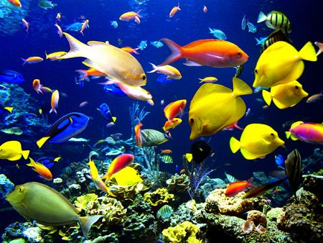
Populations

Slide 2
What Is a Population?
A population is a group of organisms of the same species that live in a specific geographical area and interbreed.
A population is a reproductive group because organisms usually breed with members of their own population.
The word population refers to the group in general and also to the size of the population, or the number of individuals it contains.

Slide 3
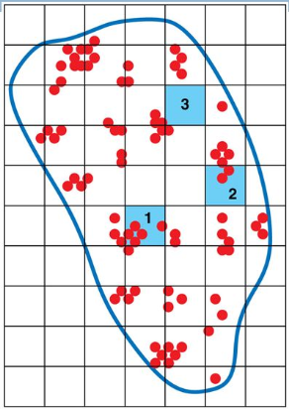
Properties of Populations
1. Size TOTAL number of individuals of the same species, living in the same place at the same time
2. Density is the number of individuals of the same species in that live in a given unit of area.

Slide 4
Properties of Populations
3. Dispersion is the pattern of distribution of organisms in a population. A population’s dispersion may be even, clumped, or random.
Size, density, dispersion, and other properties can be used to describe populations and to predict changes within them.

Slide 5
Estimating Population Size
Technique 1: Sampling - A technique called sampling is sometimes used to estimate population size. In this procedure, the organisms in a few small areas are counted and projected to the entire area.
Technique 2 - Mark and Recapture - In this procedure, biologists use traps to capture the animals alive and mark them in some way. The animals are returned unharmed to their environment. Over a long time period, the animals from the population are continued to be trapped and data is taken on how many are captured with tags. A mathematical formula is then used to estimate population size.

Slide 6
How Does a Population Grow?
A population gains individuals with each new offspring or birth and loses them with each death.
The resulting population change over time can be represented by the equation below.

Slide 7
How Does a Population Grow?
Growth rate is an expression of the increase in the size of an organism or population over a given period of time. It is the birth rate minus the death rate.
Overtime, the growth rates of populations change because birth rates and death rates increase or decrease.
For this reason, growth rates can be positive, negative, or zero.

Slide 8
Reproductive Potential
A species’ biotic potential is the fastest rate at which its populations can grow. This rate is limited by reproductive potential.
Reproductive potential is the maximum number of offspring that a given organism can produce.
Some species have much higher reproductive potentials than others. Darwin calculated that it could take 750 years for a pair of elephants to produce 19 million descendants. While bacteria could produce that in a few days or weeks.

Slide 9
Exponential Growth
Exponential growth-growth in which numbers increase rapidly by a certain factor in each successive time period.
Exponential growth occurs in nature only when populations have plenty of food and space, and have no competition or predators.
For example, population explosions occur when bacteria or molds grow on a new source of food.

Slide 10
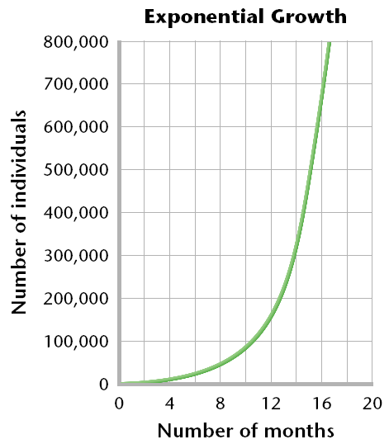
Exponential Growth
In exponential growth, a large number of individuals is added to the population in each
succeeding time period.

Slide 11
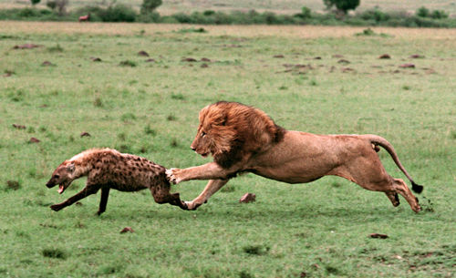
What Limits Population Growth?
Because natural conditions are neither ideal nor constant, populations cannot grow forever.
Eventually, resources are used up or the environment changes, and deaths increase or births decrease.

Slide 12
Carrying Capacity
Carrying capacity is the largest population that an environment can support at any given time.
A population may increase beyond this number but it cannot stay at this increased size.
Because ecosystems change, carrying capacity is difficult to predict or calculate exactly. However, it may be estimated by looking at average population sizes or by observing a population crash after a certain size has been exceeded.

Slide 14
Resource Limits
A species reaches its carrying capacity when it consumes a particular natural resource at the same rate at which the ecosystem produces the resource.
That natural resource is then called a limiting resource.
The supply of the most severely limited resources determines the carrying capacity of an environment for a particular species at a particular time.

Slide 15
Population Regulation
When a cause of death in a population is density dependent, deaths occur more quickly in a crowded population than in a sparse population.
This type of regulation happens when individuals of a population are densely packed together.
Limited resources, predation and disease result in higher rates of death in dense populations than in sparse populations.

Slide 16
When a cause of death is density independent, a certain proportion of a population may die regardless of the population’s density.
This type of regulation affects all populations in a general or uniform way.
Severe weather and natural disasters are often density independent causes of death.

Slide 17
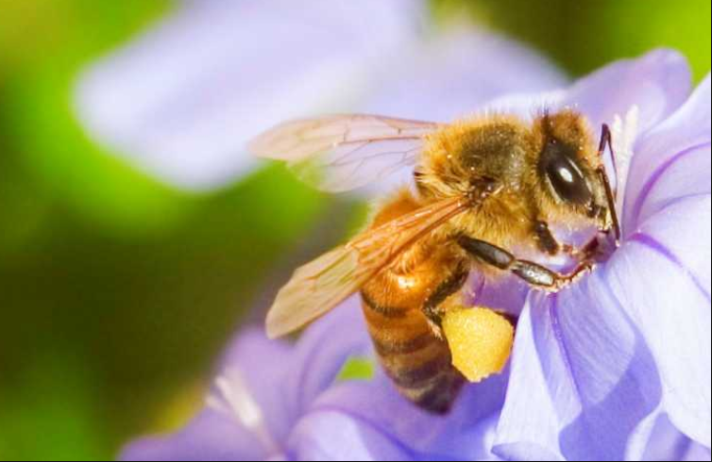
An Organism’s Niche
A niche is the unique position occupied by a species, both in terms of its physical use of its habitat and its function within an ecological community.
A niche is different from a habitat. An organism’s habitat is a location. However, a niche is an organism’s pattern of use of its habitat.
A niche can also be thought of as the functional role, or job of a particular species in an ecosystem.

Slide 18
Ways in Which Species Interact
Interactions between species are categorized at the level where one population interacts with another.
The five major types of species interactions are:
Competition
Predation
Parasitism
Mutualism
Commensalism

Slide 19
Competition
Competition is the relationship between two species (or individuals) in which both species (or individuals) attempt to use the same limited resource such that both are negatively affected by the relationship.
Members of the same species must compete with each other because they require the same resources because they occupy the same niche. When members of different species compete, we say that their niches overlap, which means that each species uses some of the same resources in a habitat.

Slide 20
Indirect Competition
Species can compete even if they never come into direct contact with each other.
For example, suppose that one insect feeds on a certain plant during they day and that another species feeds on the same plant during the night. Because they use the same food source, the two species are indirect competitors.
Humans rarely interact with the insects that eat our food crops, but those insects are still competing with us for food.

Slide 21
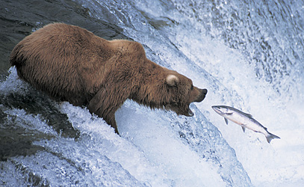
Predation
Predation is an interaction between two species in which one species, the predator, feeds on the other species, the prey.
Most organisms have evolved some mechanisms to avoid or defend against predators.

Slide 22
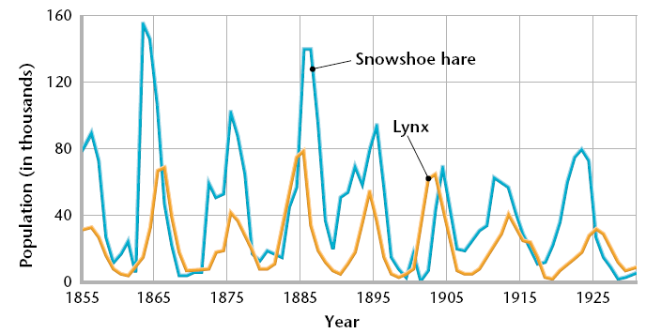
Some predators eat only specific types of prey. In this kind of close relationship, the sizes of each population tend to increase and decrease in linked patterns, as shown below.

Slide 23
Parasitism
The differences between a parasite and a predator are that a parasite spends some of its life in or on the host, and that the parasites do not usually kill their hosts.
In fact, the parasite has an evolutionary advantage if it allows its host to live longer.
However, the host is often weakened or exposed to disease by the parasite.

Slide 24
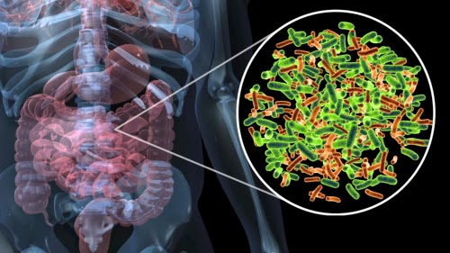
Mutualism
Mutualism is a relationship between two species in which both species benefit.
Certain species of bacteria in your intestines form a mutualistic relationship with you. These bacteria help break down food that you cannot digest. In return, you give the bacteria a warm, food-rich habitat.

Slide 25
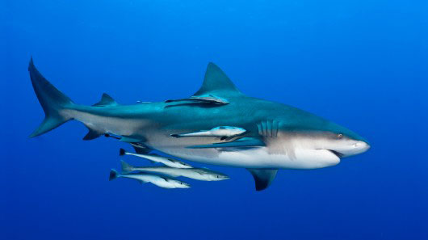
Commensalism
Commensalism is a relationship between two organisms in which one organism benefits and the other is unaffected.
An example is the relationship between sharks and a type of fish called remoras. Remoras attach themselves to sharks and feed on scraps of food left over from the shark’s meals.
Even seemingly harmless
activity, however, might
have an effect on another
species.

Slide 26
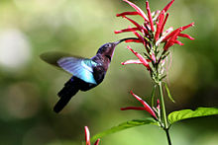
Symbiosis and Coevolution
Symbiosis is a relationship in which two different organisms live in close association with each other.
Symbiosis is most often used to describe a relationship in which at least one species benefits.
Overtime, species in close relationships may coevolve. These species may evolve adaptations that reduce the harm or improve the benefit of the relationship.

