Slide 1
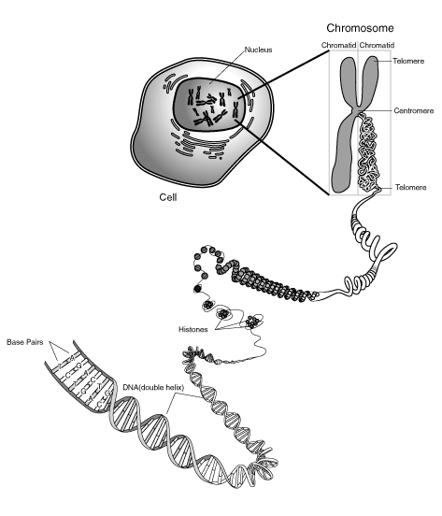
Cell Division What are the 3 stages of the cell cycle?
Cells go through a process of growth, development and division called the cell cycle
The cell cycle is controlled by Cyclins, which are proteins that regulate the cell cycle.
The DNA that codes for these
proteins is in tightly coiled
structures called chromosomes
In your diploid cells(a.k.a.
somatic or body cells), there are
two copies(23 pairs) of each type of chromosome

Slide 2
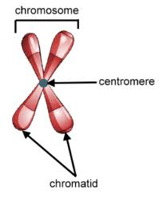
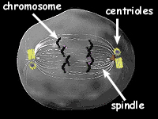
Cell cycle
Parts of the chromosome
Other Parts to know:
Centrioles: make spindle fibers-only in animal cells
Spindle fibers: pull the
chromosomes around
Sister Chromatids=
identical DNA

Slide 3
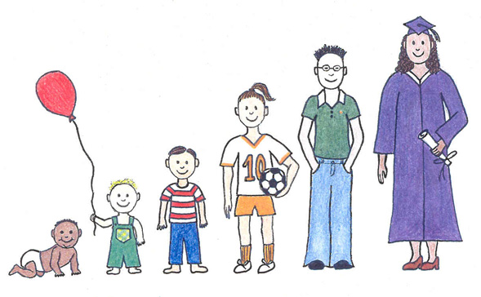
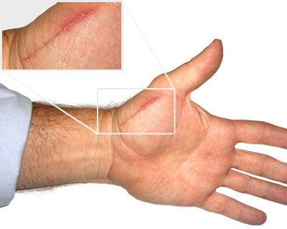
Stages of the cell cycle
Why do living things need the cell cycle?
Bacteria and other unicellular organisms-use the cell cycle to reproduce asexually through binary fission
HUMANS and other multicellular organisms-use the cell cycle to grow and develop and repair dead cells

Slide 4
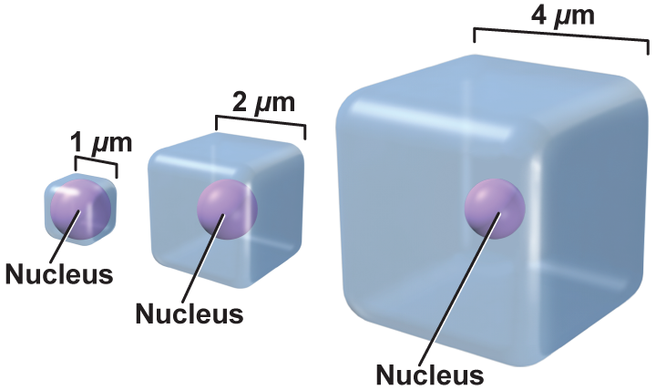
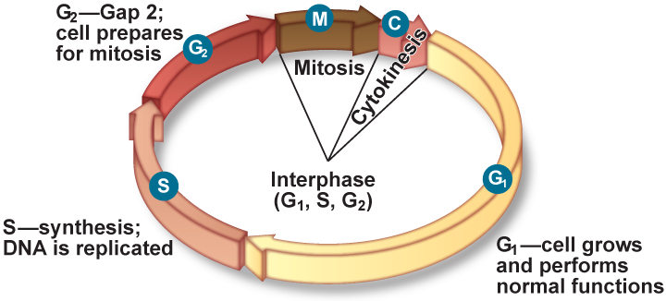
Why do living things need the cell cycle?
As the cell grows, its volume increases much more rapidly than the surface area.
What’s the problem?
The cell might have difficulty supplying nutrients and expelling enough waste products.
Mitosis decreases the ratio, so materials can be transported more easily.

Slide 5
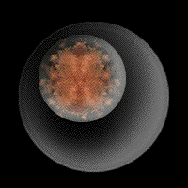
3 stages of the Cell cycle
1. Interphase-the non-dividing stage. This is the stage when the cell is growing and developing.
2. Mitosis-the division of the nucleus and the DNA, forming 2 identical nuclei with identical DNA
3. Cytokinesis-the production
of 2 new daughter cells.

Slide 6
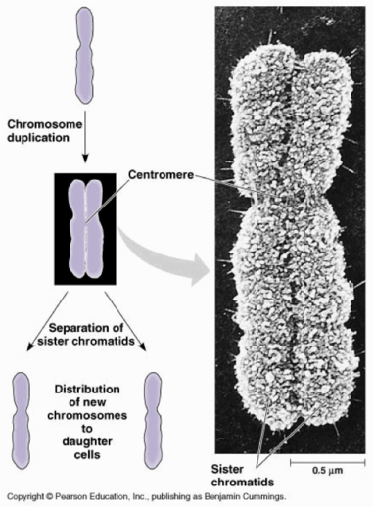
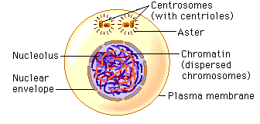
Cells in interphase
-1st stage of the cell cycle
-DNA is in the form of long, thin strands (strings) called chromatin
-DNA REPLICATES (makes a copy of itself)

Slide 7
Chapter 9
Cellular Reproduction
9.1 Cellular Growth
The Stages of Interphase
The first stage of interphase, G₁
The cell is growing, carrying out normal cell functions, and preparing to replicate DNA.

Slide 8
Chapter 9
Cellular Reproduction
9.1 Cellular Growth
The Second Stage of Interphase, S
The cell replicates its DNA in preparation for cell division.

Slide 9
Chapter 9
Cellular Reproduction
9.1 Cellular Growth
The Third Stage of Interphase, G₂
The cell prepares for the division of its nucleus.

Slide 10
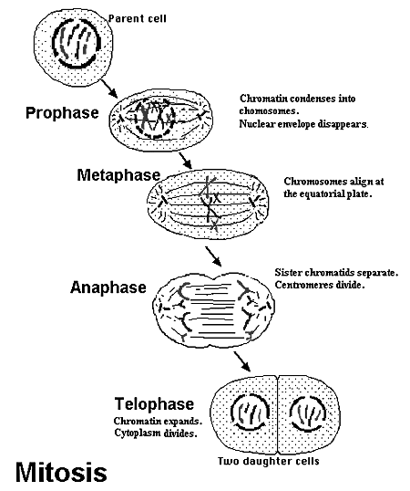
Cells in mitosis
The cell that is going
through mitosis is called
the parent cell. The 2
cells produced when the
parent cell splits are
called daughter cells.
They are identical, which
means they have the
same DNA.

Slide 11
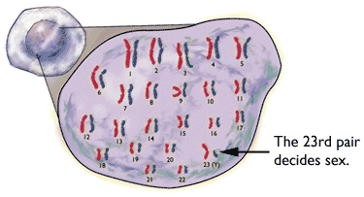
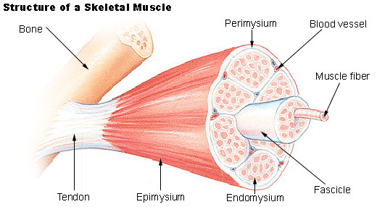
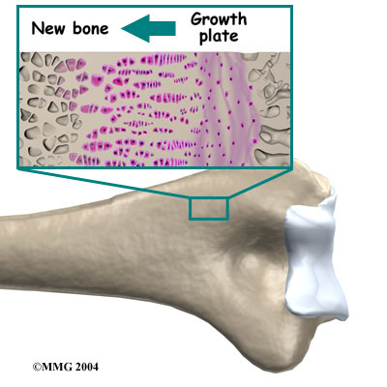
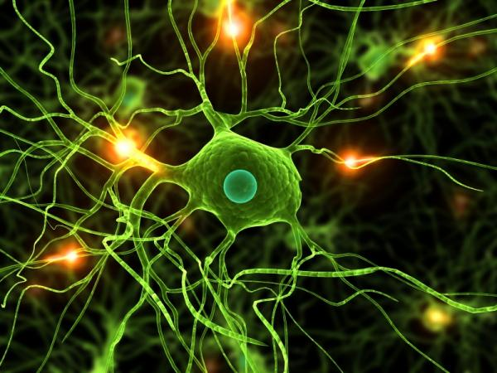
CELLS IN MITOSIS
-The process makes new diploid (somatic or body) cells
-Mitosis is divided into 4 phases
Muscle,
Nerve and
Bone cells
Have all DNA!

Slide 12
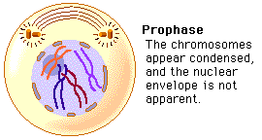
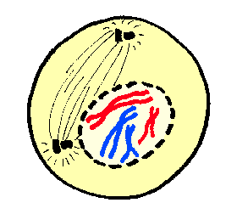
Mitosis
CELL IN PROPHASE-1ST phase of
mitosis
-nuclear membrane dissolves
-Chromatin(DNA) coils into double-stranded chromosomes
-Spindle fibers (strings) form
nuclear
membrane
chromosomes

Slide 13
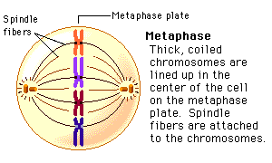
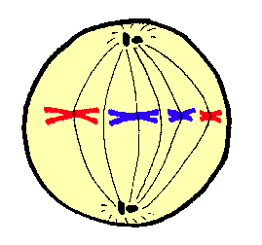
Cell division
CELL IN METAPHASE-2ND phase
of mitosis
-Spindle fibers move chromosomes to the middle of the cell
Equator
Chromosomes

Slide 14
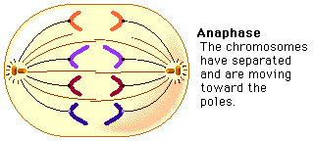
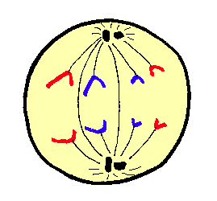
Cell division
CELL IN ANAPHASE-3RD phase
of mitosis
-Chromosomes separate and move apart to oppose
sides (poles)of the cell
Chromatids

Slide 15
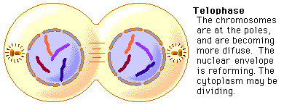
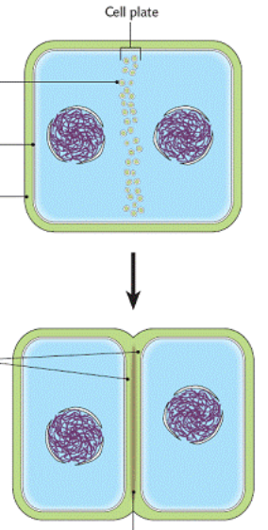
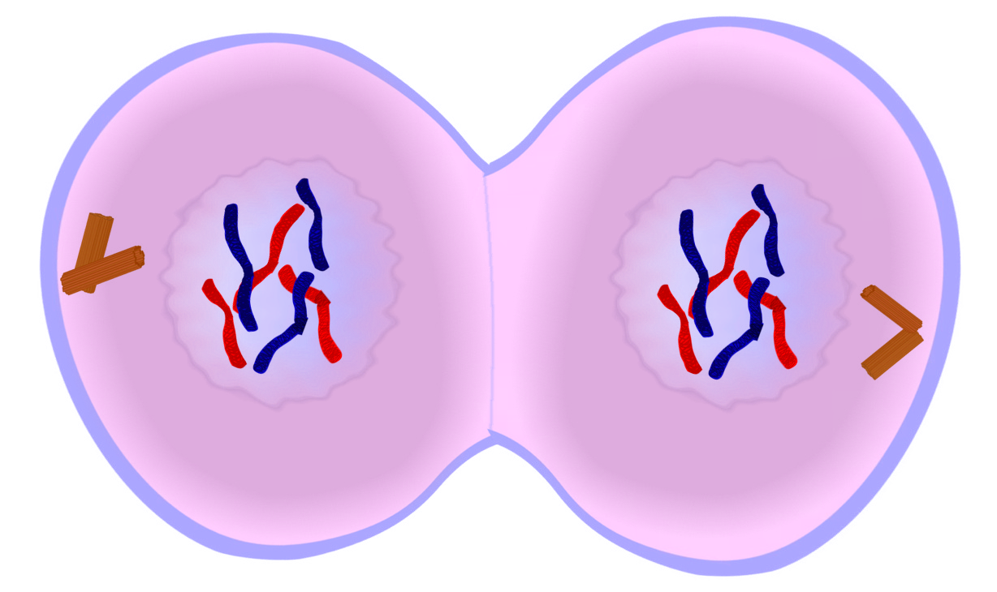
Cell division
CELL IN TELOPHASE-4TH phase
of mitosis
-Nuclear membranes (envelopes) reappear around 2 new daughter cells
-Chromosomes uncoil into chromatin again
-cleavage furrow becomes visible in animal cells
-In plant cells, a cell plate becomes visible
-Spindle fibers dissolve
Cleavage
furrow
Chromatids

Slide 16
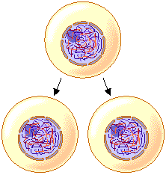
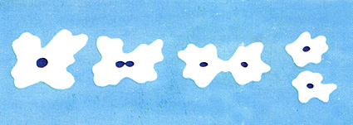
Cell division
CYTOKINESIS-3RD (final) stage of the
cell cycle
-The cell cytoplasm divide
-Cytokinesis produces 2 new daughter cells in a multicellular organism, or 2 new, identical unicellular organisms as seen in the diagram below
Parent amoeba-------------------→2 identical
offspring
An amoeba
reproducing

Slide 17
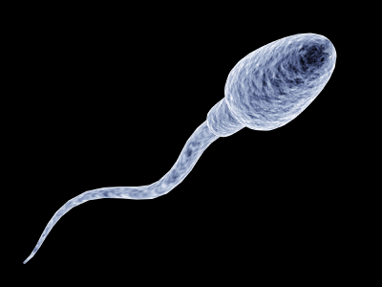
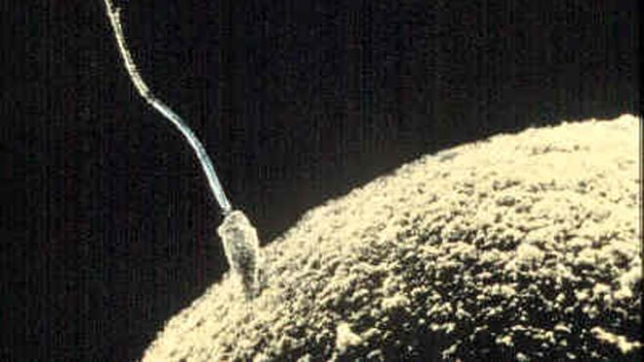
Cell division
A fertilized egg cell (egg + sperm) will repeatedly go through interphase, mitosis and cytokinesis , which will allow a single cell to grow and develop into a multicellular organism. During early development, body cells can become specialized to perform different functions, even though all these different cells(muscle, nerve, blood, bone etc…) came from 1 cell and contain the same genetic information. Cell cycle
sperm + egg= zygote-------------------→ Multicellular
+ -----→organism

Slide 18
Cell Cycle Activity
Directions: Number your paper 1-8 and Identify the stage of mitosis for each of the onion root tip slides. Explain why you chose that stage of the cell cycle based on what is happening to the chromosomes in each phase.

Slide 19
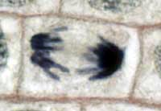
Cell Cycle Activity
1.

Slide 20
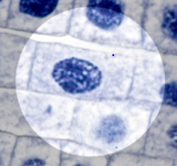
Cell Cycle Activity
2

Slide 21
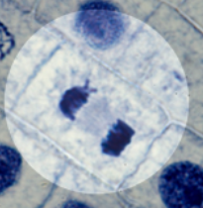
Cell Cycle Activity
3.

Slide 22
Cell Cycle Activity
4

Slide 23
Cell Cycle Activity
5

Slide 24
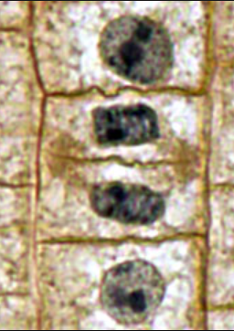
Cell Cycle Activity
6

Slide 25
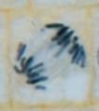
Cell Cycle Activity
7

Slide 26
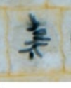
Cell Cycle Activity
8

