Slide 1
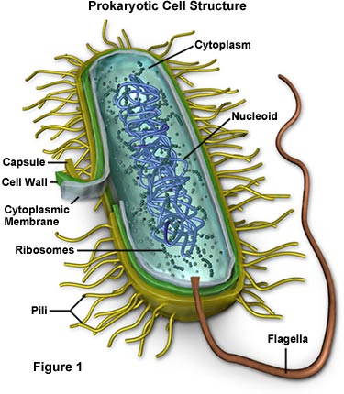
UNIT 8: Evolution How are antibiotic resistant strains of bacteria an example of evolution?
QUICK REVIEW QUESTIONS:
What organism was the FIRST to evolve on Earth? Bacteria
How long ago did they evolve? 3.5 billion years ago
Were they prokaryotic or eukaryotic?
Prokaryotic
Describe these organisms – Unicellular
& simple; have no membrane-bound
organelles

Slide 2
Antibiotic resistance
BACTERIA & ANTIBIOTIC RESISTANCE – An Outcome of Evolution
Some bacteria are helpful; while some are harmful
- When bacteria are harmful, antibiotics are used to eliminate (get rid of) the bacteria
An antibiotic is a substance that can stop or slow down the growth of bacteria
Remember: anti – against bio - life

Slide 3
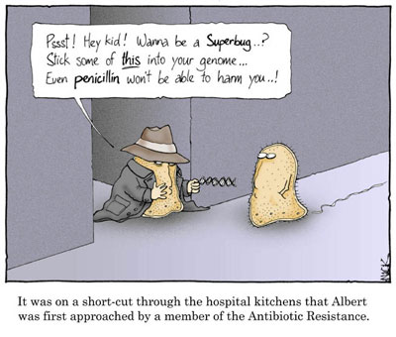
Antibiotic resistance
Also remember: All populations of organisms exhibit variations (differences) even though they’re of the same species
When bacteria are first exposed to antibiotics, some of the bacteria will have the ability to resist(defend against) an antibiotic’s attack on it

Slide 4
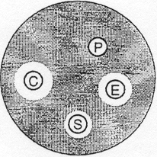
Antibiotic resistance
For example – When a person takes an antibiotic for a bacterial infection/disease, the antibiotic kills the bacteria that cannot defend themselves, leaving behind the bacteria that can survive the antibiotic. The bacteria that can resist the antibiotic are said to be selected for (natural selection)
Shaded area represents E. coli
Clear area represents absence of E. coli
P = penicillin
E = erythromycin
C = chloramphenicol
S = streptomycin

Slide 5
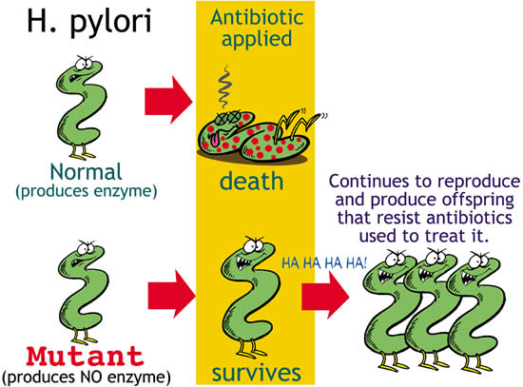
Antibiotic Resistance
Remember: Organisms that are most adapted to their environment (meaning they have the BEST traits) are more likely to survive, reproduce and pass these traits on to the next generation. In this case, the bacteria that survive are able to reproduce and pass their resistance to their offspring.

Slide 6
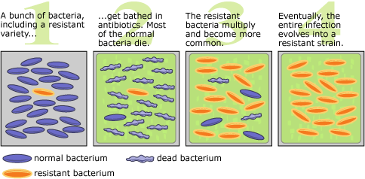
Antibiotic Resistance
All of the bacteria that are able to survive from the deadly effects of an antibiotic are members of a resistant strain, which prevents them from being killed by the antibiotic.
This process described above allows resistant strains of bacteria to evolve from non-resistant strains

