Slide 1
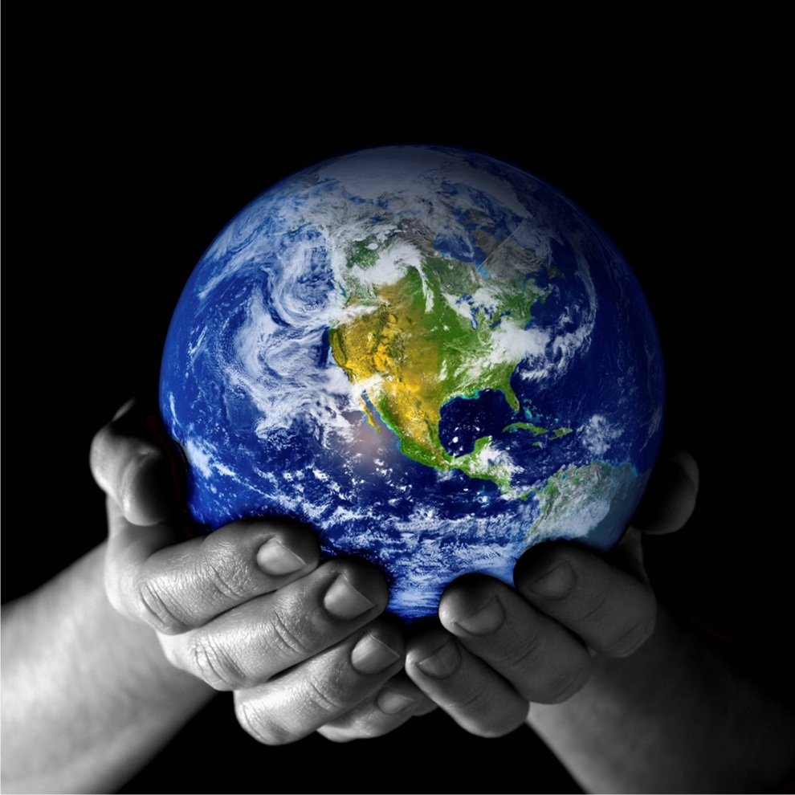
UNIT 2B: Biochemistry What is the structure of water and why is it so important for life?

Slide 2
Water
WATER (chemical formula : H₂O)
Why is water so important for the survival of all organisms?
It covers about 75%of the Earth’s surface.
About 2/3( 66% ) of the human body is made
of water.
Water is able to ABSORB large amounts of heat, so
lakes and oceans stabilize LAND & AIR temperatures.

Slide 3
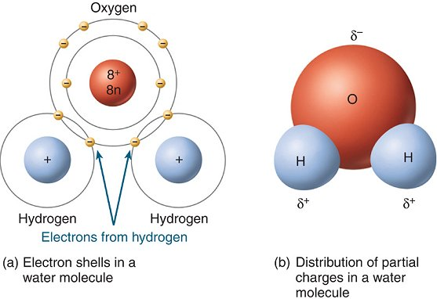
Water
Water is a polar molecule
- What does this mean? One end of the molecule is +, the other is more -
- This means water has the ability to attract ions and other polar(charged) molecules. (+, -)
Mickey
mouse!

Slide 4
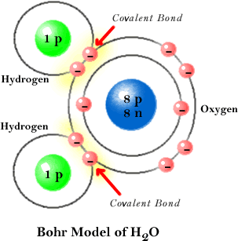
Water
Water is made up of 2 Hydrogen atoms attached to 1 Oxygen atom by covalent bonds.
Covalent bond-chemical bond that involves the sharing of electrons between atoms.

Slide 5
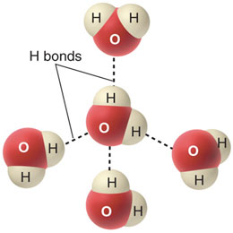
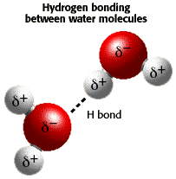
Water
- Water molecules also attract other WATER molecules. The + ends of one water molecule are attracted to the - ends of another water molecule, which creates a third type of bond called a HYDROGEN bond.
- This polarity of water contributes to the 6 properties of water, which make water one of the most important substances to organisms.

Slide 6
The 6 properties of water
1. Water has a High Surface Tension
- The POLAR attraction between water molecules causes the TOP layer of water molecules to act like a STRETCHED film over the surface of water. This property is called SURFACE TENSION.

Slide 7
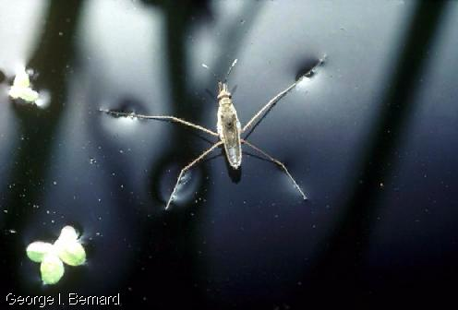
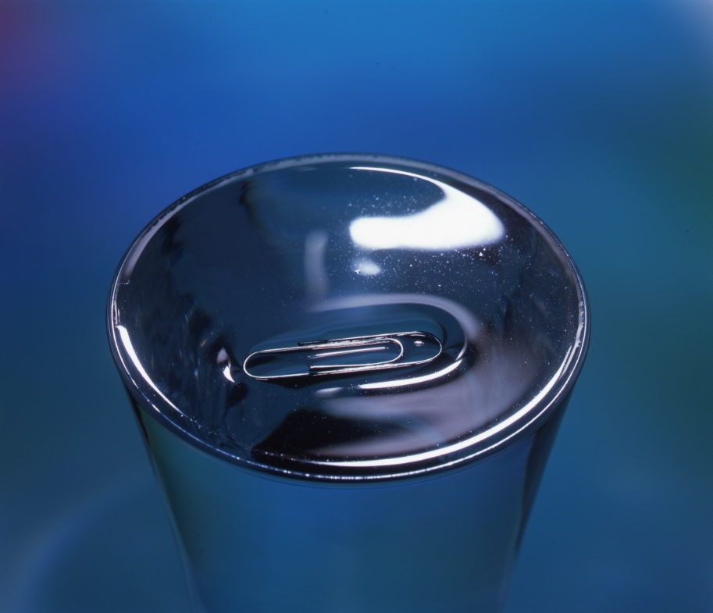
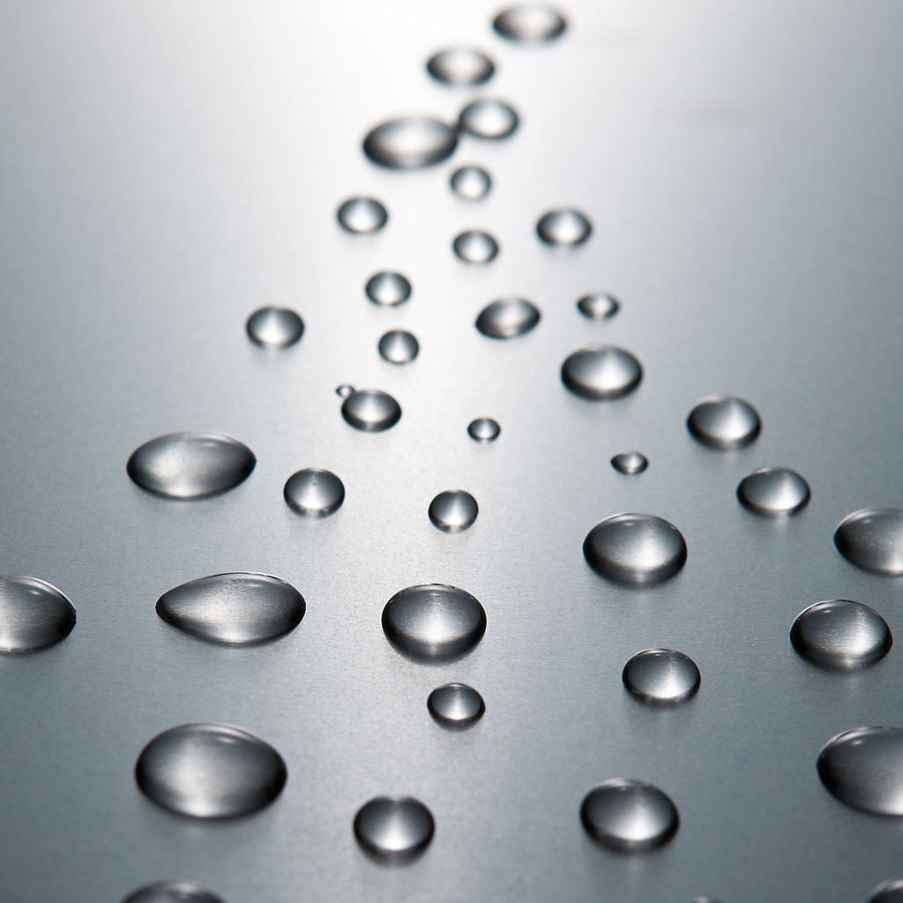
Surface Tension
Ex. Over filled glass, water
Strider and droplets
water strider

Slide 8
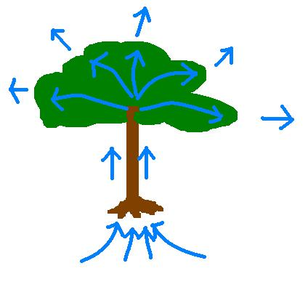
The 6 properties of water
2. Water has Capillary Action
- Water will move UPWARDS in the very thin tubes found in the roots and stems of plants so that water and nutrients can be delivered throughout the entire plant.

Slide 9
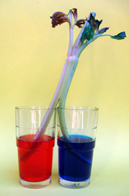
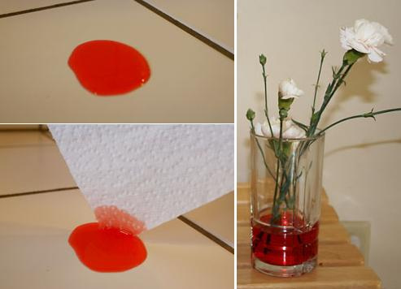
Capillary Action

Slide 10
The 6 properties of water
3. Water has a High Heat of Vaporization
- It takes A LOT of energy to make water evaporate because water molecules are strongly attracted to one another.
- Water carries heat with it when it evaporates, which allows organisms to get rid of excess heat, which cools them off.

Slide 11
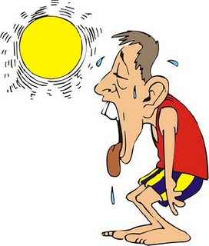
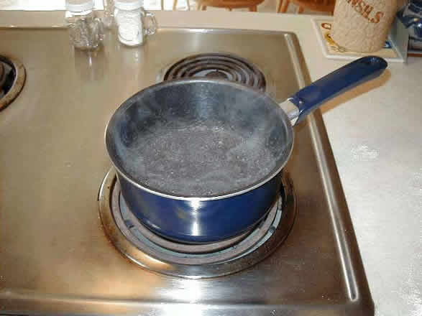
High Heat of Vaporization

Slide 12
The 6 properties of water
4. Water Resists Temperature Change
- It takes a lot of heat to increase the temperature of water
- Water also has to lose a lot of heat before it can cool
- Therefore, water does not like to change temperature.

Slide 13
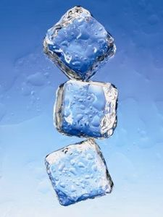
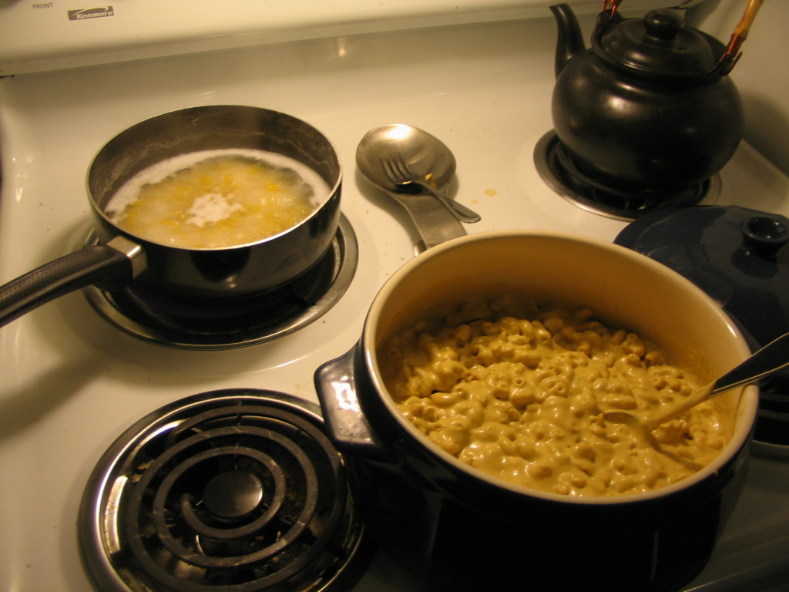
Water resists temperature change

Slide 14
The 6 properties of water
5. Water Expands when it Freezes
- Water’s solid form, ice, floats because it has a lower density than the liquid form of water. Ice is less dense than liquid water.
- Why is this so important to organisms living in lakes, ponds, rivers, streams, and oceans?

Slide 15
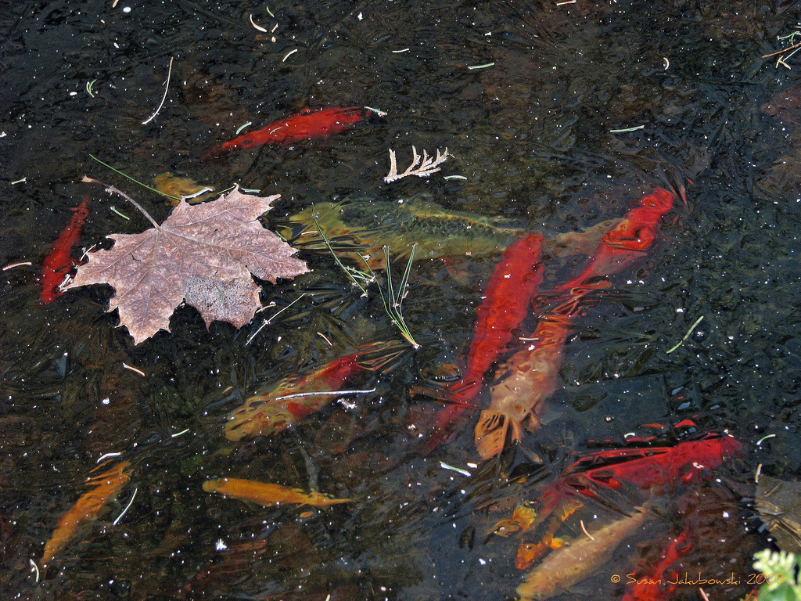
Water Expands when it Freezes

Slide 16
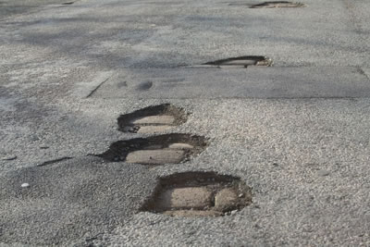
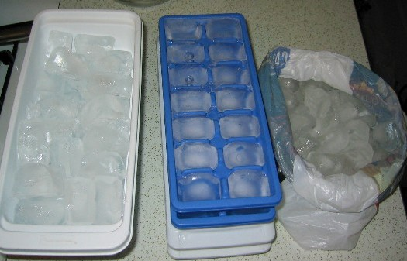
Water Expands when it Freezes
POTHOLES!
ICE TRAYS

Slide 17
The 6 properties of water
6. Water is the Universal Solvent
- Water is able to absorb many substances, so the water inside and outside of cells can carry nutrients into and around cells.
- Water also carries wastes away from cells.

Slide 18
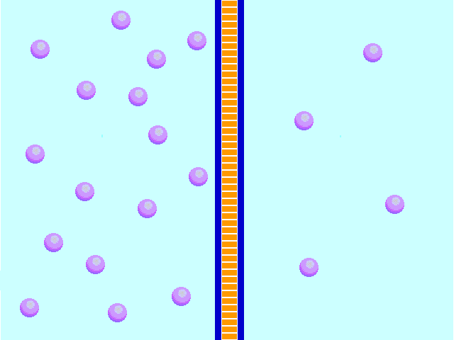
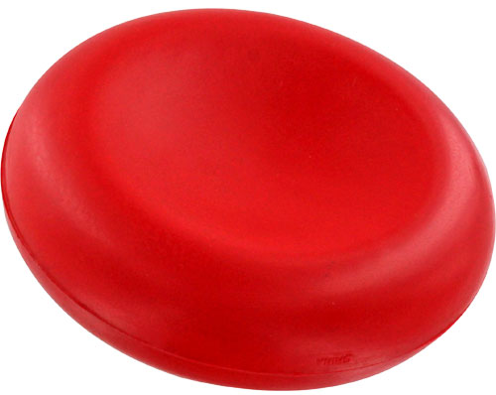
Water is the Universal Solvent
Nutrients Wastes
RED BLOOD CELL

