Slide 1
Forensic Odontology
© 2012 Cengage Learning. All Rights Reserved

Slide 2
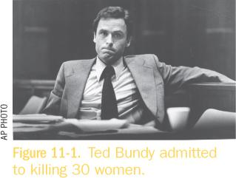
Ted Bundy 1974 - 1978
College women begin missing at the rate of about one per month
No clues until TB failed to stop for police; items lead to murder of two women
TB escaped to Florida and murders two more women, leaving bite marks on one victim
TB arrested again and brought to trial
He confessed to killing 30 women before he was executed
2
2
Forensic Science II: Forensic Odontology, Chapter 11
© 2012 Cengage Learning. All Rights Reserved

Slide 3
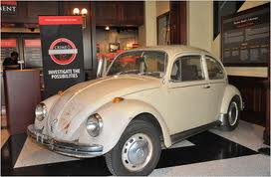
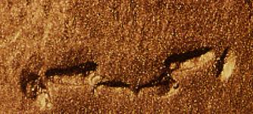
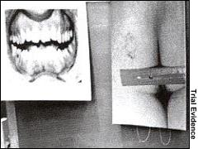
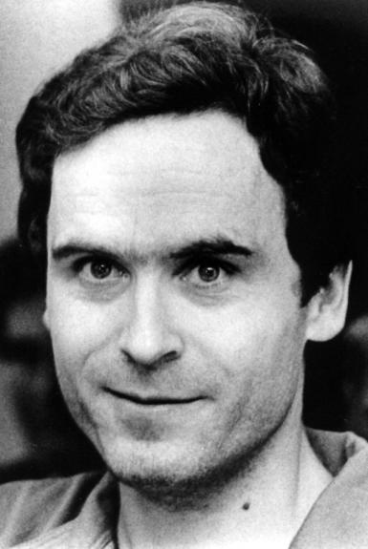
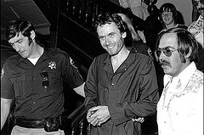
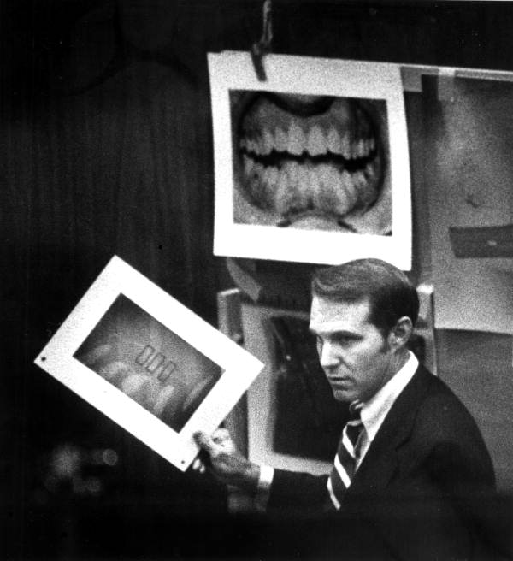
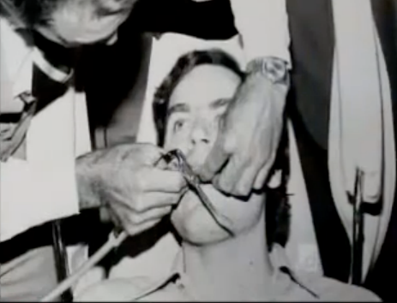
State of Florida v. Ted Bundy

Slide 4
Introduction
Odontology—the study of the anatomy and growth of teeth and diseases associated with the teeth and gums
Forensic Odontologist uses knowledge of the teeth to:
Identify victims of mass disasters
Help police in criminal investigations
Verify signs of abuse
4
Forensic Science II: Forensic Odontology, Chapter 11
© 2012 Cengage Learning. All Rights Reserved

Slide 5
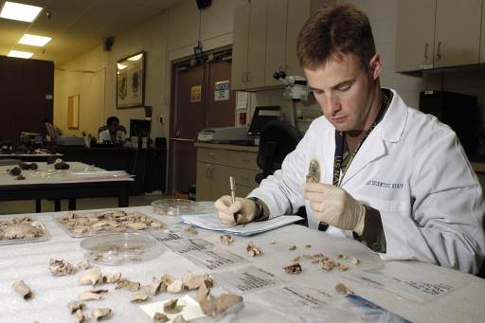
Who practices Forensic Odontology?
Forensic Odontologists
Must have DDS degree
Should have specialized training in the field through lectures
Forensic dentists help:
Identify human remains (individual and mass)
Analyze bite marks
Bite marks are compared to known teeth molds to find origin of bite injuries
Estimate age of the victim and perpetrator
Trace dental malpractice
Top: Forensic Odontologist analyzing animal teeth for comparison.
Side: Seal for American Board of Forensic Odontology.
FROM PPT BY JESSICA WONG

Slide 6
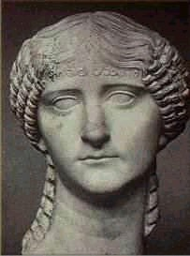
History of Forensic Odontology
66AD – First body identified using teeth
Lollia Paulina
Revolutionary War
Paul Revere was the first forensic dentist in the United States because he identified fallen revolutionary soldiers.
1849 – Mass deaths at Vienna Opera House Fire
Dental evidence is first admitted into court system in US
FROM PPT BY JESSICA WONG

Slide 7
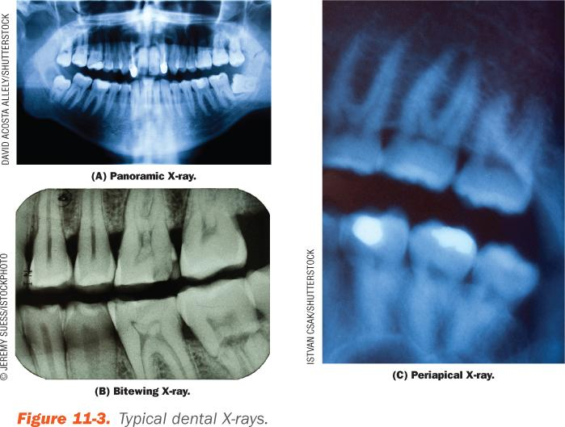
Structure & Function of Teeth
7
Forensic Science II: Forensic Odontology, Chapter 11
© 2012 Cengage Learning. All Rights Reserved

Slide 8
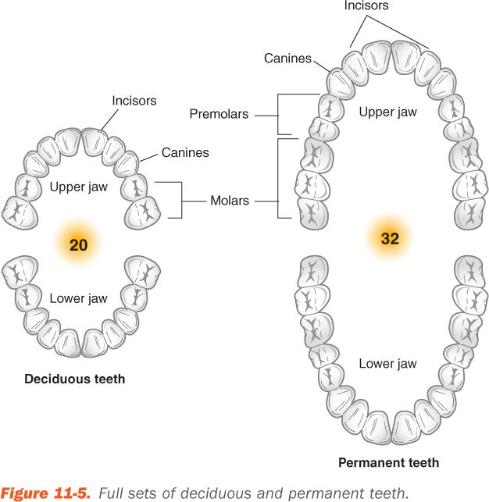
Structure & Function of Teeth
20 deciduous (baby) teeth
32 permanent (adult) teeth
Incisors
Canines
Molars
8
Forensic Science II: Forensic Odontology, Chapter 11
© 2012 Cengage Learning. All Rights Reserved

Slide 9
Estimating Physical Characteristics
A forensic odontologist compares dentals records with the victim’s remains
Dental alterations—fillings, caps, bridgework, and dentures
Teeth—size, shape, gaps, cracks, alignment, missing or extra one, wears, stains
Dentition—the pattern made by a particular set of teeth
9
Forensic Science II: Forensic Odontology, Chapter 11
© 2012 Cengage Learning. All Rights Reserved

Slide 10
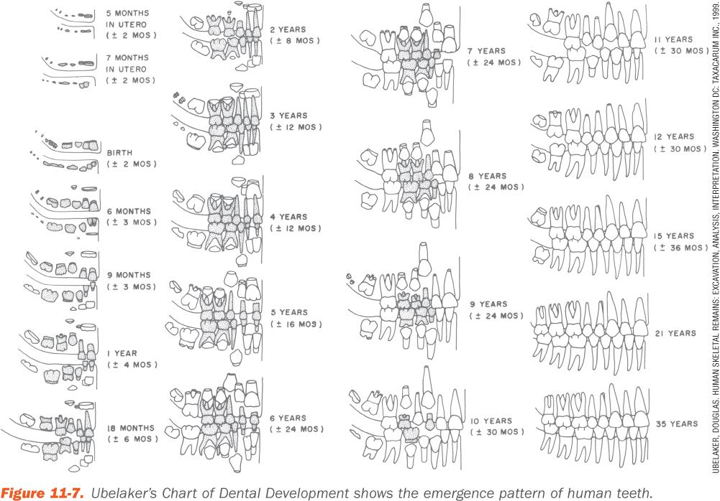
Age Estimation
10
Forensic Science II: Forensic Odontology, Chapter 11
© 2012 Cengage Learning. All Rights Reserved

Slide 11
Determining Positive Identification
Presumptive identification
Personal effects
Family ID
Location of the body
Positive identification
Fingerprints
DNA
Medical and dental records
11
Forensic Science II: Forensic Odontology, Chapter 11
© 2012 Cengage Learning. All Rights Reserved

Slide 12
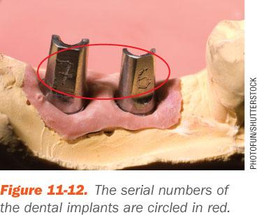
Dental Records
Forensic Odontologist compares
The antemortem records (take during life)
The postmortem records (recorded after death)
Especially helpful
Fillings
Bridgework
Dental implants
12
Forensic Science II: Forensic Odontology, Chapter 11
© 2012 Cengage Learning. All Rights Reserved

Slide 13
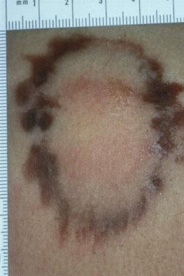
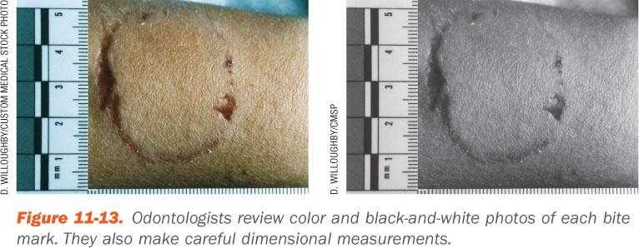
Human Bite Marks
Bite marks look different in soft and stretchy substances like skin versus hard substances like a pencil
When the bite occurs antemortem
The area bruises and swells
Typical bite has a double horseshoe pattern
13
Forensic Science II: Forensic Odontology, Chapter 11
© 2012 Cengage Learning. All Rights Reserved

Slide 14
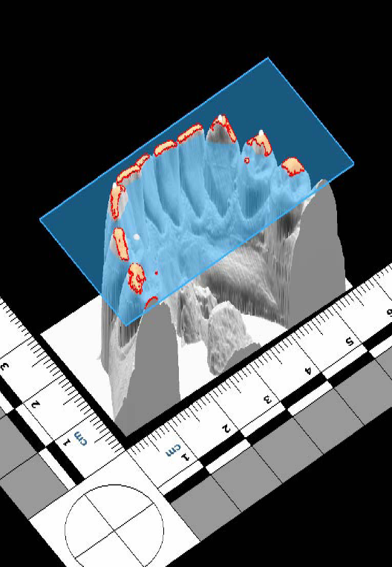
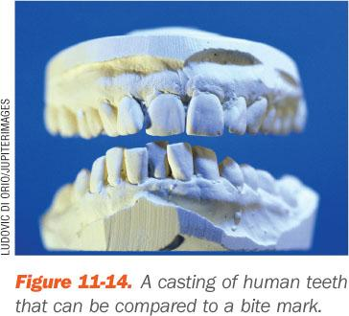
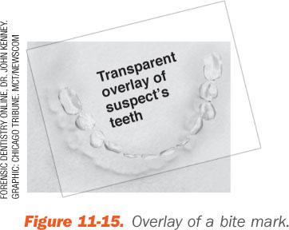
Human Bite Marks
Swelling and inflammation can deform bite marks
Trace bite marks
Cast deep bites
Compare with impressions from a suspect
14
Forensic Science II: Forensic Odontology, Chapter 11
© 2012 Cengage Learning. All Rights Reserved

Slide 15
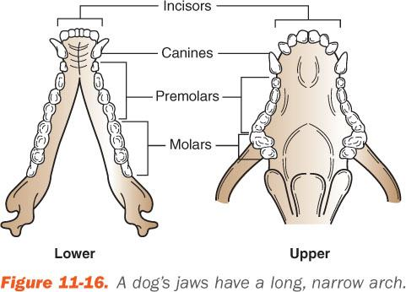
Animal Bite Marks
Very different dentition patterns
Compare DNA and bite patterns
15
Forensic Science II: Forensic Odontology, Chapter 11
© 2012 Cengage Learning. All Rights Reserved

