Slide 1
SCIENTIFIC METHOD
SCSH3. Students will identify and investigate problems scientifically

Slide 2
The Steps a scientist uses to solve a problem
State the problem.
- usually in the form of a question
Background research
- collect information about the problem
Hypothesis
- an educated answer to the problem

Slide 3
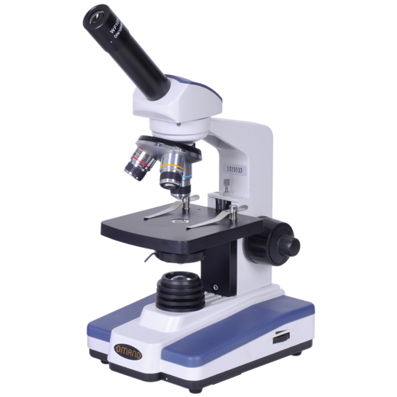
Parts of an experiment
4. Experiment
- A procedure that tests the hypothesis
An experiment includes:
a) Independent variable (IV) is the one variable that is changed by the scientist. The IV is plotted on the x-axis of a graph.
b) Dependent variable (DV) is the variable affected by changing the IV variable. The DV depends on the change of the IV.
- The DV is plotted on the y-axis of a graph.
c) Control is the group that does not receive the independent variable. It’s used to compare the results of the experimental group and is usually the ‘normal’ conditions
d) Constants are all factors in an experiment that are kept the same. Constants make the experiment valid.

Slide 4
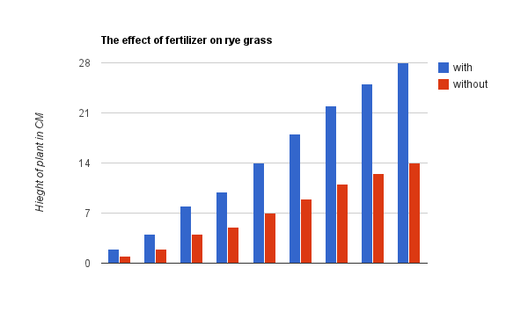
The final steps
5. Data/Results
- collect & record data observed in
the experiment
- results can be qualitative or quantitative
6. Conclusion
- Ask yourself, “Does the data support my hypothesis? Why or why not?
- Be aware of experimental and human errors.

Slide 5
What is theory?
- Theory: idea that has been tested over and over and has been proven to be true.

