Slide 1
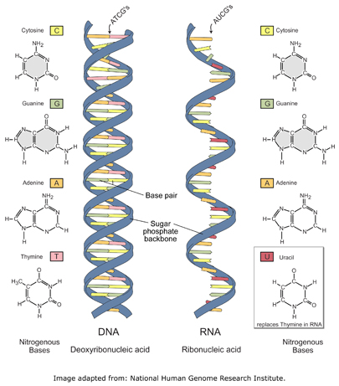
DNA VS. RNA
DNA BOTH RNA
1. Double stranded 1. nucleic 1. single stranded
2. A-T, C-G acids 2. A-U(uracil), C-G
3. Instructions for 2. nucleotides 3. recipe to make
life proteins
4. Deoxyribose 4. Ribose

Slide 2
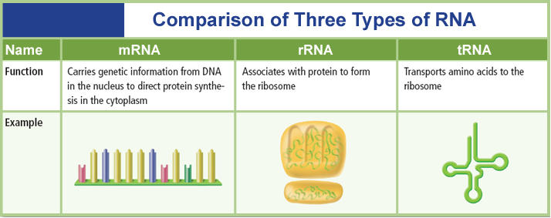
Chapter 12
Molecular Genetics
12.3 DNA, RNA, and Protein

Slide 3
UNIT: DNA and RNA How is the genetic code contained in DNA used to make proteins?
Transcription and Translation
DNA codes for RNA which codes for Proteins
(DNA→RNA→Proteins)
1. DNA→RNA=Transcription
a. transcription writes the recipe-makes RNA, occurs in the nucleus
2. RNA→Proteins=Translation/or Protein Synthesis
-follows the recipe to make the protein
-occurs in the ribosome
-Translation is when RNA leaves the nucleus and amino acids are “read”.

Slide 4
Transcription-makes RNA
A. Steps of transcription: DNA→RNA
RNA polymerase unzips DNA
RNA nucleotides join w/DNA nucleotides A pairs with U; C pairs with G
Sugar and phosphates come in (to form backbone)
mRNA leaves nucleus and goes to cytoplasm where it finds a ribosome and attaches to it
DNA strand: AGA-CCG-TGC-TTC
mRNA strand: UCU-GGC-ACG-AAG
https://www.youtube.com/watch?v=h5mJbP23Buo

Slide 5
TRANSLATION-Protein Synthesis
5. tRNA brings in an anticodon that matches with the codon; there is also an amino acid attached
a. CODON-3 bases together on mRNA strand
1. Code for an amino acid
-monomer of protein
2. There are 20 amino acids
example: A-U-C
mRNA strand: UCU-GGC-ACG-AAG
1 2 3 4
**There are 4 codons in this RNA strand
b. ANTICODON-3 bases on tRNA strand

Slide 6
Codon charts
The Messenger RNA (mRNA) protein synthesis code
1st base | 2nd Base |  |  |  | 3rd Base
A | A | G | U | C
 | Lysine | Arginine | Isoleucine | Threonine | A
 | Lysine | Arginine | Methionine | Threonine | G
 | Asparagine | Serine | Isoleucine | Threonine | U
 | Asparagine | Serine | Isoleucine | Threonine | C
G | Glutamic acid | Glycine | Valine | Alanine | A
 | Glutamic acid | Glycine | Valine | Alanine | G
 | Aspartic acid | Glycine | Valine | Alanine | U
 | Aspartic acid | Glycine | Valine | Alanine | C
U | STOP | STOP | Leucine | Serine | A
 | STOP | Tryptophan | Leucine | Serine | G
 | Tyrosine | Cysteine | Phenylalanine | Serine | U
 | Tyrosine | Cysteine | Phenylalanine | Serine | C
C | Glutamine | Arginine | Leucine | Proline | A
 | Glutamine | Arginine | Leucine | Proline | G
 | Histidine | Arginine | Leucine | Proline | U
 | Histidine | Arginine | Leucine | Proline | C

Slide 7
Translation-makes protein
When they match up together tRNA drops off, and you now have an amino acid
The Amino Acids from the mRNA strand code for a protein-A.K.A. polypeptide=peptide bonds hold amino acids together

Slide 8
Protein Synthesis
Nuclear
membrane
DNA
Transcription
mRNA
Ribosome
Translation
Protein

Slide 9
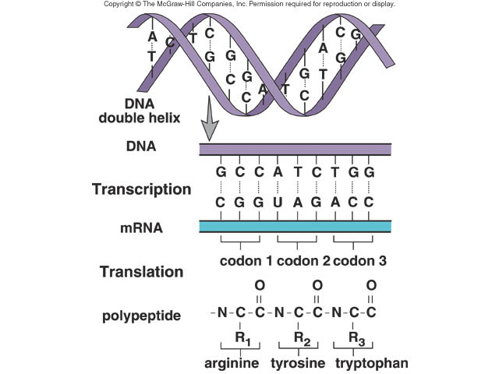
Transcription
Translation

Slide 10
Chapter 12
Molecular Genetics
12.3 DNA, RNA, and Protein
RNA Processing
The code on the DNA is interrupted periodically by sequences that are not in the final mRNA.
Intervening sequences are called introns.
are cut out by enzymes
The portions of DNA molecules that actually code for the production of proteins are called exons.
parts of the mRNA that are kept and expressed

