Slide 1
UNIT: DNA and RNA How is the genetic code contained in DNA used to make proteins?
Transcription and Translation
DNA codes for RNA which codes for Proteins
(DNA→RNA→Proteins)
1. DNA→RNA=transcription
a. transcription makes RNA, occurs in the nucleus
2. RNA→Proteins=Translation/or Protein Synthesis
Translation is when RNA leaves the nucleus and amino acids are “read”.

Slide 2
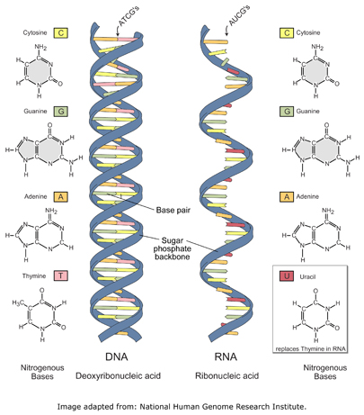
DNA VS. RNA
DNA BOTH RNA
1. Double stranded 1. nucleic 1. single stranded
2. A-T, C-G acids 2. A-U(uracil), C-G
3. Instructions for 2. nucleotides 3. recipe to make
life proteins
4. Deoxyribose 4. Ribose

Slide 3
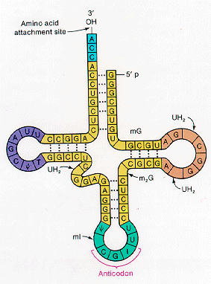
RNA
EX. DNA strand: A-T-T-A-C-G-A-T-G-G-A
RNA strand:U-A-A-U-G-C-U-A-C-C-U
3. Types of RNA
a. Messenger RNA (mRNA)-working copies of
DNA; Strand that leaves nucleus
b. Transfer RNA (tRNA)-“Dictionary” for
translation of nucleotides to protein
c. Ribosomal RNA (rRNA)-makes ribosomes;
site of protein synthesis

Slide 4
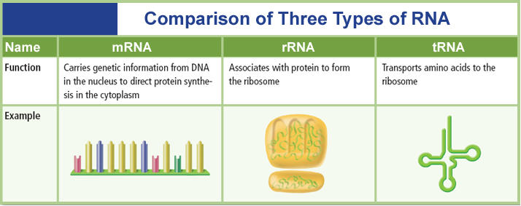
Chapter 12
Molecular Genetics
12.3 DNA, RNA, and Protein

Slide 5
Transcription-makes RNA
https://www.youtube.com/watch?v=h5mJbP23Buo
A. Steps of transcription:
RNA polymerase unzips DNA
RNA nucleotides join w/DNA nucleotides A pairs with U; C pairs with G
Sugar and phosphates come in (to form backbone)
mRNA leaves nucleus and goes to cytoplasm where it finds a ribosome and attaches to it

Slide 6
TRANSLATION-Protein Synthesis
5. tRNA brings in an anticodon that matches with the codon; there is also an amino acid attached
a. CODON-3 bases together
1. Code for an amino acid
2. There are 20 amino acids
example: A-U-C
RNA: AAA-UAC-GAU-UGC-GGG
1 2 3 4 5 **There are 5 codons in this RNA strand

Slide 7
Codon charts
The Messenger RNA (mRNA) protein synthesis code
1st base | 2nd Base |  |  |  | 3rd Base
U | U | C | A | G
 | Phenylalanine | Serine | Tyrosine | Cysteine | U
 | Phenylalanine | Serine | Tyrosine | Cysteine | C
 | Leucine | Serine | Stop | Stop | A
 | Leucine | Serine | Stop | Tryptophan | G
C | Leucine | Proline | Histidine | Arganine | U
 | Leucine | Proline | Glutamine | Arganine | C
 | Leucine | Proline | Glutamine | Arganine | A
 | Leucine | Proline | Asparagine | Arganine | G
A | Isoleucine | Threonine | Asparagine | Serine | U
 | Isoleucine | Threonine | Lysine | Serine | C
 | Isoleucine | Threonine | Lysine | Arginine | A
 | Methionine; Start | Threonine | Aspartate | Arginine | G
G | Valine | Alanine | Aspartate | Glycine | U
 | Valine | Alanine | Aspartate | Glycine | C
 | Valine | Alanine | Glutamate | Glycine | A
 | Valine | Alanine | Glutamate | Glycine | G

Slide 8
Translation
When they match up together tRNA drops off, and you now have an amino acid
The Amino Acids from the mRNA strand code for a protein.

Slide 9
Chapter 12
Molecular Genetics
12.3 DNA, RNA, and Protein
RNA Processing
The code on the DNA is interrupted periodically by sequences that are not in the final mRNA.
Intervening sequences are called introns.
are cut out by enzymes
The portions of DNA molecules that actually code for the production of proteins are called exons.
parts of the mRNA that are kept and expressed

Slide 10
Protein Synthesis
Nuclear
membrane
DNA
Transcription
mRNA
Ribosome
Translation
Protein

Slide 11
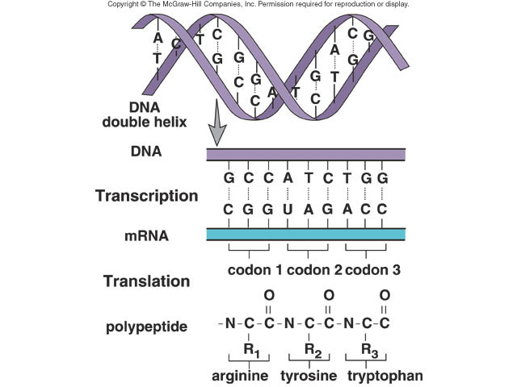
Transcription
Translation

