Slide 1
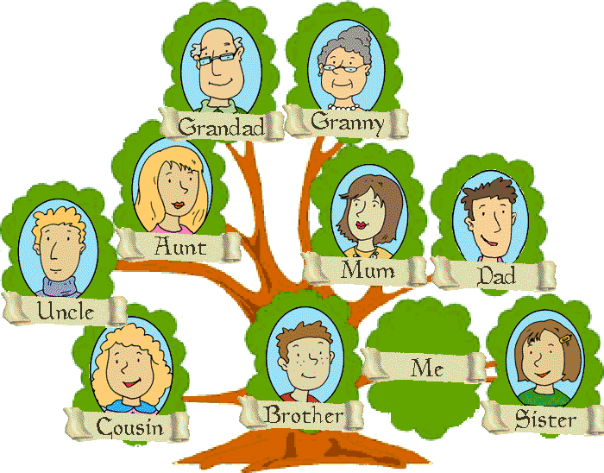
UNIT: Genetics How do pedigrees show the inheritance of a trait in a family?
Pedigrees
A pedigree is a record that shows how a trait is inherited over several generations
A pedigree is like a family tree
It shows patterns of inheritance

Slide 2
Pedigrees
A marriage (or mating) is symbolized by a
Horizontal line
Offspring are symbolized by a
Vertical line
Generations are
represented by
Roman numerals

Slide 3
Pedigrees
Pedigree charts are often constructed to show the inheritance of genetic conditions within a family. Such charts are a great help in determining whether a phenotype is controlled by a dominant, recessive or sex-linked allele.

Slide 4
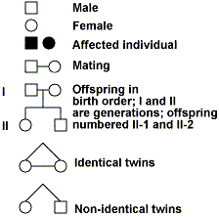
Pedigrees
3 Types of inheritance
Autosomal Dominant: Each affected individual has an affected parent; no skipping generations
Autosomal Recessive: may not have an affected parent.
X-link Recessive: may not have an affected parent. Males are more likely to be affected. Females can be carriers.

Slide 5
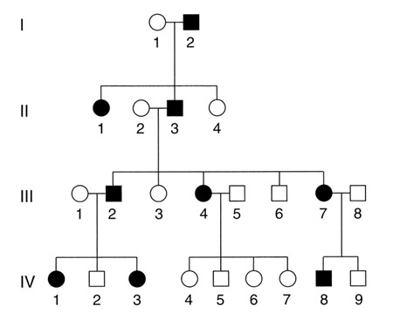
Pedigrees: Sickle cell anemia is a recessive trait N=normal n=sickle cell anemia

Slide 6
pedigrees
Pedigree I below traces the dimples trait through three generations of a family.
D-dimples
d-no dimples
-male
-female
- has the trait
-carrier
(heterozygous)

Slide 7
pedigrees
Pedigree I The following passage describes the family shown in Pedigree I. Write the name of each person below the correct symbol in Pedigree I.
Although Jane and Joe Smith have dimples, their daughter, Clarissa does not. Joe’s dad, Mr. Smith, has dimples, but his mother, Mrs. Smith, and his sister, Grace, does not.
Jane’s dad, Mr. Renaldo, her brother Jorge, and her sister Emily do not have dimples, but her mother, Mrs. Renaldo, does.

Slide 8
Pedigree I

Slide 9
Pedigree showing a dominant trait
A-dimples
a-no dimples

Slide 10
Pedigree showing a dominant trait
A-dimples
a-no dimples
Shaded or - has trait
Genotype: homozygous dominant-AA
Half-shaded or -has trait
Genotype: heterozygous Aa
Non-shaded or -does not have trait
Genotype: homozygous recessive-aa

Slide 11
Pedigree showing a dominant trait
A-dimples
a-no dimples
K Aa aa aa Aa
aa aa Aa Aa aa
aa

Slide 12
Pedigree showing a recessive trait
A-Normal color vision
a-colorblind

Slide 13
Pedigree showing a Recessive trait
A-Normal color vision
a-colorblind
Shaded or - has trait
Genotype: homozygous recessive-aa
Half-shaded or -has trait
Genotype: heterozygous a.k.a. hybrid; Aa
Non-shaded or -does not have trait
Genotype: homozygous dominant; AA

Slide 14
Pedigree showing a recessive trait
A-Normal color vision
a-colorblind
Aa Aa
aa Aa aa AA
Aa aa Aa Aa Aa

