Slide 1
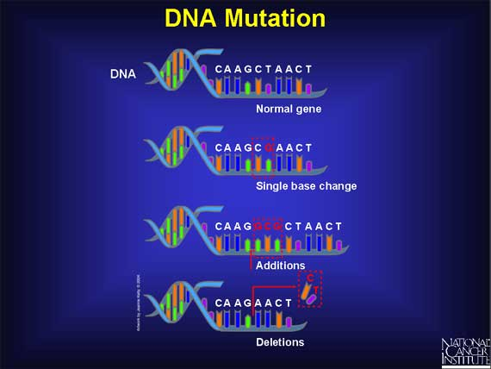
UNIT: Molecular Genetics What is a mutation and how does it cause changes in organisms?
Mutations
-changes in a single base pair in DNA=changes in the nucleotide sequence
2 general categories:
a. Base substitutions
b. Base insertions or
deletions

Slide 2
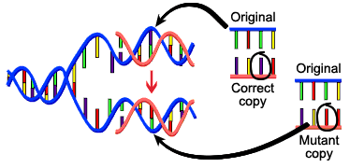
Chapter 12
Molecular Genetics
12.4 Gene Regulation and Mutation
Causes of Mutation-creation of mutations
=mutagenesis
Can occur spontaneously during replication or recombination-called Spontaneous mutations
Radiation such as UV rays and X rays
Chemicals – Mutagens & carcinogens
Nondisjunction
Viral Infection- HPV

Slide 3
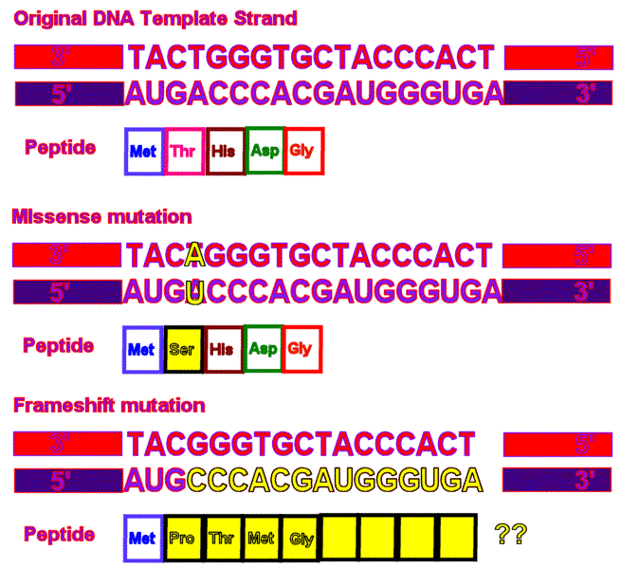
Mutations
Physical or chemical agent that could cause a mutation is called a mutagen
ex. Radiation
Mutations can be harmful or useful
b/c of mutation there is variety in us!
essential for geneticists-create different alleles
needed for genetic
research

Slide 4
Chapter 12
Molecular Genetics
12.4 Gene Regulation and Mutation
Body-cell v. Sex-cell Mutation
Somatic cell mutations are not passed on to the next generation.
Mutations that occur in sex cells are passed on to the organism’s offspring and will be present in every cell of the offspring.

Slide 5
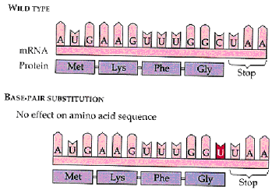
Mutations
Point Mutations: Base Substitutions
Replacement of one nucleotide with another
Can result in no change in the Protein, insignificant changes or might be crucial
Ex. Sickle cell anemia
Has a single difference in amino acid (a valine instead of a glu.)
Protein can’t perform normally

Slide 6
Chapter 12
Molecular Genetics
12.4 Gene Regulation and Mutation
Types of Point Substitution Mutations
Silent: causes no change in the amino acid sequence
Missense: causes a change in one amino acid only
Nonsense: introduces a stop codon into the mRNA strand

Slide 7
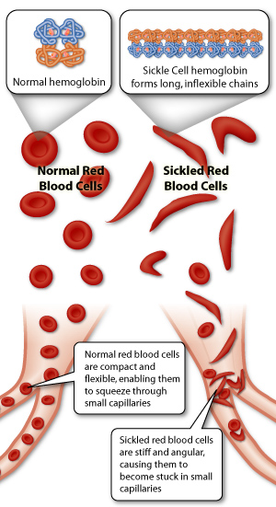
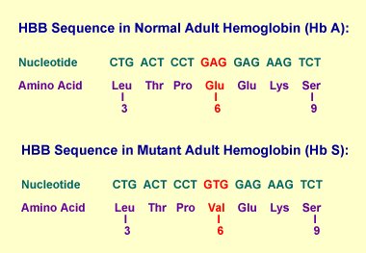
Sickle Cell Anemia

Slide 8
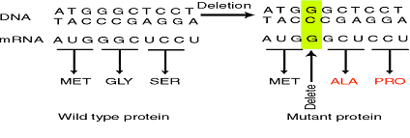
Mutations
Frameshift mutations
Base insertions or deletions
Can be disastrous=add or delete nucleotides
May alter the reading frame (triplet grouping) of the genetic message
Regrouped into different codons

Slide 9
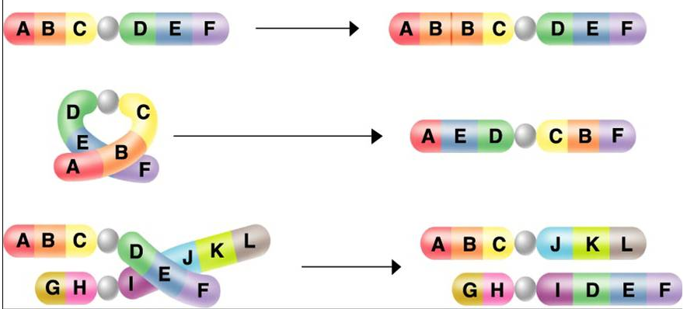
Chromosomal mutations
Change in the number or structure of the chromosomes
Duplication
Inversion
Translocation

