Slide 1
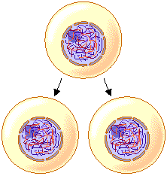
UNIT 6: Cell Division What are the differences between mitosis and meiosis?
Quick Review of Mitosis:
-Mitosis is the division of the nucleus
-How many and what types of cells are
produced by mitosis? 2 diploid body cells
Are they identical? Yes
-Ex: A human skin cell nucleus contains 46 chromosomes. After mitosis, 2 skin cells would be produced, each with 46 chromosomes inside its nucleus
-A diploid (2n) cell has both copies of each type of chromosome.
Meaning-Diploid cells contain ALL (100%) of the genetic material from the parent cell

Slide 2
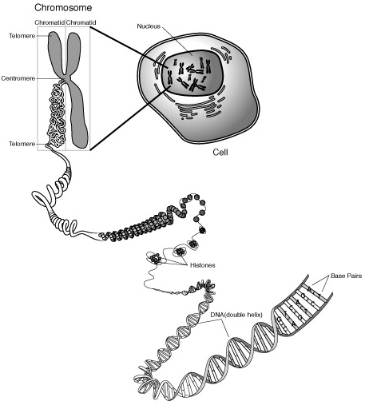
Quick Review continued…
Chromosomes contain DNA.
Almost all cells have 46 chromosomes, except gametes (sex cells: egg and sperm).
If a cell has 46 chromosomes it is considered to be diploid (2n). If it has half the number of chromosomes it is haploid (n), these are found in the gametes.
A human has 46 diploid (2n) cells and 23 haploid (n) cells.
Females carry an XX on their chromosomes, Males carry an XY on their chromosomes.

Slide 3
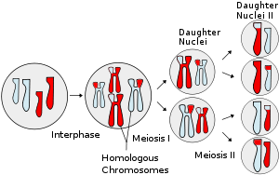
Meiosis occurs-Why is it important?
Meiosis
Only for reproductive (sex) cells or gametes
Nuclear division in which chromosome number is cut in half (haploid=n)
Same 4 phases as mitosis, but goes through them twice.

Slide 4
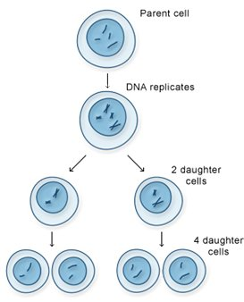
THE PHASES OF MEIOSIS
Meiosis I
Prophase I, Metaphase I, Anaphase I and telophase I (Interphase)
PII, MII, AII, TII (no interphase)
Interphase I
-chromosomes replicate/duplicate
(contains 46 chromosomes)

Slide 5
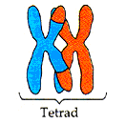
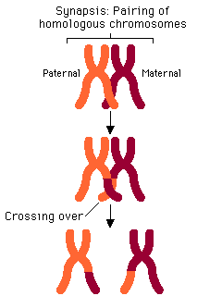
THE PHASES OF MEIOSIS
Prophase I
During synapses homologous chromosomes (same/identical) pair up.
Called a tetrad (4 chromosomes)
Crossing over occurs→gives genetic
variation
Chromosomes line up side by
side
Exchange DNA
Form new genes

Slide 6
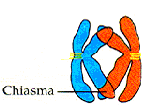
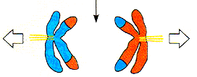
THE PHASES OF MEIOSIS
Metaphase I
Tetrads line up in the middle of the cell (equator)
Anaphase I
Chromosomes pulled to opposite sides of the cell
Notice that they are complete (in mitosis they are singles).

Slide 7
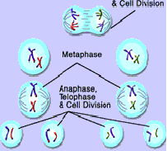
THE PHASES OF MEIOSIS
Telophase I and Cytokinesis
Each cell has a haploid set of chromosomes
2 haploid daughter cells form
Cell will then go through the second Meiotic Stage (like mitosis divison now).

Slide 8
THE PHASES OF MEIOSIS
Pro I
Met I
Ana I
Telo I
Pro II
Meta II
Ana II
Telo II
The second round of cell
division (Meiosis II) is identical
to the phases of Mitosis except
that they are happening in 2 cells
instead of 1.

Slide 9
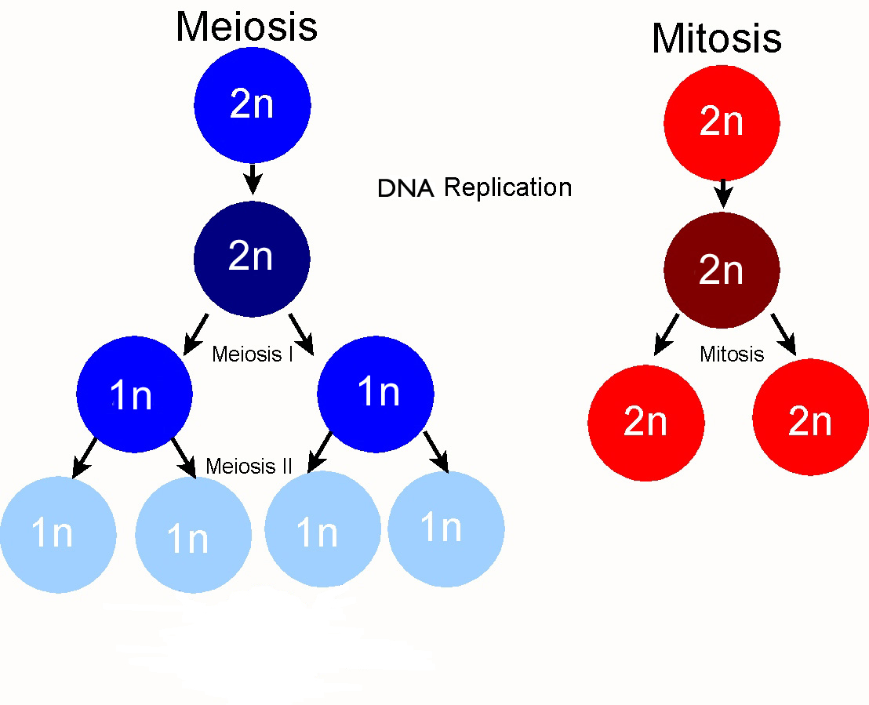
CELLS IN Meiosis
-At the end of Meiosis II, 4 haploid cells are formed from the 1 original parent cell. These haploid cells will become gametes (a.k.a. sex cells)
eggs or sperm

Slide 10
SUMMARY COMPARISON OF MITOSIS AND MEIOSIS
Mitosis | Meiosis
Type of cell division that makes diploid (somatic and body) cells | Type of cell division that makes gametes (haploid and sex cells)
2 identical diploid cells are produced (clones of the parent cell) | 4 different haploid cells are produced (cells with different combination of chromosomes)
Each daughter cell has 2 copies of each type of chromosome (1 from each parent) | Each gamete has only 1 copy of each type of chromosome
A.K.A. asexual reproduction | Makes cells that are used in sexual reproduction

Slide 11
Mitosis vs. Meiosis
http://www.lpscience.fatcow.com/jwanamaker/animations/meiosis.html
http://www.pbs.org/wgbh/nova/body/how-cells-divide.html

