Slide 1
UNIT: Cell Division What is a karyotype and how is it used to detect genetic disorders?
Quick Review:
What is the diploid (2n) number of chromosomes in humans? 46
How many pairs of chromosomes are in the human body cells? 23
For each pair of chromosomes, one chromosome contains genetic material from mom and the other contains genetic material from dad.

Slide 2
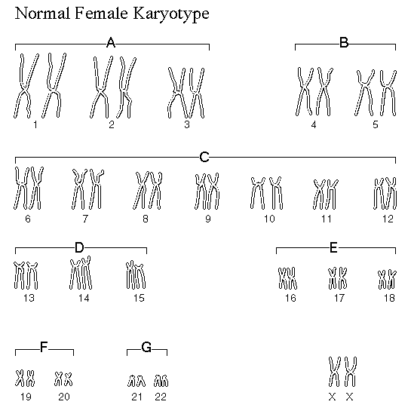
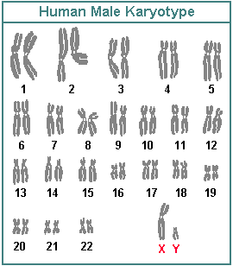
Karyotypes
A karyotype is a chart of 46 chromosomes arranged in homologous pairs that is used to detect genetic disorders by showing abnormalities in chromosomes

Slide 3
Karyotypes
Karyotypes are produced by staining cells in metaphase so that the chromosomes are distinct and easy to see. The chromosomes are then photographed and the photograph is enlarged.
http://www.cengage.com/biology/discipline_content/animations/karyotype.html

Slide 4
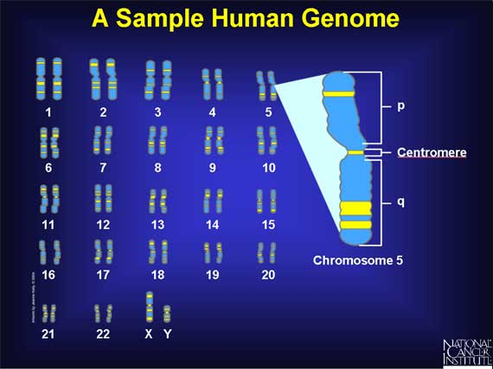
Karyotypes
Chromosome pairs #1-22 (#1-44) are called autosomes
Chromosome pair #23 (#45 & 45) are the sex chromosomes:
XX-FEMALE; XY-MALE
Chromosomes are arranged in order according to size, arm length, centromere position
and banding patterns

Slide 5
Karyotype Practice
What’s wrong with karyotype #1? Extra chromosome #21
This genetic disorder, Trisomy 21 (a.k.a. Down’s syndrome) is
caused by 1 extra chromosome on chromosome pair 21

Slide 6
Karyotype practice
2. What’s wrong with karyotype #2? Extra sex chromosome
This genetic disorder, Klinefelter’s is caused by an extra X sex chromosome

Slide 7
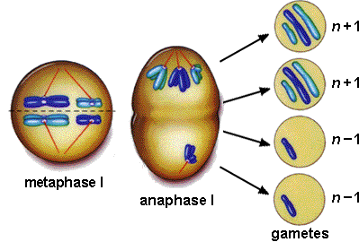
Karyotype practice
3. The people with karyotypes #1 & 2 above received extra chromosomes as a result of what process?
nondisjunction

Slide 8
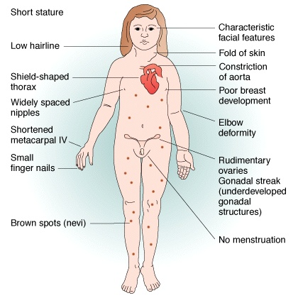
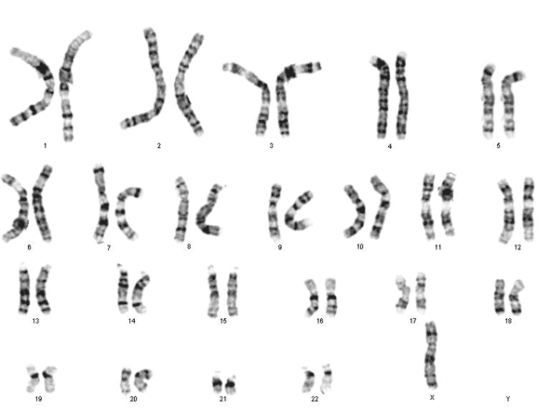
Turner’s Syndrome

Slide 9
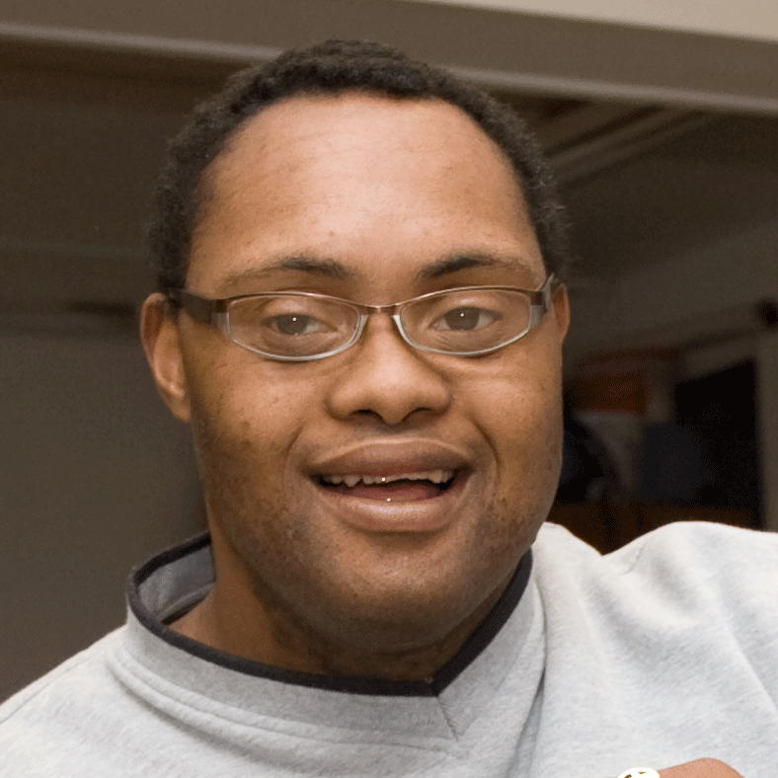
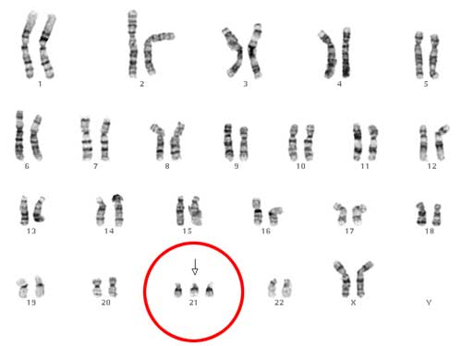
Down’s Syndrome
Most children with Down syndrome have mild to moderate cognitive disability. About half of the children who have Down syndrome are born with a heart defect. Children with Down syndrome are also prone to developing other health problems. For example, respiratory infections, hearing problems, and dental problems are common.

Slide 10
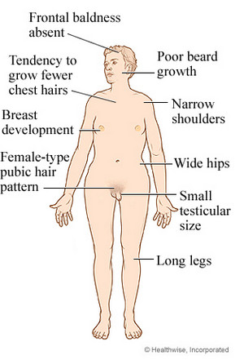
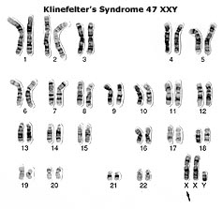
Klinefelter’s
Many men who have Klinefelter syndrome do not have obvious symptoms. Some boys with Klinefelter syndrome have language and learning problems.

Slide 11
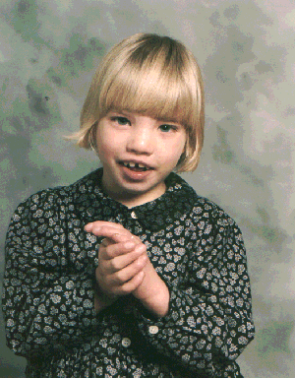
Cri du Chat
Cry that is high-pitched and sounds like a cat
Downward slant to the eyes
Low birth weight and slow
growth
Intellectual disability
Partial webbing or fusing of
fingers or toes
Slow or incomplete development of motor skills
Small head
Small jaw
Wide-set eyes

