Slide 1
The Study of Hair
Chapter 3
SFS1. Students will recognize and classify various types of evidence in relation to the definition and scope of Forensic Science
SFS2. Students will use various scientific techniques to analyze physical and trace evidence.
b. Analyze the morphology and types of hair, fibers, soil and glass.

Slide 2
Introduction
Human hair is one of the most frequently found pieces of evidence at the scene of a violent crime.
From hair one can determine:
If the source is human or animal
Race (sometimes)
Origin of the location on the source’s body
Whether the hair was forcibly removed
If the hair has been treated with chemicals
If drugs have been ingested

Slide 3
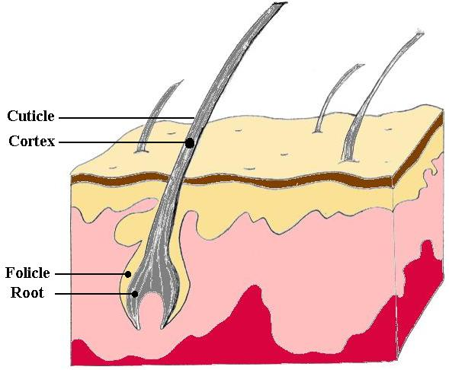
The Structure of Hair
The actively growing base of the hair is called the follicle, and contains DNA and living cells.

Slide 4
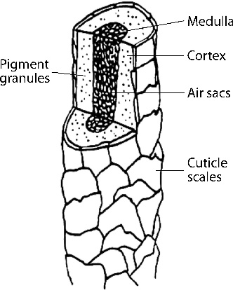
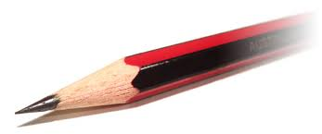
The Structure of Hair
Hair is often compared to a pencil.

Slide 5
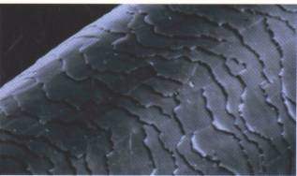
The Structure of Hair
The cuticle is made of scales that overlap and protect the inner layers of the hair. The edges of the scales always point away from the root.

Slide 6
The Structure of Hair
The cortex is the largest part of the hair. It is filled with pigment called melanin that gives hair its color.
It also determines shape.

Slide 7
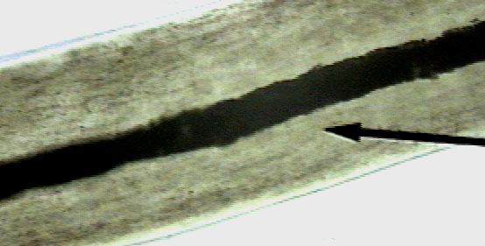
The Structure of Hair
The medulla is the center of the hair. It can be a hollow tube, or filled with cells.

Slide 8
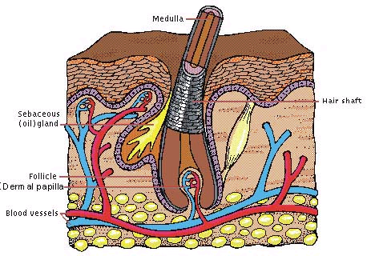
What Can We Find Out From Hair?
Hair with follicle cells is individual evidence.
It can be used to make a DNA match.

Slide 9
What Can We Find Out From Hair?
Hair is class evidence without follicle cells.
It can be used to identify a class a people with certain hair characteristics.

Slide 10
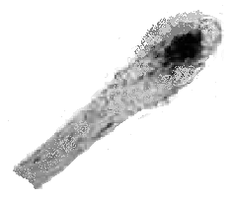
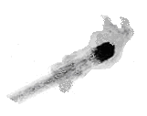
The Root
Human roots look different based on whether they have been forcibly removed or if they have fallen out. Animal roots will vary, but in general have a spear shape.
Fallen out
Forcibly removed

Slide 11
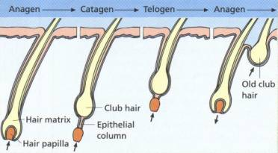
The Life Cycle of Hair
Anagen – Hair grows.
80 – 90% of hair in this phase
Length of this phase varies from person to person, and on different parts of the body

Slide 12
The Life Cycle of Hair
Catagen – Growth slows, and then stops
Phase lasts only a couple of weeks
Follicle shrinks and root breaks away.
Telogen – Hair rests, no active growth
Lasts five to six weeks
Root begins to grow a new hair (in anagen), pushing the old hair out.

Slide 13
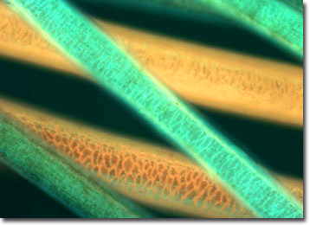
What Can We Find Out From Hair?
Phase contrast microscopy and fluorescent microscopy can make it easier to determine the presence of a dye or other treatment.

Slide 14
Treated Hair
Hair that has been bleached or dyed can make hair brittle and disturb the cuticle.
Dying changes the color of both the cuticle and the cortex.
Time since last treatment can be used to help identify hairs from the same person.

Slide 15
Animal Hair vs. Human Hair
Spinous Coronal Imbricate
The cuticle is typically different.
The cuticle scales in animals tend to resemble petals (spinous) or they give the appearance of a stack of crowns (coronal).
The cuticle scales in humans commonly are flattened and narrow (imbricate).

Slide 16
Animal Hair vs. Human Hair
Human hair has pigment denser toward the cuticle. Animal hair is denser toward the medulla.
Human hair is usually one color long its length. Animal hair can change suddenly in bands.
The ratio of the diameter of the medulla to the diameter of the entire hair is called the medullary index.
If the medullary index is 1/3 or less, the hair is human. If it is ½ or more, it is animal.

Slide 17
What Can We Find Out From Hair?
Neutron activation analysis (NAA) can identify fourteen specific elements in hair, greatly increasing the accuracy of matches.
Hair can be used to detect exposure to poisons or narcotics.
The average hair grows 1.3 cm each month, allowing forensic chemists to determine when exposure occurred.

Slide 18
DNA from Hair
The root contains nuclear DNA. If the hair has been forcibly removed, some follicular tissue may be attached containing DNA.
The hair shaft contains abundant mitochondrial DNA, inherited only from the mother. This process is more difficult and costly than using nuclear DNA.

Slide 19
Other Hair Info
Number of hairs on typical heads
Redheads = ~80,000
Dark hair = ~100,000
Blondes = ~120,000

