Slide 1
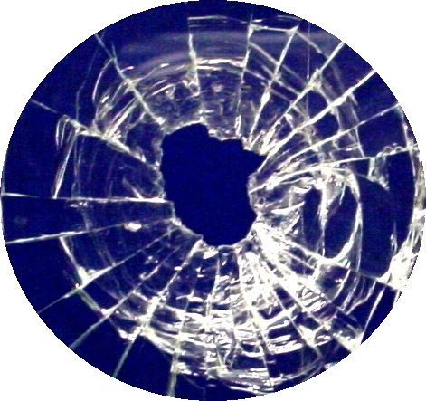
Glass Evidence

Slide 2
Density - Common Examples
Type of Glass | Density (g/ml)
Bottle glass | 2.50
Window glass | 2.53
Lead crystal | 2.98-3.01
Pyrex | 2.27
Tempered (auto) | 2.98
Flint | 3.70
Crown | 2.50

Slide 3
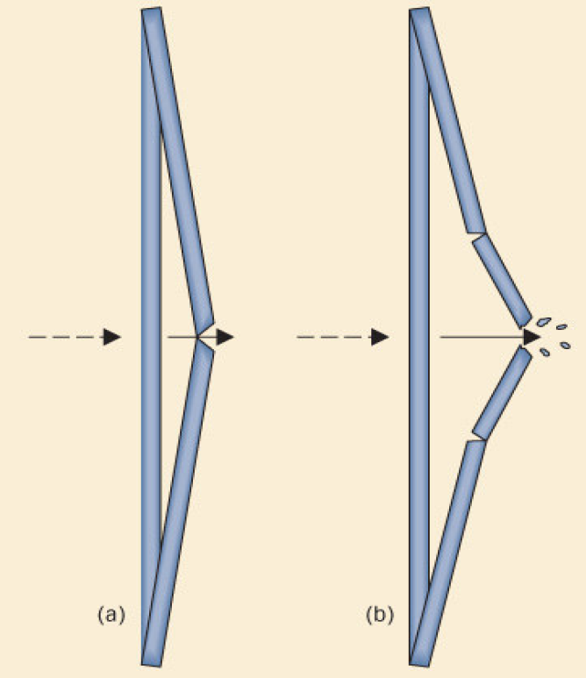
Crack patterns
Radial cracks are first to form. They are on the side opposite to force.
Concentric cracks form second, beginning on side of force.

Slide 4
Fractures
Concentric-circles
Radial-linear
bsapp.com

Slide 5
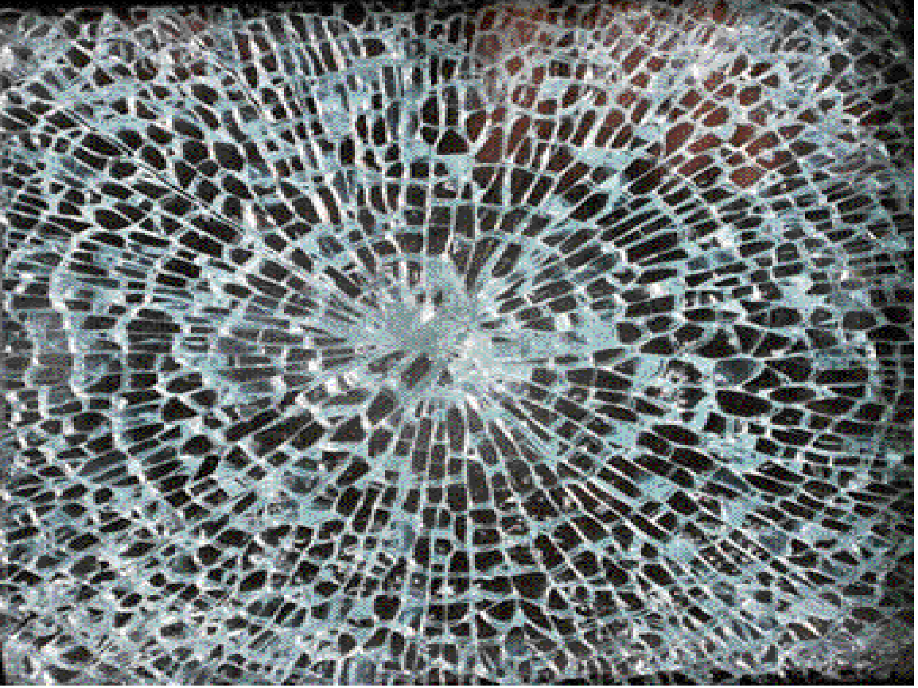

Slide 6
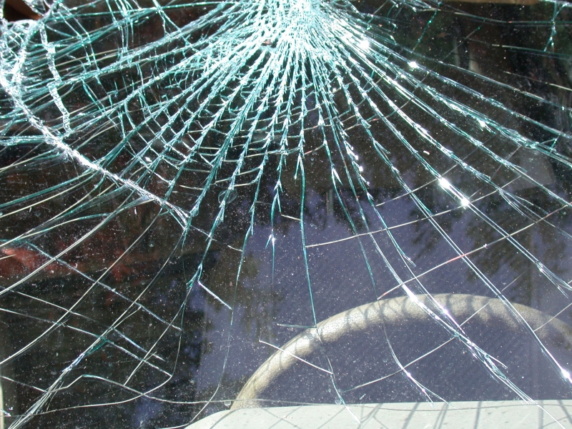

Slide 7
bsapp.com

Slide 8
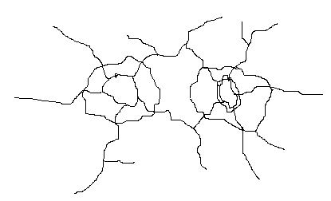
Determining Sequence
It is possible to determine the order cracks occurred in, because new cracks stop when they hit old cracks.

Slide 9
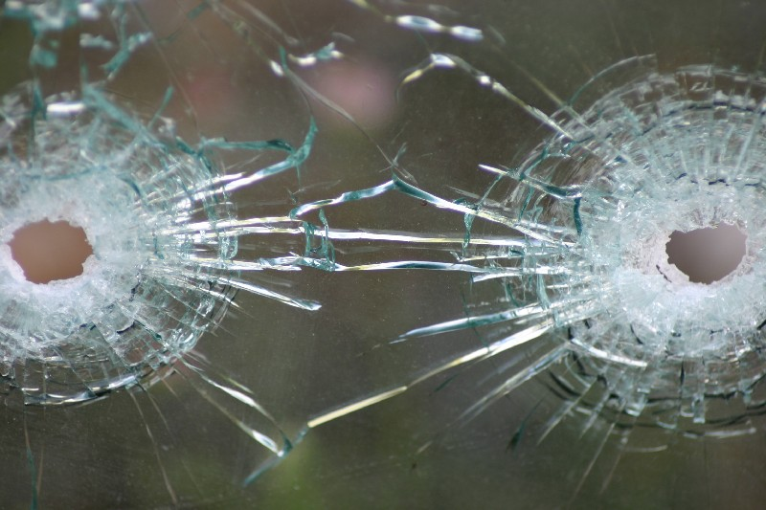
Which bullet was fired first?

Slide 10
bsapp.com

Slide 11
bsapp.com

Slide 12
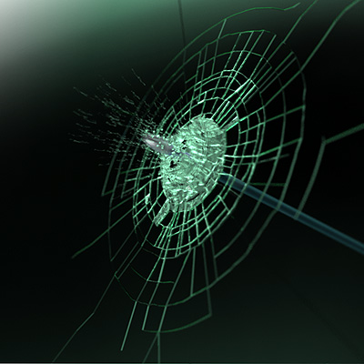
Determining Direction of Impact
High speed projectiles like bullets often leave holes that are wider at the exit side.

Slide 13
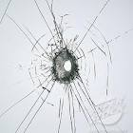
What direction?

Slide 14
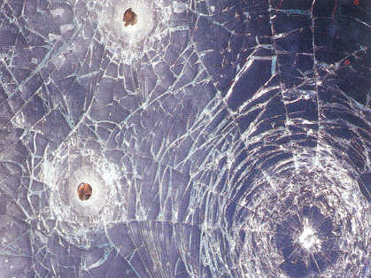
What direction, and in what order?

Slide 15
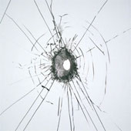
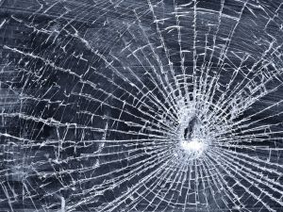
Speed of Impact
Higher speed impacts produce fewer concentric fractures than lower speed impacts.

Slide 16
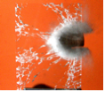
Path of a Bullet Passing through Window Glass
The entry hole will be round if the bullet was fired perpendicular to the pane.
If fired from an angle, glass pieces will be forced out to the opposite side from the shot.
The angles at which bullets enter window glass can help locate the position of the shooter.

Slide 17
Backscatter
Most glass fragments will be carried forward during impact, showing the direction force came from
Some will be projected backwards. This is backscatter, and is sometimes trace evidence found on the perpetrator

Slide 18
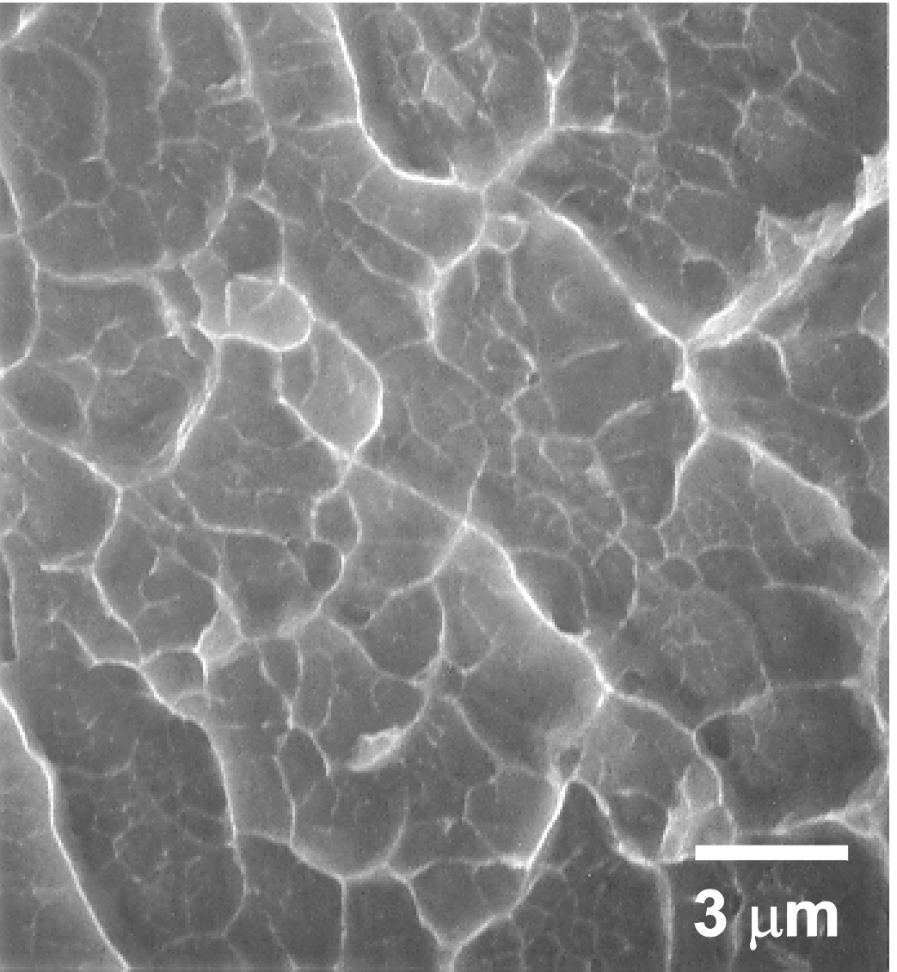
Heat Fracture
Extreme heat can break glass. It causes wavy lines.
Glass will tend to break toward the area of higher temperature.

Slide 19
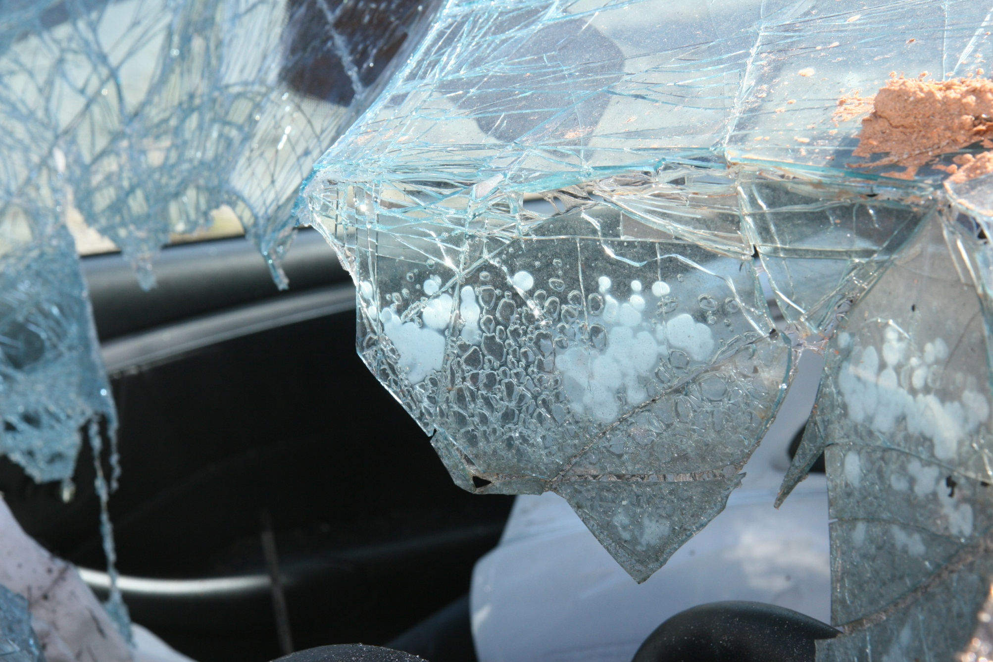
Picture courtesy of Kelsey Nelson

Slide 20
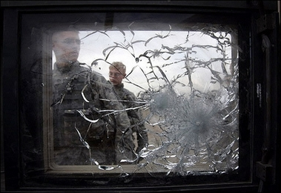
Bulletproof Glass
Made of two or more layers of glass, and sometimes plastic to absorb impact.

Slide 21
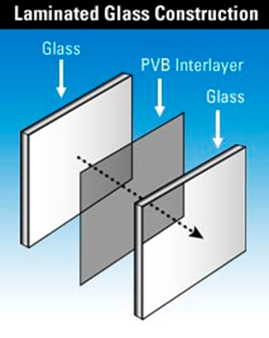
Laminated Glass
Two layers of glass with plastic in middle
Used in windshields, patio doors, etc.
Harder to recognize fracture patterns

Slide 22
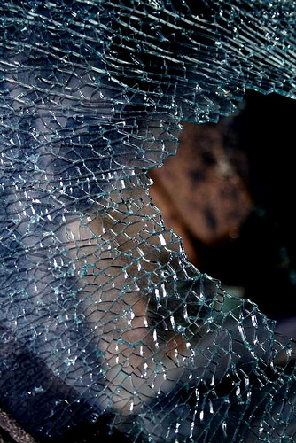
Tempered Glass
Glass is made stronger through the rapid heating and cooling of the glass surfaces. Chemicals can also be used to make this “toughened glass”
Tempered glass does not shatter, it “dices” into small squares

Slide 23
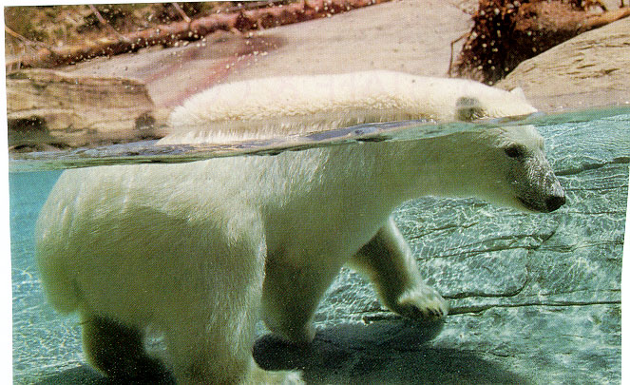
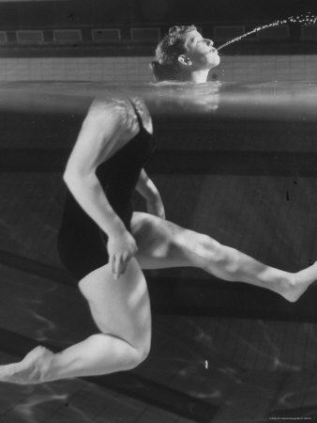
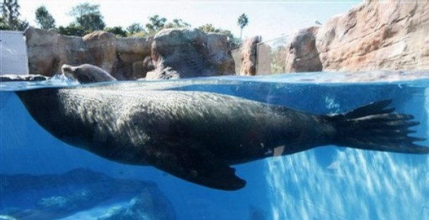
What is going on here?
Notes:
23

Slide 24
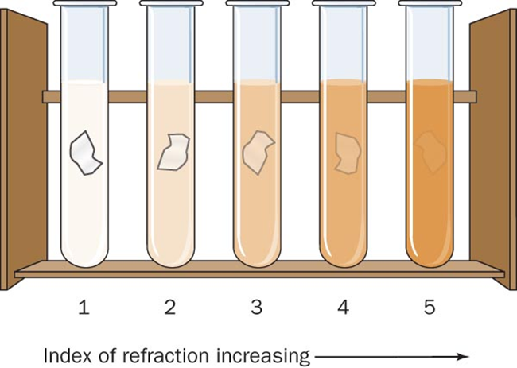
Refractive Index-
Submersion Method – glass fragments are immersed in different liquids whose refractive index is known until it is equal to that of the glass
The “match point” is noted by the disappearance of the Becke Line-glass fragment disappears
Becke Line –a bright halo that is observed near the border of a particle immersed in a liquid of a different refractive index

Slide 25
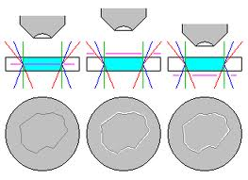
Refractive Index
Becke Line - a halo-like effect appearing at the edges of a glass fragment when the reflective index of the glass and liquid are different
If the line is inside the glass perimeter, the glass index is higher than the index of the liquid
If the line is outside the glass perimeter, the glass index is lower

Slide 26
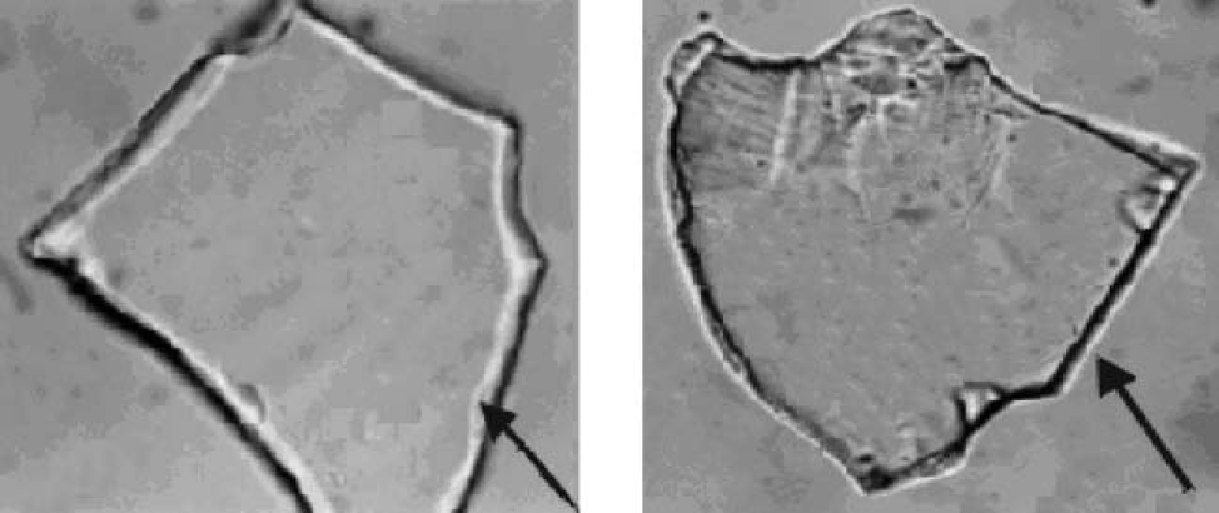

Slide 27
Handling of Crime Scene Glass Samples
Identify and photograph any glass samples before moving them.
Collect the largest fragments that can be reasonably collected.
Identify the outside and inside surface of any glass.
If multiple panes are involved, make a diagram.
Note trace evidence such as skin, hair, blood, or fibers.
Package all materials collected to maintain the chain of custody.

