Slide 1
Fingerprints
SFS2. Students will use various scientific techniques to analyze physical and trace evidence.
Identify and utilize appropriate techniques used to lift and evaluate readable, latent, plastic and visible fingerprints.
Most of this ppt came from Kristen Kohli and several pics came from the FBI.

Slide 2
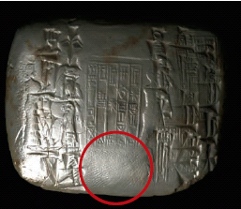
History of Fingerprinting
First known use: In China nearly 4000 years ago as signatures on clay tablets.
In ancient Babylon (dating back to 1792-1750 B.C.), fingerprints pressed into clay tablets marked contracts.

Slide 3

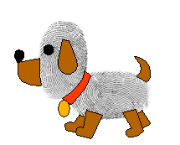
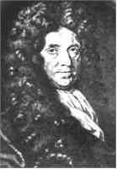
The earliest written study (1684) is Dr. Nehemiah Grew’s paper describing the patterns he saw on human hands under a microscope, including the presence of ridges.

Slide 4
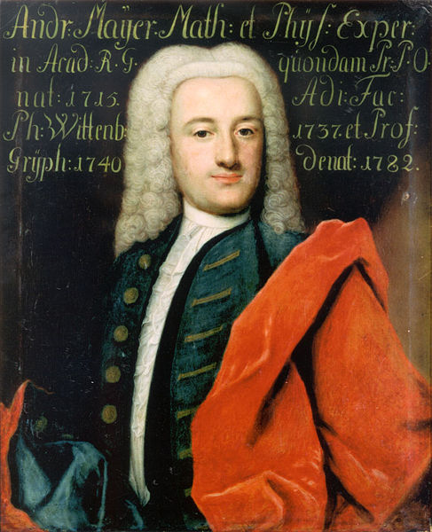
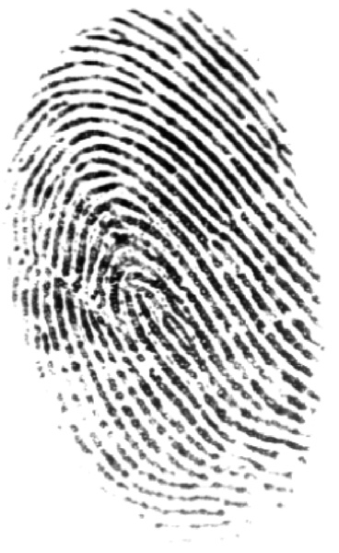
History of Fingerprinting
In 1788, Andreas Mayer was the first to note that no two fingerprints are the same.

Slide 5
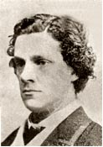
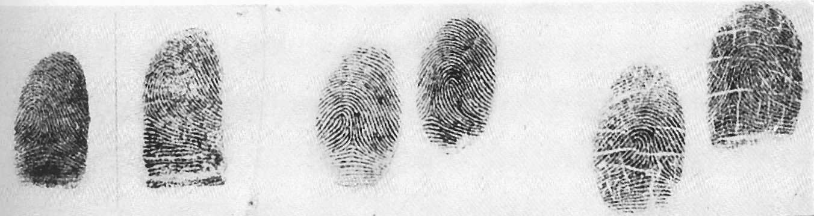
History of Fingerprinting
Sir William Herschel, in 1856, began the collection of fingerprints and noted they were not altered by age.

Slide 6
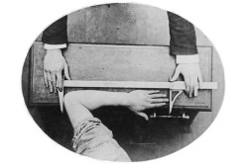
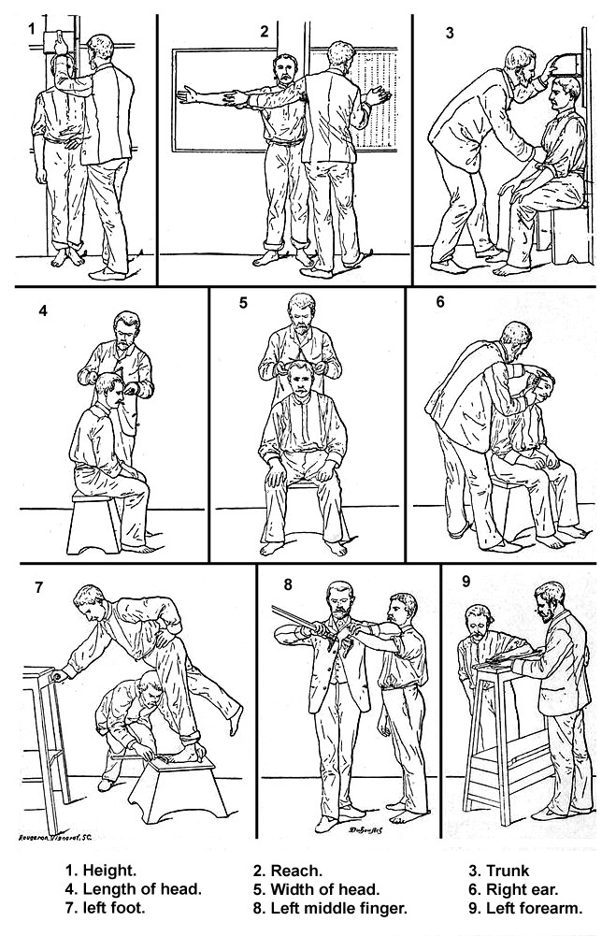
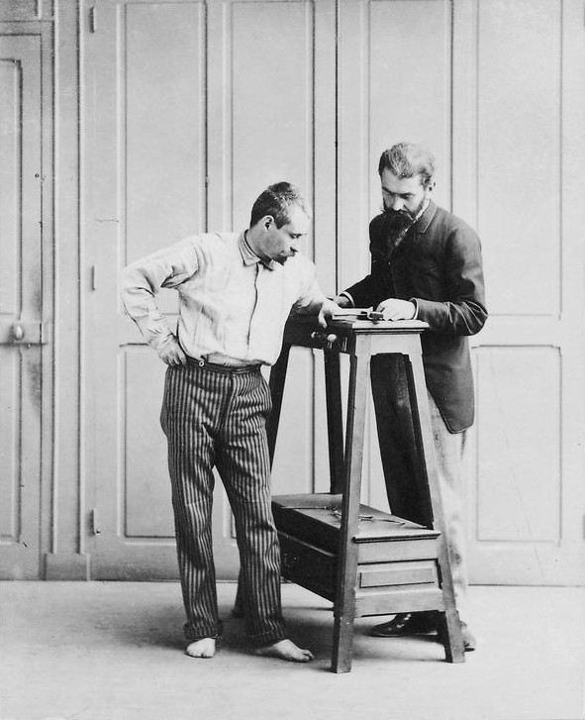
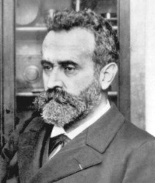
History of Fingerprinting
In 1879, Bertillon began keeping measurements of criminals in police files.

Slide 7
Bertillon Measurements
Here are some of the measurements:
Height
Stretch: Length of body from left shoulder to right middle finger when arm is raised
Bust: Length of torso from head to seat, taken when seated
Length of head: Crown to forehead
Width of head: Temple to temple
Length of right ear
Length of left foot
Length of left middle finger
Length of left cubit: Elbow to tip of middle finger
Width of cheeks
Length of left little finger

Slide 8
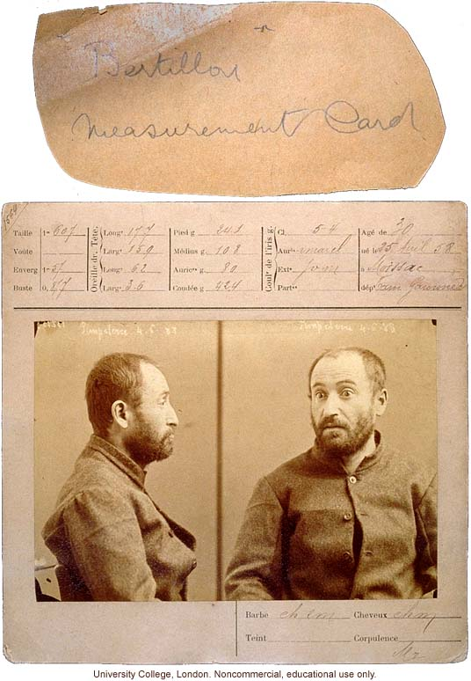

Slide 9
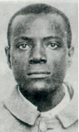
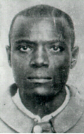
The Wests
Will West's Bertillon Measurements
178.5; 187.0; 91.2; 19.7; 15.8; 14.8; 6.6; 28.2; 12.3; 9.7
William West's Bertillon Measurements
177.5; 188.0; 91.3; 19.8; 15.9; 14.8; 6.5; 27.5; 12.2; 9.6;

Slide 10
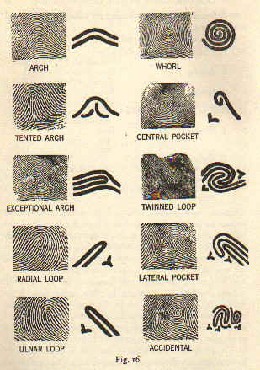
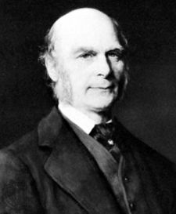
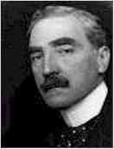
History of Fingerprinting
In 1888, Sir Francis Galton and Sir Edmund Richard Henry both contributed to the fingerprint classification system that is still in use in the United States.

Slide 11
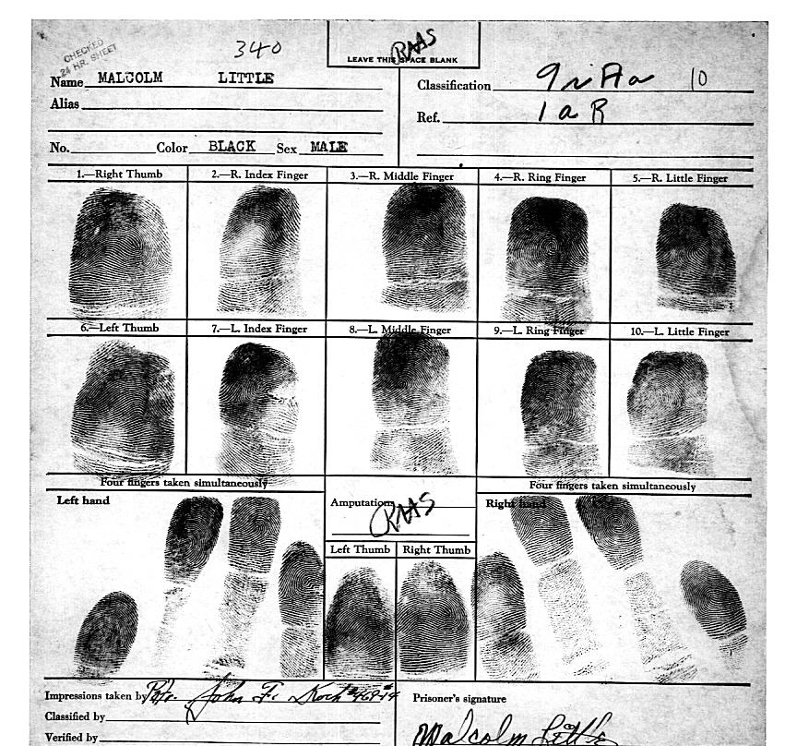
History of Fingerprinting
Beginning in 1896, Sir Henry, with the help of two colleagues, created a system that divided fingerprints into groups. Along with notations about individual characteristics, all ten fingerprints were imprinted on a card (called a ten card).
Link to FBI’s fingerprinting page

Slide 12
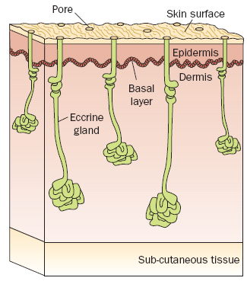
What is a Fingerprint?
Our skin has ridges on the surface to help us grip things.
Water, oil, and salt from our glands mix with dirt in the environment and stick to everything we touch.

Slide 13
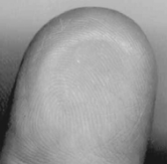
Fundamental Principles of Fingerprints
A fingerprint is an individual characteristic.
A fingerprint will remain unchanged during an individual’s lifetime.
Fingerprints have general characteristic ridge patterns that permit them to be systematically classified.
Did you know?
The koala is one of the few mammals (other than primates) that has fingerprints. In fact, koala fingerprints are remarkably similar to human fingerprints; even with an electron microscope, it can be quite difficult to distinguish between the two.

Slide 14
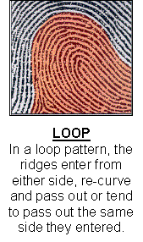
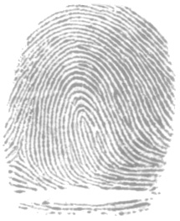
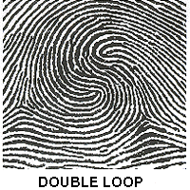
Characteristics of Fingerprints
Three main types:
  Loop - most common, about 65% of all prints
  If the loop opens toward the little finger, it is called an ulnar loop.
  If the loop opens toward the thumb, it is called a radial loop.

Slide 15
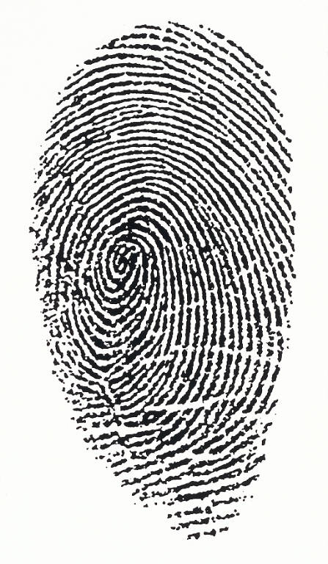
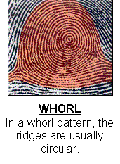
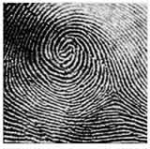
Characteristics of Fingerprints
Whorls – About 30% of all prints patterns
Can be plain, central pocket, double loop, or accidental.

Slide 16
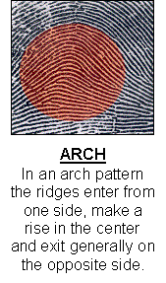
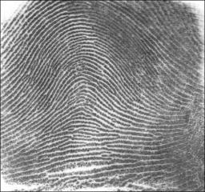
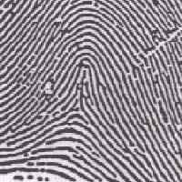
Characteristics of Fingerprints
Arches – About 5% of all fingerprints. Can be plain or tented.

Slide 17
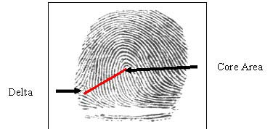
Characteristics of Fingerprints
Forensic examiners look for the presence of a core (the center of a whorl or loop) and deltas (triangular regions near a loop or whorl).
A ridge count is another characteristic that distinguishes one fingerprint from another. The count is made from the center of the core to the edge of the delta.

Slide 18
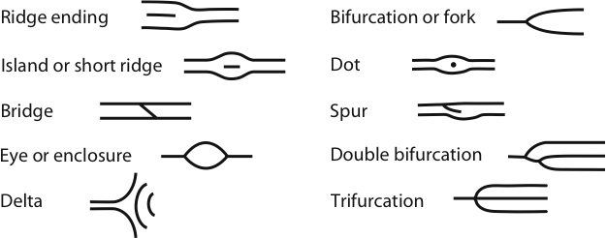
Ridge Characteristics
Minutiae—characteristics of ridge patterns

Slide 19
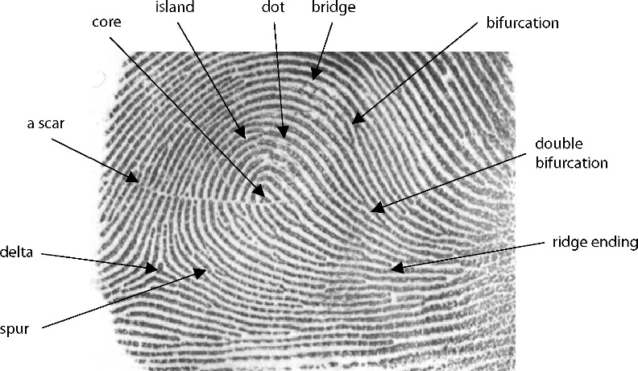
Fingerprint Minutiae

Slide 20
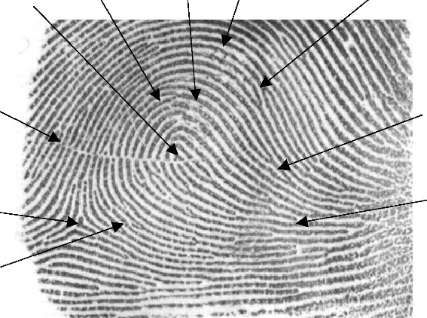
Comparison
There are no legal requirements in the United States on the number of points. Generally, criminal courts will accept 8 to 12 points of similarity.

Slide 21
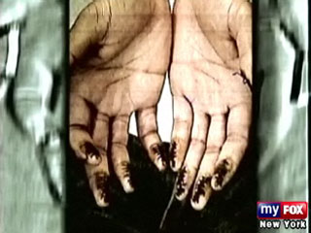
Can Fingerprints Be Changed?
Many criminals have tried, using chemicals or fire.
Most end up with even more recognizable prints because of differences in the scarring patterns.

Slide 22
AFIS
The Automated Fingerprint Identification System - a computer system for storing and retrieving fingerprints
Began in the early 1970’s to:
  Search large files for a set of prints taken from an individual
  Compare a single print, usually a latent print developed from a crime scene

Slide 23
AFIS
By the 1990’s most large jurisdictions had their own system in place. The problem - a person’s fingerprints may be in one AFIS but not in others.
It could take 3 months to run a search.
IAFIS—the FBI’s Integrated Automated Fingerprint Identification system which is a national database of all 10-print cards from all over the country became operational in 1999.

Slide 24
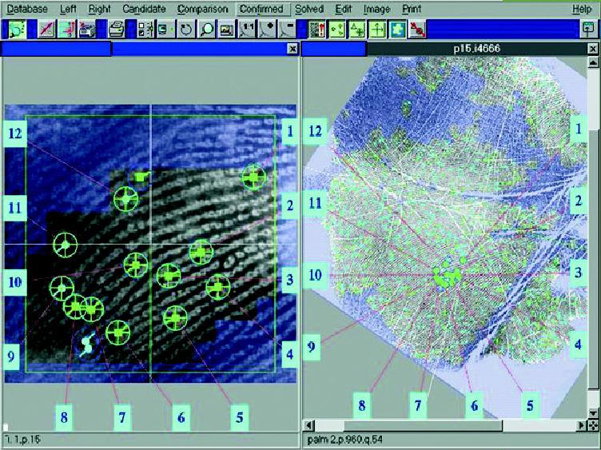
AFIS

Slide 25
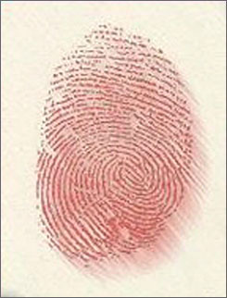
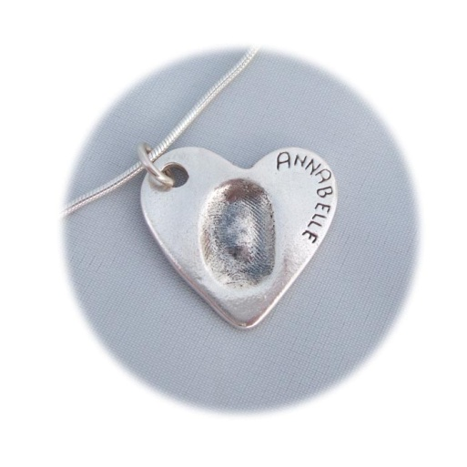
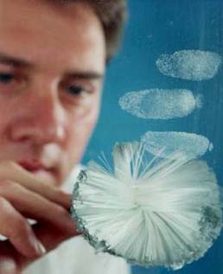
Evidence Types
Three types of prints can be found:
  Patent fingerprints –visible prints left when fingers have a liquid (such as blood) on them.
  Plastic fingerprints – actual indentations made in soft material like clay.
  Latent fingerprints – hidden prints that can be made visible with special techniques
All are individual evidence.

Slide 26
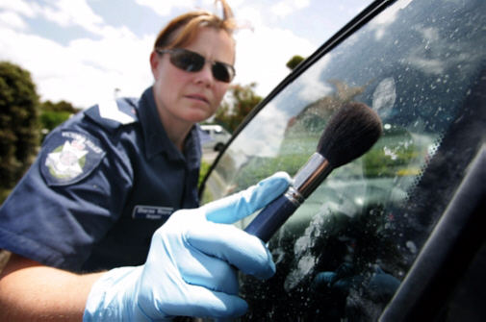
Methods to Collect Fingerprints
Latent prints can be made visible with carbon or talc, and then collected on tape.

Slide 27
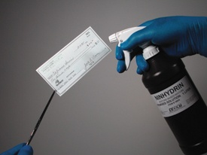
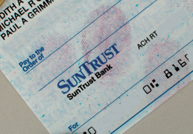
Methods to Collect Fingerprints
Ninhydrin can be sprayed on paper. It reacts with amino acids in sweat to leave a purple print.

Slide 28
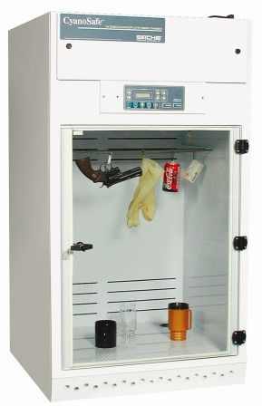
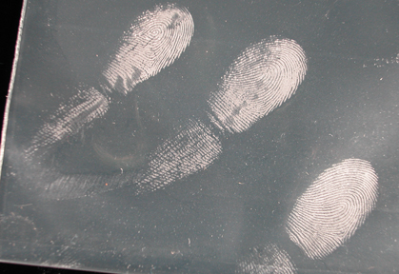
Methods to Collect Fingerprints
Cyanoacrylate (super glue) can be heated in a vapor tent. It sticks to amino acids to get fingerprints on glass, plastic, metal, and skin.

Slide 29


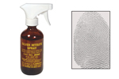
Methods to Collect Fingerprints
Wood or styrofoam objects can be dipped or sprayed with silver nitrate. It reacts with chloride in the salty sweat to show a print.

Slide 30
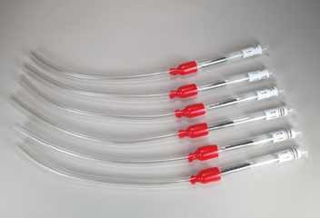
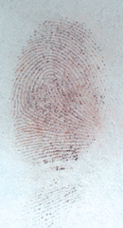
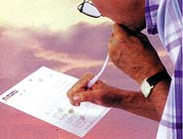
Methods to Collect Fingerprints
Iodine can be heated in a vapor tent or a fuming gun to get prints off of paper, cardboard, and unpainted surfaces. It fades and must be photographed.

Slide 31
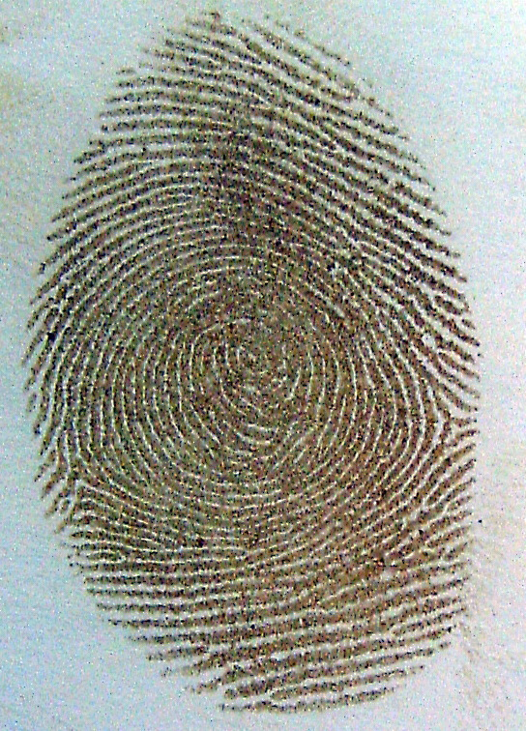
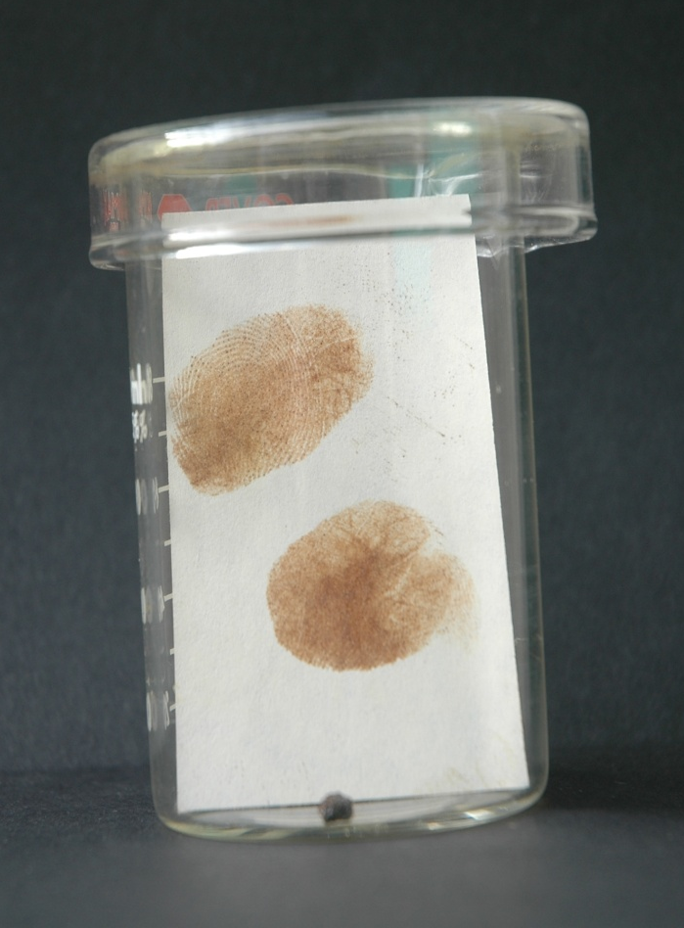
Iodine Fingerprint

Slide 32
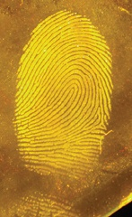


Methods to Collect Fingerprints
Fluorochromes can be sprayed on non-porous items and then viewed with UV light.

Slide 33

Fingerprint Forensic FAQs
How are latent fingerprints collected?

Slide 34

The Future of Fingerprint Technology
Scanning technology can show tiny pore patterns on ridges for better matching.

Slide 35


The Future of Fingerprint Technology
Other physical features such as eye and facial patterns are being used to identify people.

Slide 36

The Future of Fingerprint Technology
Trace evidence in fingerprints is being used to identify traces of explosives or drugs.

Slide 37
Other Prints
Ears—shape, length and width
Voice—electronic pulses measured on a spectrograph
Foot—size of foot and toes; friction ridges on the foot
Shoes—can be compared and identified by type of shoe, brand, size, year of purchase, and wear pattern.

Slide 38

Other Prints
Palm—friction ridges can be identified and may be used against suspects.

Slide 39

Other Prints
Footprints are taken at birth as a means of identification of infants.

Slide 40

Other Prints
Lips—display several common patterns
  Short vertical lines
  Short horizontal lines
  Crosshatching
  Branching grooves

Slide 41

Other Prints
Teeth—bite marks are unique and can be used to identify suspects. These imprints were placed in gum and could be matched to crime scene evidence.

Slide 42

Other Prints
The blood vessel patterns in the eye may be unique to individuals. They are used today for various security purposes.

Slide 43
NGI
Next Generation Identification
Began in 2014--FBI’s newest identification system, slated to replace IAFIS in the future
Uses wide array of biometric identification methods –scars, tattoos, facial, voice, and iris recognition
http://www.fbi.gov/about-us/cjis/fingerprints_biometrics/ngi

