Slide 1
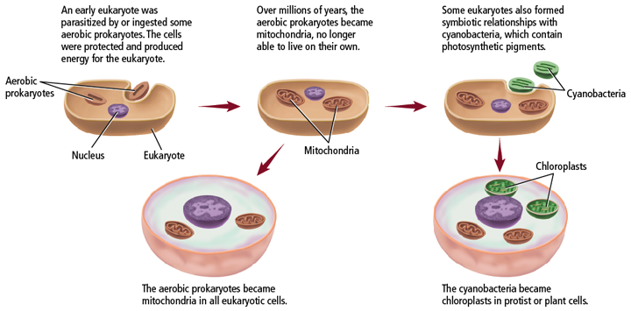
Chapter 14
The History of Life
Endosymbiont theory-the theory that eukaryotic cells evolved from prokaryotic cells; mitochondria and chloroplasts serve as evidence

Slide 2
Chapter 15
Evolution
15.1 Darwin’s Theory of Natural Selection
Natural Selection-success of populations based on their phenotypes and how well they can survive in their environments
“Survival of the Fittest”

Slide 3
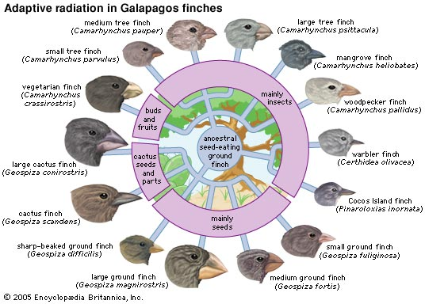
Adaptive Radiation- the emergence of many species from one common ancestor; Darwin’s finches are an example

Slide 4
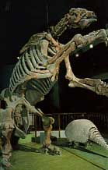
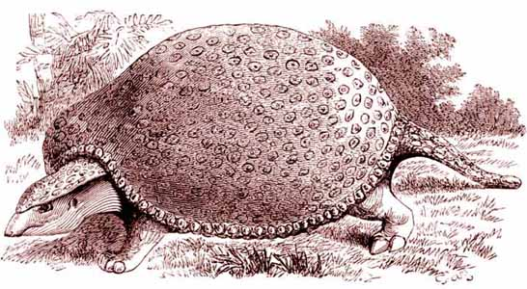
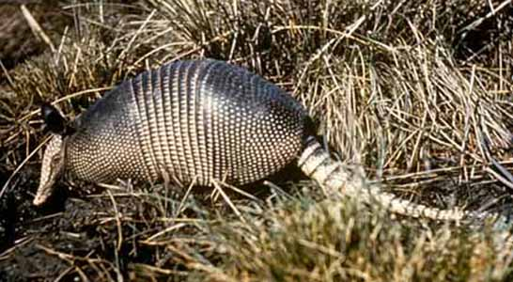
Chapter 15
Evolution
15.2 Evidence of Evolution
Support for Evolution
The fossil record
Provide a record of species that lived long ago.
Show that ancient species share similarities with species that now live.
Glyptodont
Armadillo

Slide 5
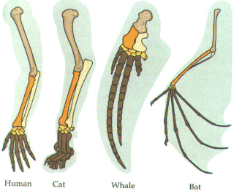
Homologous Structures
Anatomically similar structures inherited from a common ancestor

Slide 6
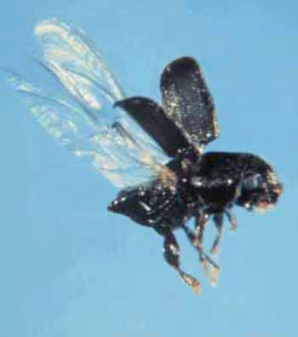
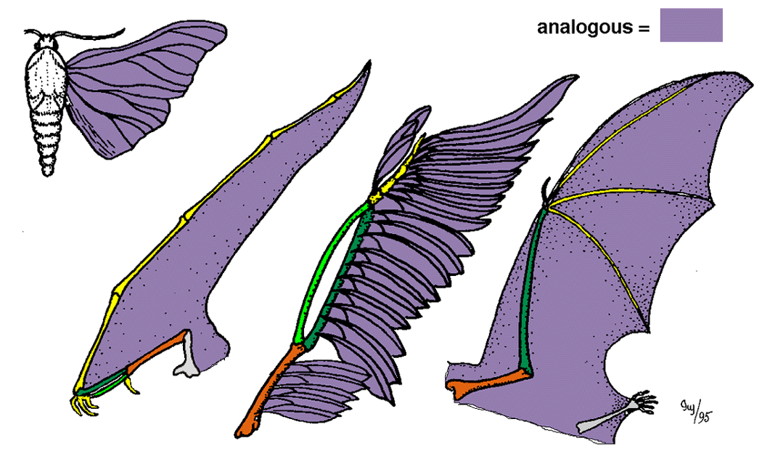
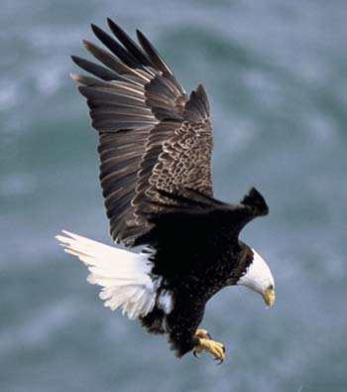
Chapter 15
Evolution
Analogous Structures
Same function but different structure
NOT inherited from
common ancestor.

Slide 7
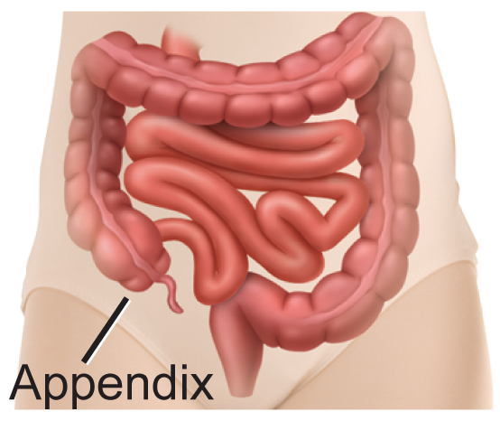
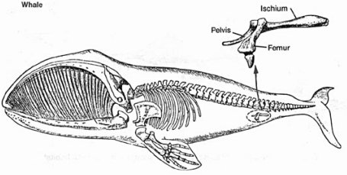
Chapter 15
Evolution
15.2 Evidence of Evolution
Vestigial Structures
Structures that are the reduced forms of functional structures in other organisms.
Evolutionary theory
predicts that features of ancestors that no
longer have a function for that species will
become smaller over time until they are lost.

Slide 8
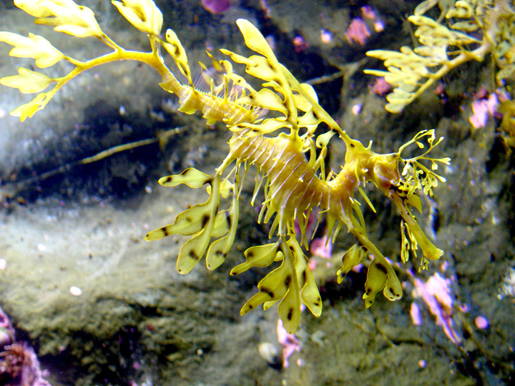
Chapter 15
Evolution
15.2 Evidence of Evolution
Camouflage
Allows organisms to become almost invisible to predators
Leafy sea dragon

Slide 9
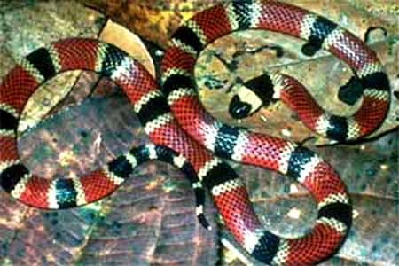
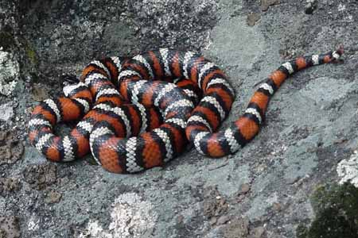
Chapter 15
Evolution
15.2 Evidence of Evolution
Mimicry
One species evolves to resemble another species.
Western coral snake
California kingsnake

Slide 10
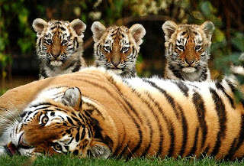
UNIT: Evolution
Biological species-a group of organisms capable of interbreeding and producing fertile offspring

Slide 11
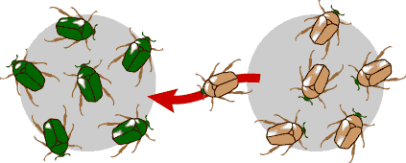
Gene Flow
Genes entering or leaving a population
AKA. Migration
Emigration→ Genes LEAVING a population
Immigration→ INCOMING genes in a population

Slide 12
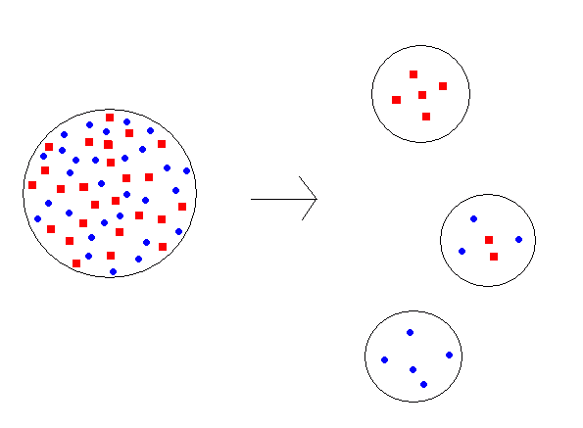
Chapter 15
Evolution
15.3 Shaping Evolutionary Theory
Founder Effect
The loss of genetic variation that occurs when a new population is established by a very small number of individuals from a larger population
random change in a gene pool that happens when a small group leaves a larger group
Island 1
Island 2
Mainland
Island 3

Slide 13
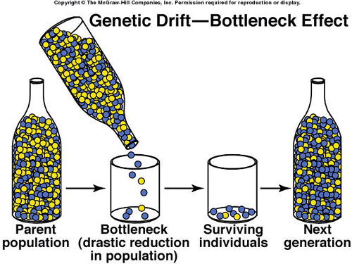
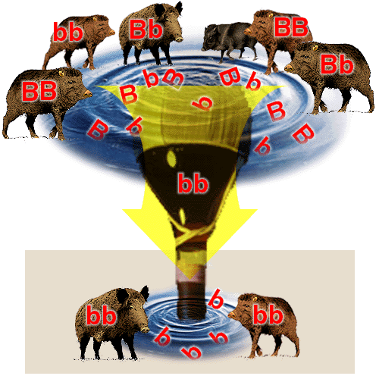
Evolution
15.3 Shaping Evolutionary Theory
Bottleneck
genetic drift resulting from a drastic reduction in population size, often caused by natural disaster

Slide 14
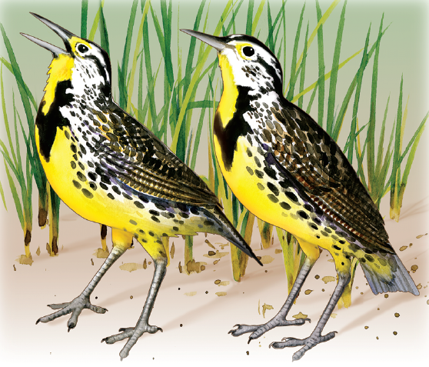
Chapter 15
Evolution
15.3 Shaping Evolutionary Theory
Prezygotic isolation prevents reproduction by making fertilization unlikely.
In behavioral isolation-happens when organisms are not attracted sexually to members of another species due to traits like mating dances or calls
patterns of courtship may be different.
In temporal isolation-happens when organisms breed at different times
In geographical isolation-a physical separation of groups within a population that may lead to speciation
Eastern meadowlark and Western meadowlark

Slide 15
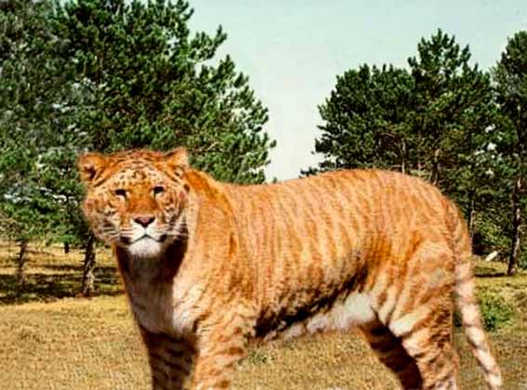
Chapter 15
Evolution
15.3 Shaping Evolutionary Theory
Postzygotic isolation occurs when fertilization
has occurred but
a hybrid offspring
cannot develop
or reproduce.
offspring cannot reproduce, such as mules or ligers
Liger

Slide 16
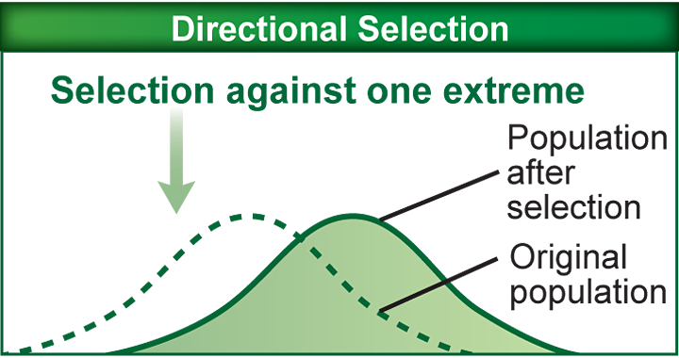
Chapter 15
Evolution
15.3 Shaping Evolutionary Theory
Directional selection makes an organism more fit.
an example of natural selection that favors one end of a phenotypic spectrum and acts against another
Favors the extremes
Ex. Greyhound Dog-bred for extreme speed!
Notes:
Directional selection favors those individuals who have extreme variations in traits within a population. A useful example can be found in the breeding of the greyhound dog. Early breeders were interested in dog with the greatest speed. They carefully selected from a group of hounds those who ran the fastest. From their offspring, the greyhound breeders again selected those dogs who ran the fastest. By continuing this selection for those dogs who ran faster than most of the hound dog population, they gradually produced a dog who could run up to 64km/h (40mph).

Slide 17
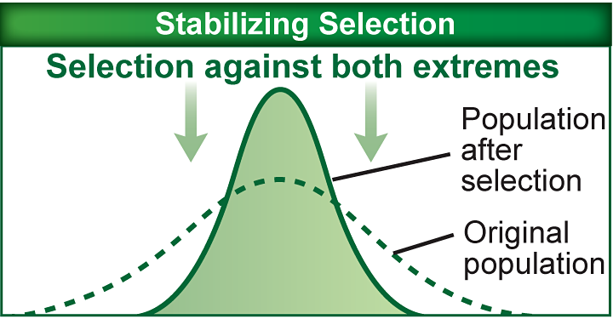
Chapter 15
Evolution
15.3 Shaping Evolutionary Theory
Stabilizing selection natural selection that favors intermediate phenotypes rather than the extreme phenotypes
Siberian Husky-medium height and build helps them do their job in the snow!
Notes:
Stabilizing selection favors the norm, the common, average traits in a population. Look at the Siberian Husky, a dog bred for working in the snow. The Siberian Husky is a medium dog, males weighing 16-27kg (35-60lbs). These dogs have strong pectoral and leg muscles, allowing it to move through dense snow. The Siberian Husky is well designed for working in the snow. If the Siberian Husky had heavier muscles, it would sink deeper into the snow, so they would move slower or would sink and get stuck in the snow. Yet if the Siberian Husky had lighter muscles, it would not be strong enough to pull sleds and equipment, so the dog would have little value as a working dog. So stabilizing selection has chosen a norm for the the size of the Siberian Husky.

Slide 18
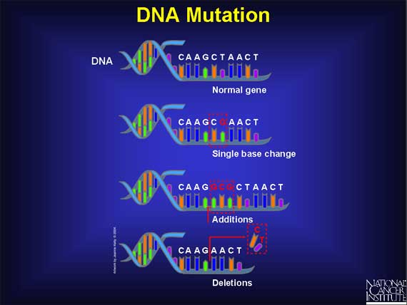
A mutation a change in DNA, may cause evolution in future populations

