Slide 1
UNIT: DNA and RNA How is the genetic code contained in DNA and how do cells pass on this information through replication?
I. History of DNA
A. 1928-Griffith wanted to know how bacteria make people sick (looking at pneumonia).
1. Used mice and two types of bacteria (1 caused pneumonia; 1did not).
2. The mice injected with disease causing bacteria died.
3. The mice that were injected with harmless bacteria lived.
4. Killed bacteria with heat then injected mice→mice lived.
5. Mixed heated bacteria with live harmless bacteria→mice
died.
6. Somehow the heated disease bacteria passed their genes to the harmless live bacteria → called transformation.

Slide 2
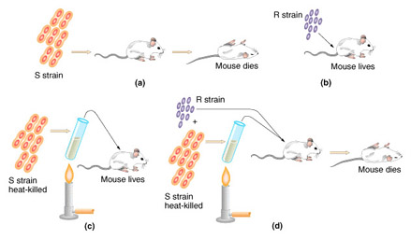
UNIT: DNA and RNA How is the genetic code contained in DNA and how do cells pass on this information through replication?

Slide 3
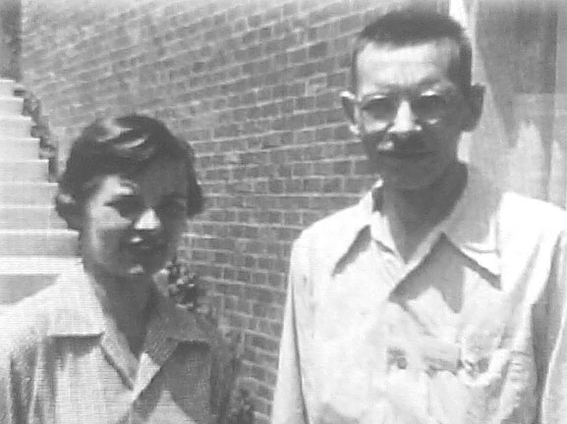
UNIT: DNA and RNA
B. In 1944 Avery and other scientists wanted to know which
molecule was important for transformation.
discovered that the nucleic acid DNA stores and then
transmits the genetic information from one generation
to the next.

Slide 4
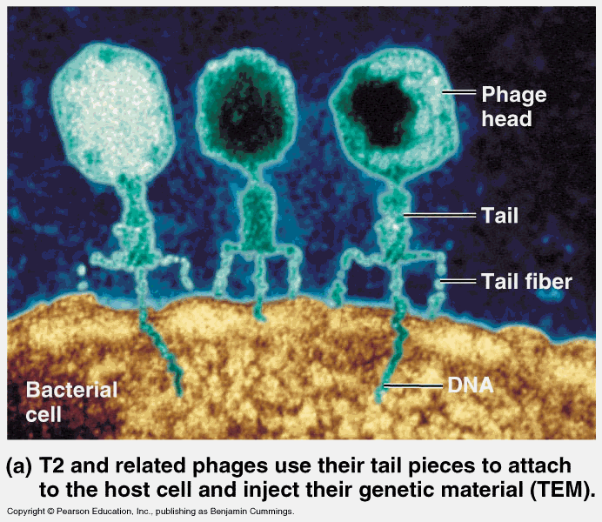
UNIT: DNA and RNA
C.1952-Hershey and Chase took E.coli (bacteria) and killed it
with a virus called a bacteriophage.
1. found that DNA from the virus went into the
bacteria=knew it was DNA

Slide 5
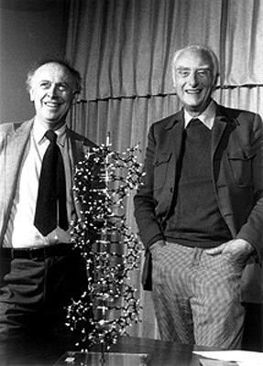
UNIT: DNA and RNA
D. 1953Watson and Crick solved the structure debate. Used
wire and tin to get the DNA structure.
1. Structure of DNA (helical, or twisted): 2 strands

Slide 6
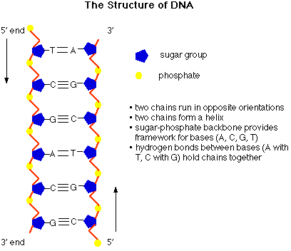
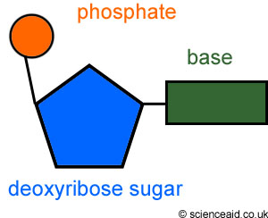
DNA: The genetic code
2. DNA is made up of nucleotides
A. Nucleotides are made up of 3 parts
1. Sugar
2. Phosphate
3. Base
3. The bases are Adenine, Cytosine, Thymine and Guanine
A pairs with T C pairs with G

Slide 7
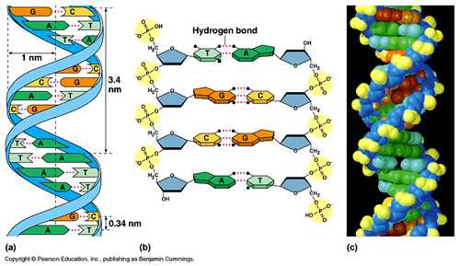
The structure of DNA
4. DNA is Double Stranded
5. Hydrogen bonds connect the two strands together.
6. Pair the following strand with its complementary strand
A-T-T-G-C-T-A-A-T
T-A-A-C-G-A-T-T-A

Slide 8
DNA Replication a.k.a. DNA Synthesis
DNA is replicated (copied) before cell reproduction begins so that the genetic information is copied and passed on to new cells

Slide 9
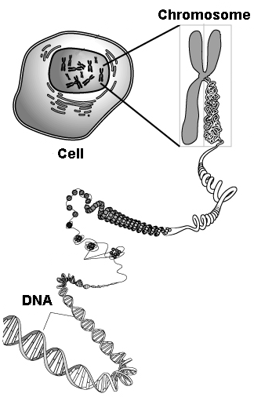
DNA Replication a.k.a. DNA Synthesis
II. DNA Replication
A. DNA replicates (makes a new strand from the original strand or template).
Occurs at hundreds of places on a chromosome
A chromosome contains both DNA and protein tightly packed together to form a substance called chromatin.

Slide 10
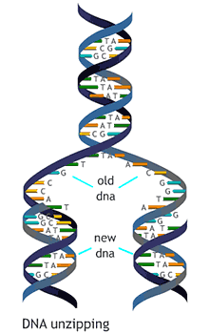
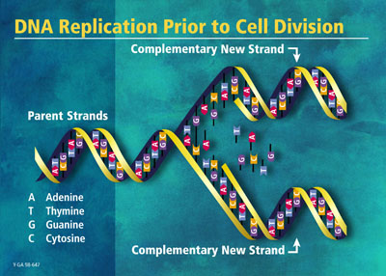
DNA Replication a.k.a. DNA Synthesis
1. Steps in Replication
a. Helicase (enzyme)-unzips DNA and is pulled apart
b. Bring in DNA polymerase and nucleotides
c. Hook up backbone with ligase
d. get 2 Identical DNA strands

Slide 11
DNA Replication
http://www.phschool.com/atschool/phbio/active_art/dna_replication/index.html
http://highered.mheducation.com/sites/0072943696/student_view0/chapter3/animation__dna_replication__quiz_1_.html

