Slide 1
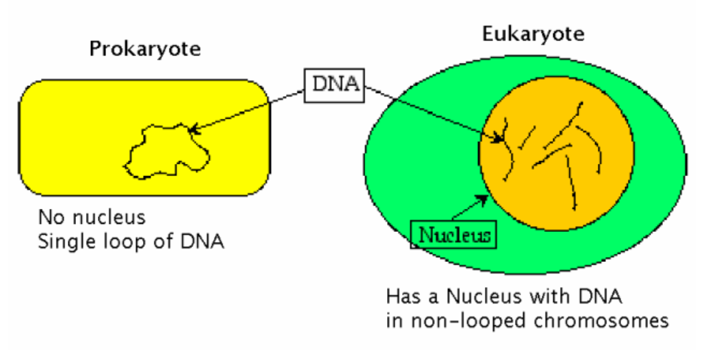
UNIT: DNA and RNA How does DNA store and transmit genetic information?
Quick Review:
DNA is found in the nucleus of eukaryotic cells
What are 2 types of nucleic acids? DNA and RNA
Why is DNA so important? Because it is the genetic code
life!
DNA is a polymer (Macromolecule)
made up of repeating subunits (monomers) called nucleotides

Slide 2
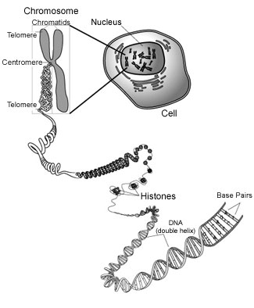

Slide 3
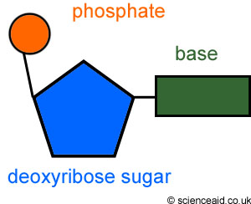
DNA: The genetic code
The genetic code is the sequence(order) of DNA nucleotides (monomer)
Remember: a DNA nucleotide is made of:
1) Phosphate group
2)5-Carbon sugar-deoxyribose
3) Nitrogen base-Adenine (A), Thymine (T), Guanine (G) or Cytosine (C)

Slide 4
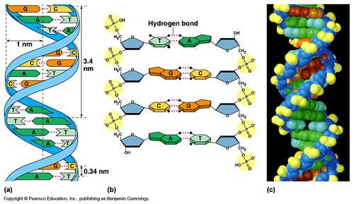
The structure of DNA
The structure of DNA is called a double helix because DNA is made of 2 long chains of nucleotides that are a twisted ladder
If we untwist the 2 strands of the nucleotides then…
The sides of the “ladder” are the 5 carbon sugars and phosphate group
The rungs(steps) of the “ladder” are the complimentary base pairs: A------------T & C-----------------G
Hydrogen bonds (weak) hold the 2 nitrogen bases together

Slide 5
DNA Replication a.k.a. DNA Synthesis
DNA is replicated (copied) before cell reproduction begins so that the genetic information is copied and passed on to new cells

Slide 6
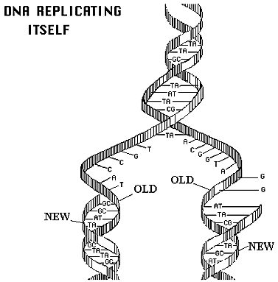
DNA Replication
Steps of DNA replication
1. Enzymes unwind and unzip the double helix
2. Each strand serves as a template (guide) for building a new DNA molecule
3. With the help of the enzyme DNA Polymerase-Free nucleotides bond to the template (A-T & C-G)
forming a complimentary strand
4. The final product: 2 new identical DNA molecules

Slide 7
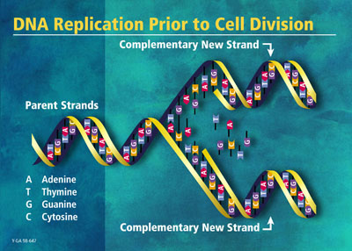
DNA Replication
http://www.phschool.com/atschool/phbio/active_art/dna_replication/index.html

