Slide 1
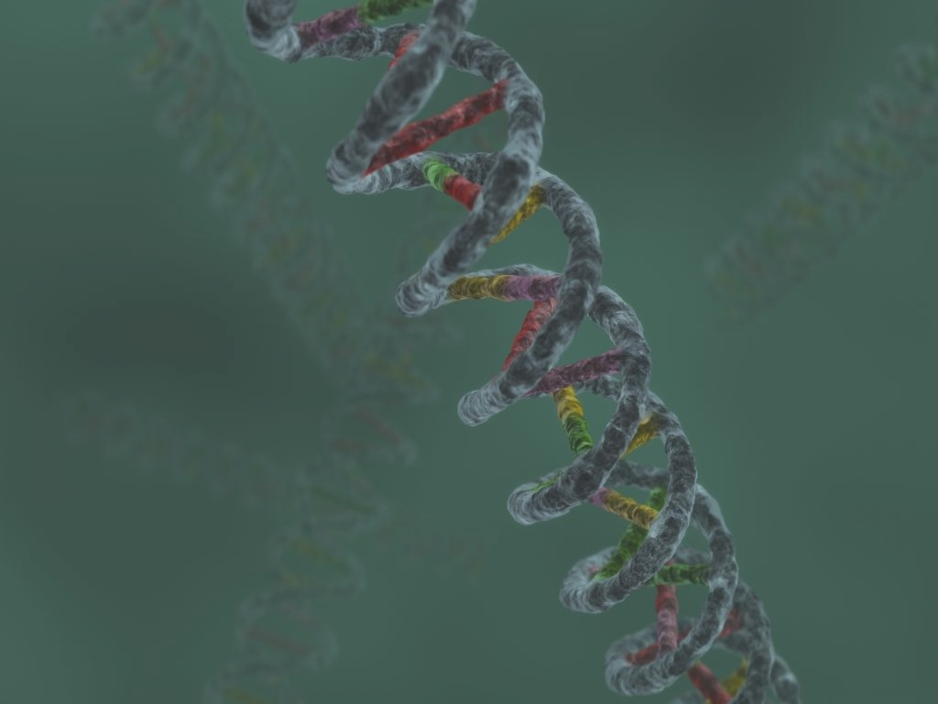
DNA Fingerprinting
Chapter 7
SFS1. Students will recognize and classify various types of evidence in relation to the definition and scope of Forensic Science
SFS3. Students will assess how the analysis of DNA, toxicology, serology, and illicit drugs are used for forensic investigations
Compare short tandem repeat patterns (STR) and relate to identifying the DNA of an individual.
Understand the use of the DNA database for DNA profiling.
most of this ppt comes from K. Kohli’s site

Slide 2
Historical Information
James Watson and Francis Crick—1953 discovered DNA configuration
Alec Jeffreys—1985 isolated DNA markers developed the DNA fingerprinting
Kary Mullis—1985 developed PCR testing
1988—FBI starts DNA casework
1998—FBI launches CODIS database

Slide 3
Where Is DNA Found?
Nucleated body cells
white blood cells, semen, saliva, urine, hair root(with follicle cells), teeth, bone, tissue
Red blood cells have no nuclei

Slide 4
DNA
A double stranded macromolecule because of nucleotide base pairing
A → T (Always)
C → G (Always)
99.9% the same in humans
0.1% is different
Use the 0.1% to generate a DNA profile of an individual

Slide 5
Uses of DNA Profiling
identify suspects or victims
exonerate individuals
determine maternity or paternity
match organ donors
identify human remains

Slide 6
Avoiding contamination
Use disposable everything
Avoid talking in the evidence area
Air-dry evidence or freeze it
cool and dry during transportation and storage

Slide 7
Packaging Biological Evidence
Dried blood
swap with clean cotton swab dipped in distilled water
Standard/reference DNA specimens must also be collected
blood or the buccal swab
DNA

Slide 8
How is DNA processed?

Slide 9
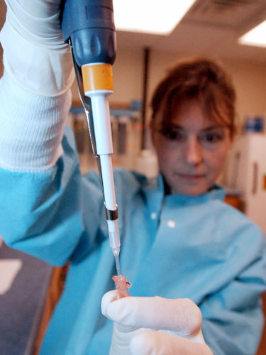
Step One: Extraction
Cells are treated to separate the DNA from everything else

Slide 10
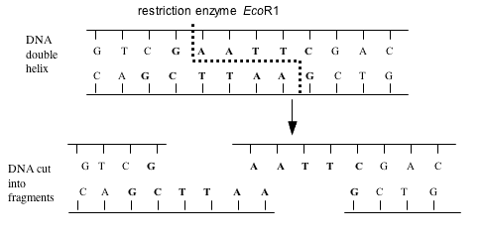
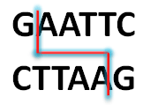
Step Two: Restriction Fragments
DNA is cut with restriction enzymes

Slide 11
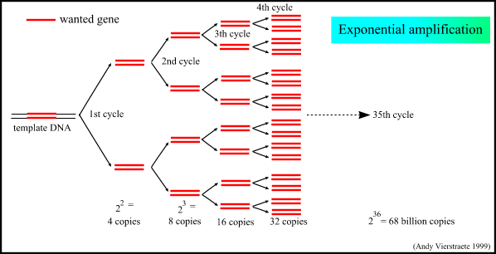
Step Three: Amplification
Amplification: polymerase chain reaction (PCR) makes more DNA by copying it over and over again

Slide 12
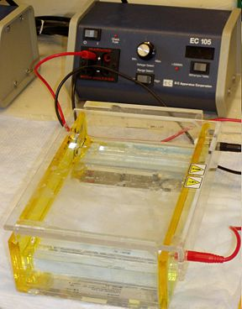
Step Four: Gel Electrophoresis
DNA samples are loaded into wells in agar
loaded agar is placed in a gel box and covered with buffer solution

Slide 13
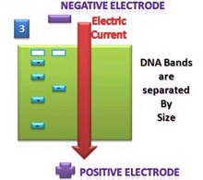
Step Four: Gel Electrophoresis (continued)
An electrical current is passed through the box
DNA moves to + electrode

Slide 14
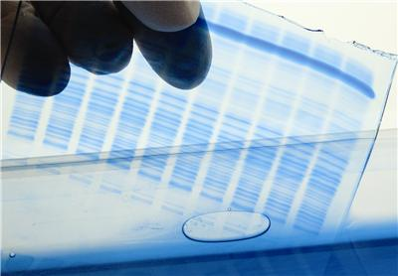
Step Four: Gel Electrophoresis (continued)
Shorter pieces of DNA travel farther through the gel, leaving a banding pattern
DNA is stained for viewing

Slide 15
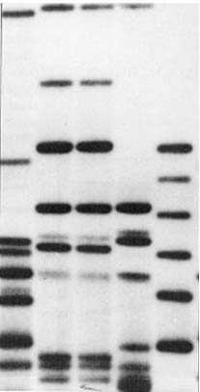
Step Five: Analyzing Results
Southern blotting to allow specific fragments to be compared

Slide 16
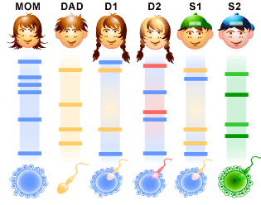
Step Five: Analyzing Results (continued)
Samples from children have bands that are also found in one or the other of their parents

Slide 17
Short Tandem Repeats (STRs)
The latest method of DNA typing
They serve as useful markers for identification
Advantages:
less susceptible to degradation
ideal for multiplication by PCR

Slide 18
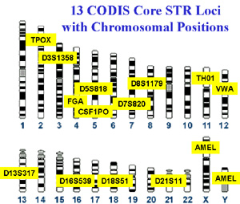
STR’s
A high degree of individualism
Currently, the US has standardized 13 STR’s for entry into CODIS

Slide 19
CODIS
Combined DNA Index System: a computer software program developed by the FBI that maintains local, state, and national databases of DNA profiles

Slide 20
Mitochondrial DNA
Analyzes DNA found in cell mitochondria rather than from the nucleus
Inherited maternally
Uses small amounts of DNA
FBI does mitochondrial analysis on case by case basis
Private labs will process - $1500 or more per sample

Slide 21
“John Doe” Warrant
DNA profile is used as the description on the arrest warrant
First “JD” warrant issued in 1999 – Wisconsin
“JD” warrant states that investigators can arrest anyone with matching DNA profile

Slide 22
http://learn.genetics.utah.edu/content/labs/

