Slide 1
Forensic Anthropology
SFS2. Students will use various scientific techniques to analyze physical and trace evidence.
Evaluate how post mortem changes are used to determine probable time of death
SFS5 Students will evaluate the role of Forensics as it pertains to Medicolegal Death Investigation
Identify the various causes of death
Analyze evidence that pertains to the manner of death
Interpret various modes of death.

Slide 2
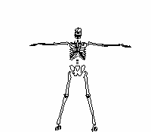
What Bones Can Tell Us
Osteology is the study of bones
There are 206 bones in an adult (if they have all they are supposed to have) and over 300 in a baby
Bones contain a record of the physical life.
Analyzing bones can reveal clues to such things as gender, age, height, and health.

Slide 3
How Bones Connect
Bones are held together by:
cartilage—wraps the ends of bones and keeps them from scraping one another.
ligaments—bands that connect two or more bones together.
tendons—connect muscle to bone.
Until about 30 years of age, bones increase in size.
Deterioration after 30 can be slowed with exercise.

Slide 4
Done by measuring the long bones: humerus, radius, ulna, femur, tibia, & fibula
Length is put into a formula that is different depending on race and gender.
Male Female
femur x 2.23 + 69.08 femur x 2.21 +61.41
tibia x 2.39 + 81.68 tibia x 2.53 + 72.57
humerus x 2.97 + 73.57 humerus x 3.14 + 64.97
radius x 3.65 + 80.40 radius x 3.87 + 73.50

Slide 5
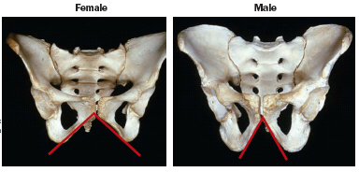
Distinguishing Gender – Pelvis
Subpubic angle –90° in females, less in males

Slide 6
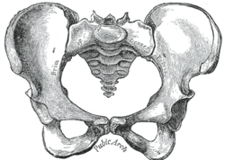
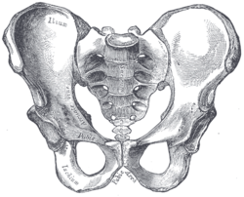
Distinguishing Gender – Pelvis
Pelvic cavity – Oval (F) vs. heart shaped (M)
Sacrum – curved out in females, inward in males
Female pelvis may have scarring from childbirth.

Slide 7
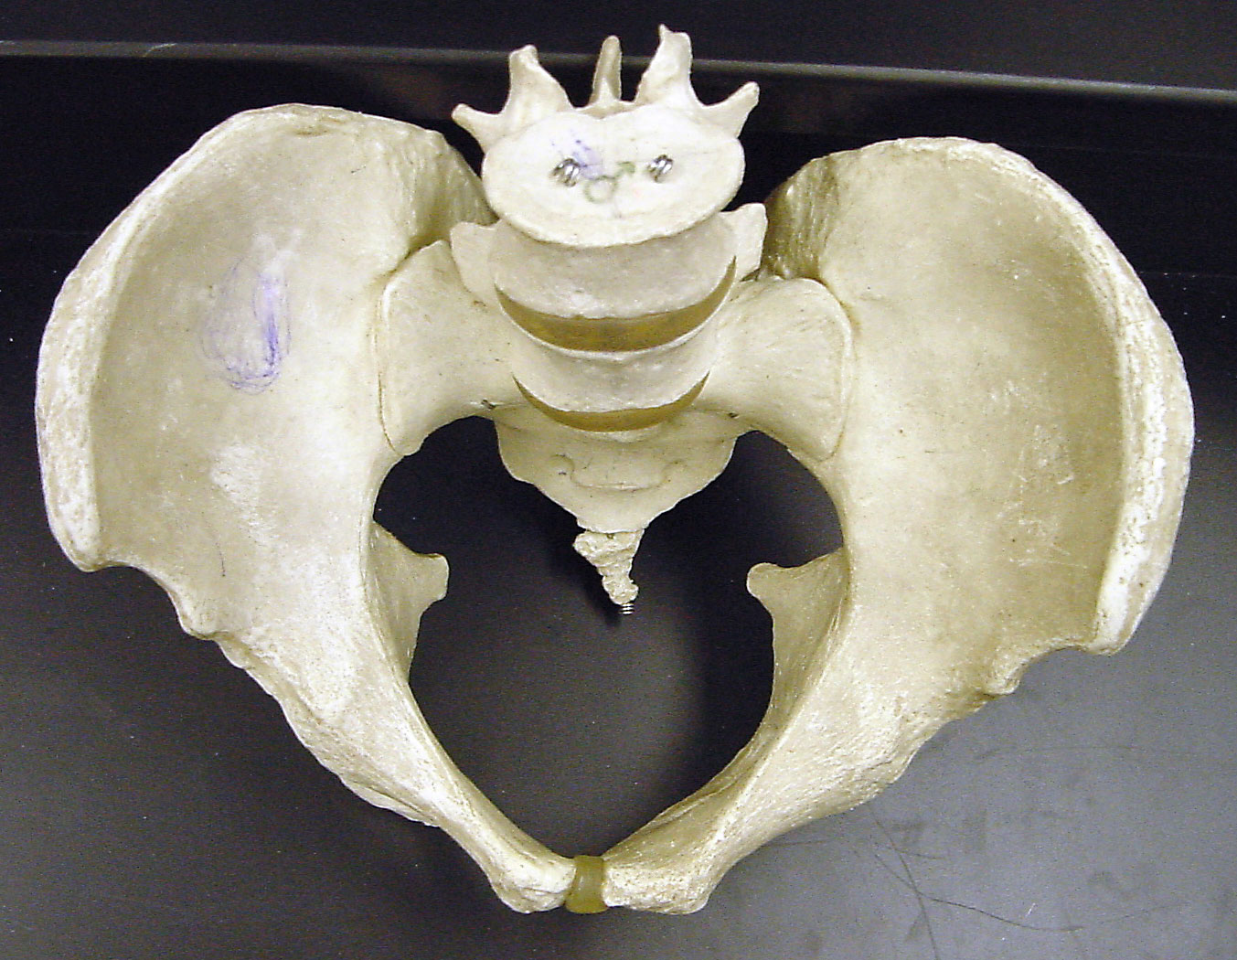
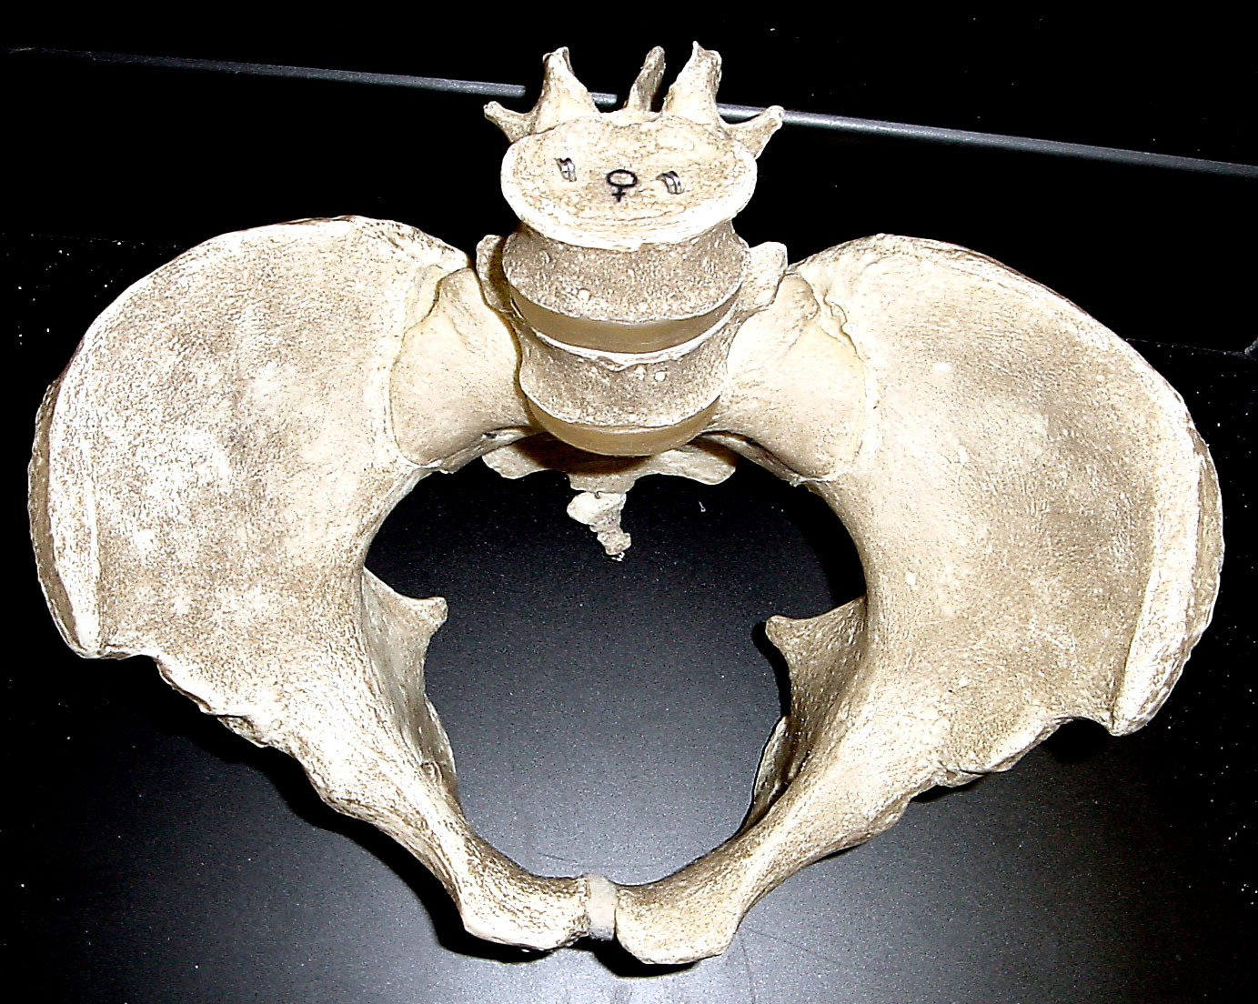
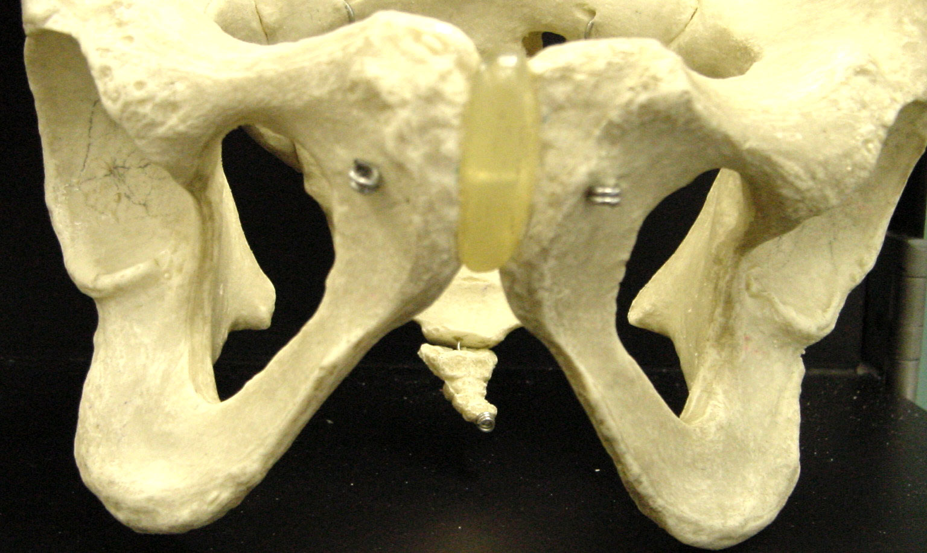
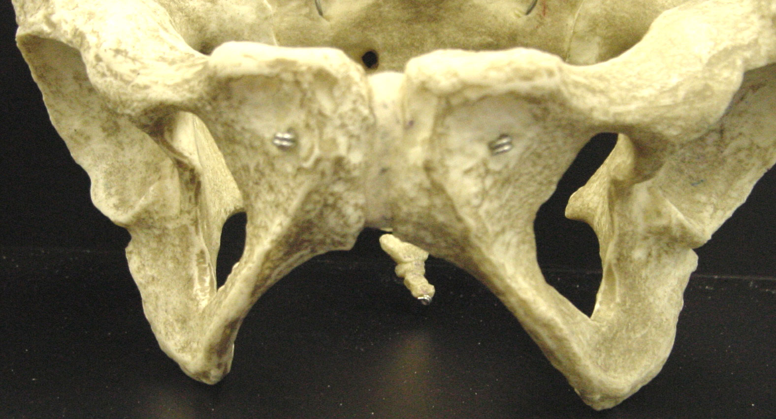
Male Female
Sub Pubic Angle

Slide 8
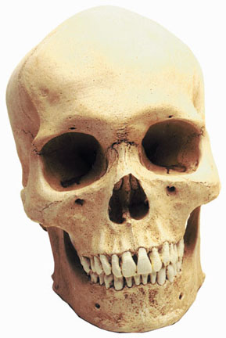
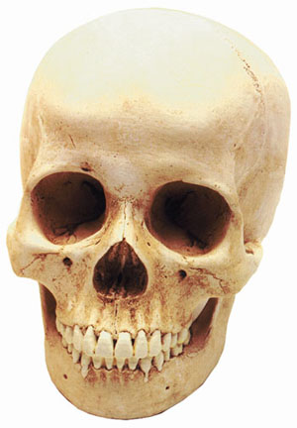
Distinguishing Gender - Skulls
Jaw shape (more square vs. V-shaped)
Brow ridge (thicker vs. thinner)
Eye shape (square vs. round)
Male
Female

Slide 9
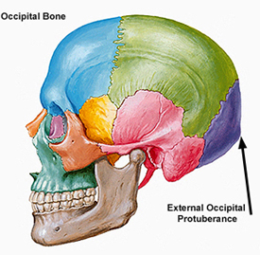
Distinguishing Gender - Skulls
Occipital Protuberance (present in males)

Slide 10
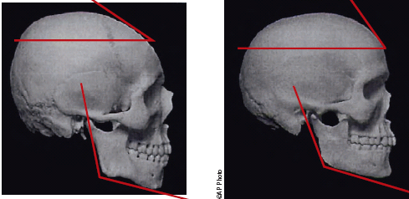
Distinguishing Gender - Skulls
Jaw angle – about 90° vs. greater than 90°
Frontal bone – low & sloping vs. high & rounded
Surface – rough & bumpy vs. smooth
Male
Female

Slide 11
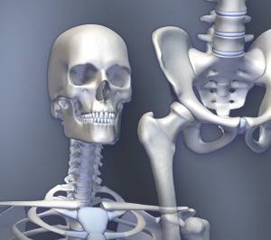
Distinguishing Gender – Thigh Bones
The femur is thicker in males and joins the pelvis at a straighter angle than in females.

Slide 12
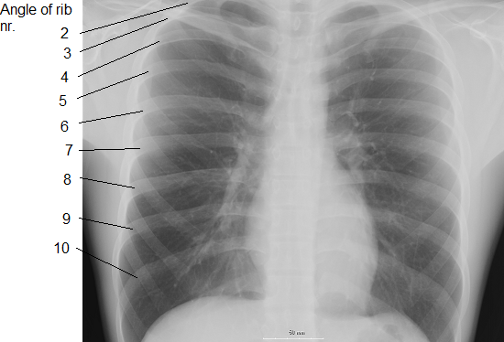
Gender Differences
The ribcage and shoulders of males are generally wider and larger than that of females.
Notes:
It has been noted that 37% of females lack the floating eleventh and twelfth ribs. This has been attributed to the Lotfi Hormonal Theory, where the raised serum testosterone levels during puberty shows a direct correlation with osteoblast activity in the chest cavity. This causes the growth of the eleventh and twelfth ribs. If Acromegaly coincides with puberty, a thirteenth rib (more commonly seen on the left) is seen in 67% of patients.

Slide 13
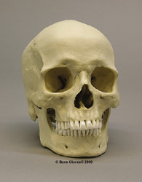
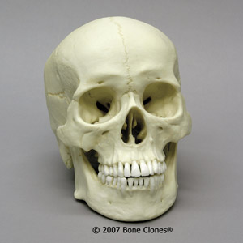
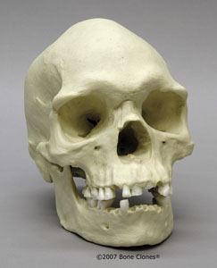
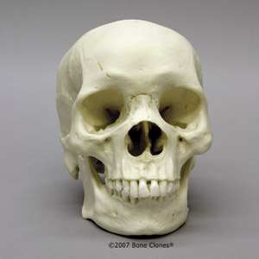
Distinguishing Race
Difficult due to mixed heritage
Done by comparing shape of eye sockets, absence or presence of nasal spine, measuring the nasal opening, and comparing the projection of the upper jaw.

Slide 14
Race
An experienced forensic anthropologist can generally place skulls into one of three groups:
Caucasoid—European, Middle Eastern, and Indian descent
Negroid—African, Aborigine, and Melanesian descent
Mongoloid—Asian, Native American and Polynesian descent

Slide 15
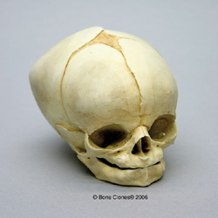
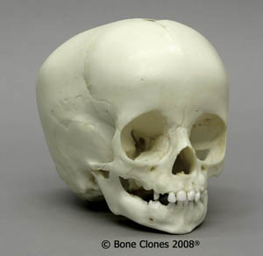
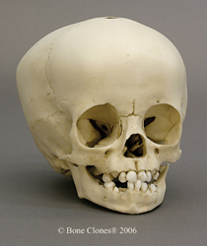
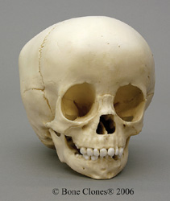
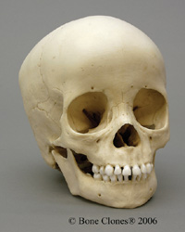
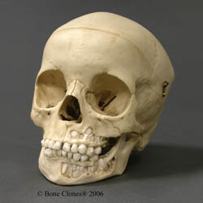
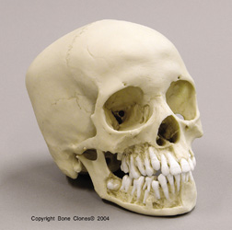
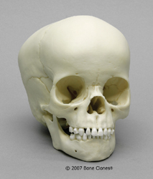
Estimating Age - Skull
Skull plates grow together, forming suture marks.

Slide 16
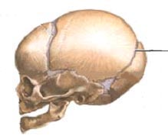
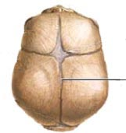
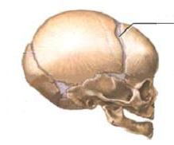
Age
By about age 30, the suture at the back of the skull will have closed.
By about age 32, the suture running across the top of the skull, back to front, will have closed.
By about age 50, the suture running side to side over the top of the skull, near the front, will have closed.

Slide 17
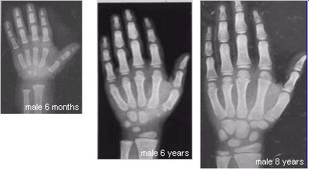
Estimating Age – Cartilaginous Lines
Many bones grow together as we age, replacing cartilage with bone.
Different bones fuse at different ages.

Slide 18
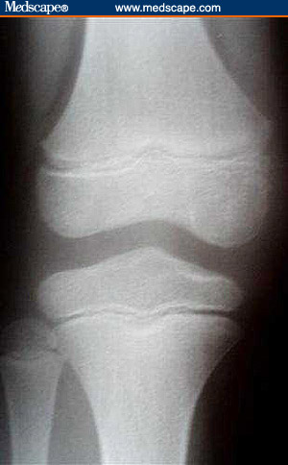
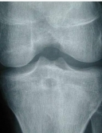
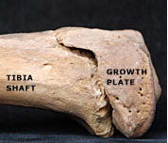
Estimating Age – Cartilaginous Lines
In long bones, the line of remaining cartilage is called the epiphysis.
It disappears at different ages in different long bones.

Slide 19
Skeletal Trauma Analysis
Forensic anthropologists often determine if damage to bones occurred before or after death.
Definite distinctions exist between patterns on bones made by weapons and the patterns created by the environment after death.
Sharp-force trauma, blunt-force trauma, gunshot wounds, and knife wounds all have distinctive patterns.

Slide 20
Facial Reconstruction
After determining the sex, age, and race of an individual, facial features can be built upon a skull to assist in identification. Erasers are used to make tissue depths at various points on the skull. Clay is used to build around these markers and facial features are molded.

Slide 21
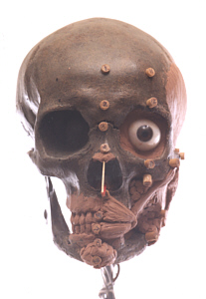
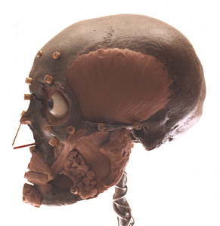
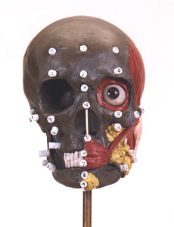
Facial Reconstruction
Add tissue depth markers
Based on largely on sex and race
Begin to add common fat deposits and underlying muscles

Slide 22
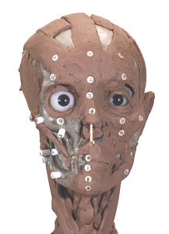
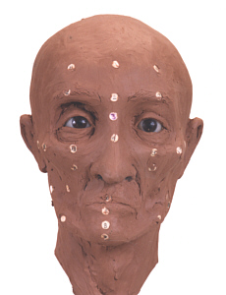
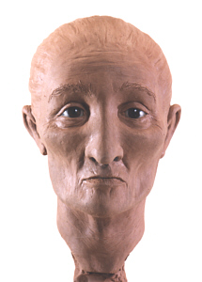
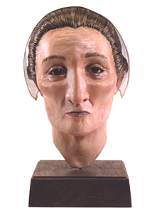
Facial Reconstruction
Add muscle to average depth for race
Add skin, nose, ears
Add features related to age and race (wrinkles, eye and hair color)
Add clothing etc appropriate for the time period, religious affiliations, etc

Slide 23
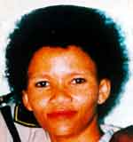
Facial Reconstruction

Slide 24
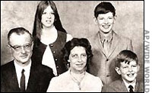
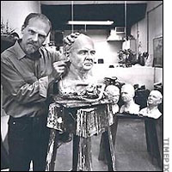
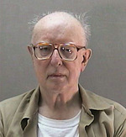
Real Life
John List killed his entire family, moved to a new town and assumed a new identity. Seventeen years later, Frank Bender reconstructed what he believed List would look like. It was shown on America’s Most Wanted, and he was turned in by the viewers almost immediately. . . looking very much like the reconstruction.

Slide 25
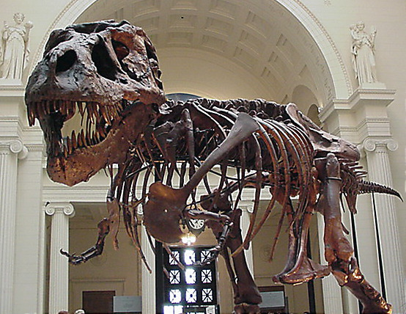
More Applications
Forensic experts may be called upon
to give information on the life and death
of humans and animals in unique
circumstances, including:
Mass Murder (Oklahoma bombing, plane crashes, World Trade Center)
Earlier man (mummies, Iceman, Lindow man)
Historical Significance (Holocaust, uncertain death of famous people)
Prehistoric Animals (Dinosaurs)

