Slide 1
Blood and Blood Spatter
SFS1. Students will recognize and classify various types of evidence in relation to the definition and scope of Forensic Science
SFS3. Students will assess how the analysis of DNA, toxicology, serology, and illicit drugs are used for forensic investigations
Differentiate the forensic techniques used to distinguish human and animal blood
Analyze the physics of blood stain patterns.

Slide 2
“Out damned spot! Out I say
Here’s the smell of the blood still.
All the perfumes of Arabis will not
Sweeten this little hand. Oh, Oh, Oh!”
Shakespeare
(Macbeth)

Slide 3
Introduction
Blood typing can provide class evidence; whereas DNA profiling can provide individual evidence.
A blood spatter pattern can give information about the truthfulness of an account by a witness or a suspect.
It also can provide information about the origin of the blood, the angle and velocity of impact, and type of weapon used.

Slide 4
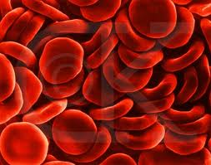
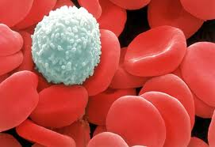
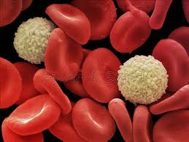
Composition of Blood
Whole blood carries cells and plasma—the fluid with hormones, clotting factors, and nutrients.
Red blood cells carry oxygen to the body’s cells and carbon dioxide away.
White blood cells fight disease and foreign invaders and, alone, contain cell nuclei.
Platelets aid in blood clotting and the repair of damaged blood vessels.

Slide 5
Some Blood Factoids
On average, blood accounts for 8% of total body weight
5 to 6 liters of blood for males
4 to 5 liters of blood for females
A 40% blood volume loss, internally or/and externally, is required to produce irreversible shock (death).
There are about one billion red blood cells in two to three drops of blood. For every 600 red blood cells, there are about 40 platelets and one white cell.

Slide 6
What are blood types?
Blood typing is quicker and less expensive than DNA profiling.
It produces class evidence but can still link a suspect to a crime scene or exclude a suspect.
There are 3 alleles or genes for blood type: A, B, & O. Since we have 2 genes, there are 6 possible combinations.
Blood Types
OO = Type O
AA or AO = Type A BB or BO = Type B AB = Type AB
www.redcrossblood.org/learn-about-blood/blood-types

Slide 7
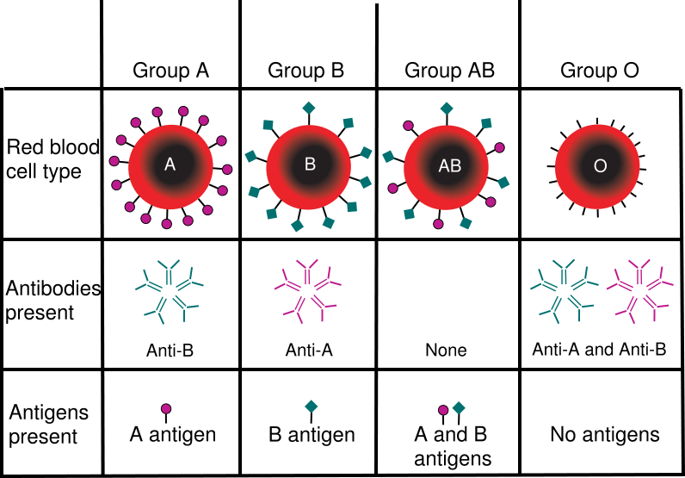
Blood Types

Slide 8
Blood Donors
Type
Antigen
Antibody
Can Give
Blood To
Can Get
Blood From
A
A
B
A, AB
O, A
B
B
A
B, AB
O , B
AB
Neither
A nor B
A and B
AB
A, B, O, AB
O
Neither
A nor B
A and B
A, B, O, AB
O

Slide 9
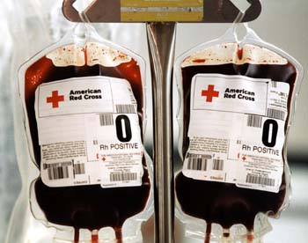
Blood Donors
When someone receives a blood transfusion, no plasma is in the transfused blood. This means that no antibodies are in it.
Type O is the universal donor.
Type AB is the universal receiver.

Slide 10
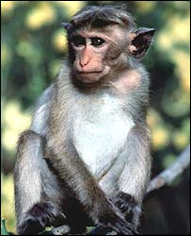
Historical Perspective of Blood Typing
Around 1900, Karl Landsteiner discovered that there are four different types of human blood based on the presence or absence of specific antigens found on the surface of the red blood cells.
In 1940, Landsteiner and Weiner reported the discovery of the Rh factor by studying the blood of the Rhesus monkey. 85% of Caucasians, 94% of Black Americans and 99% of all Asians are Rh positive.

Slide 11
Forensic Use of Blood Types
Although DNA analysis has replaced most conventional serology tests, there is still some useful information in the blood
About 80% of the population are secretors
Secretors secrete their blood antigens into their tears, sweat, semen and saliva
Knowing the blood type allows you to rule out suspects rather than identify them.

Slide 12
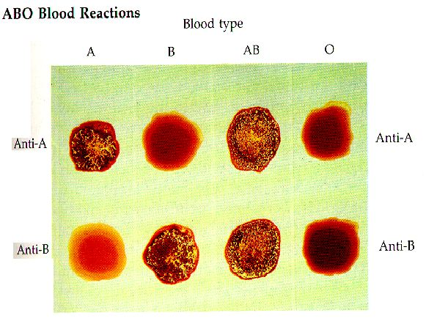
Blood Types - Testing

Slide 13
Blood Typing Lab
A
Use the results shown to determine the blood type for each sample.
Rh
B
Blood Type: ___
+ = present
A
A
A
- = absent
Rh
Rh
Rh
B
B
B
Blood Type: ___
Blood Type: ___
Blood Type: ___

