Slide 1
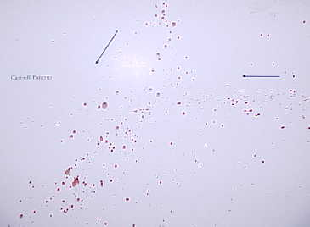
Cast-off Pattern
A bloodstain pattern created when blood is released or thrown from a blood-bearing object in motion

Slide 2
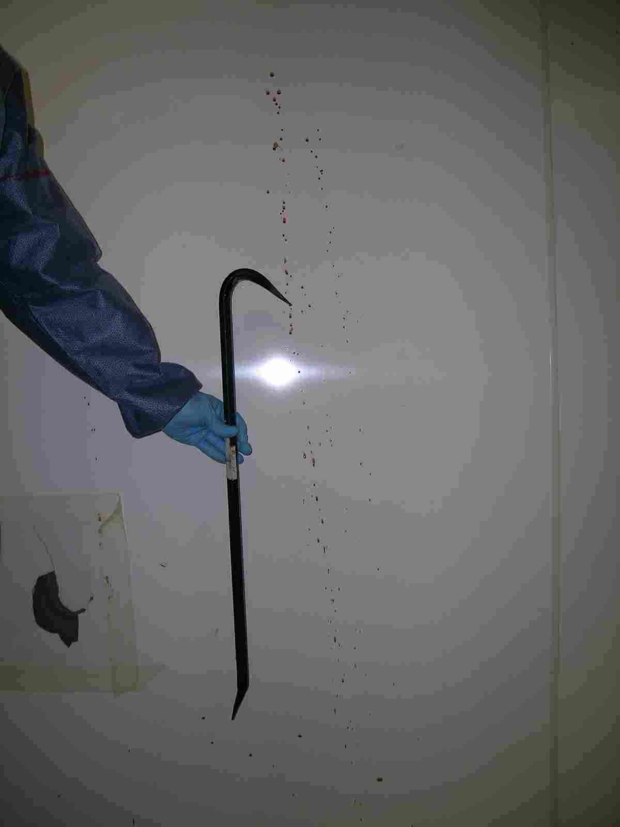
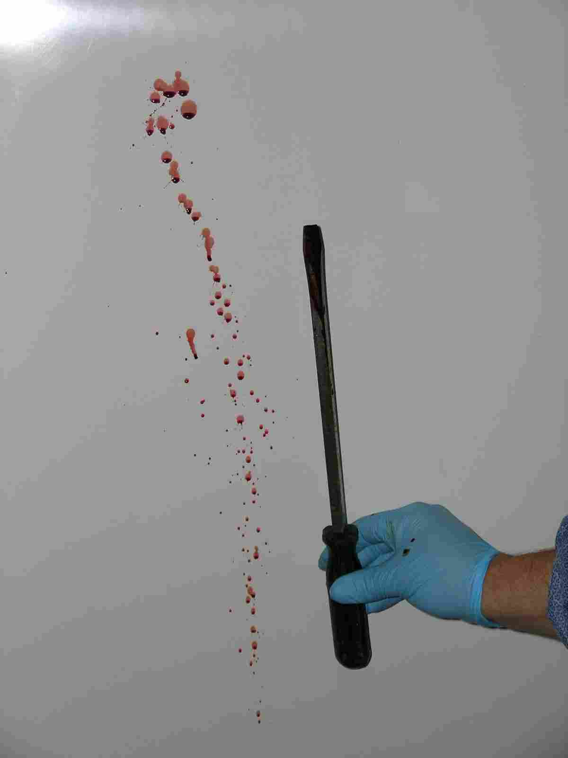
Cast off patterns

Slide 3
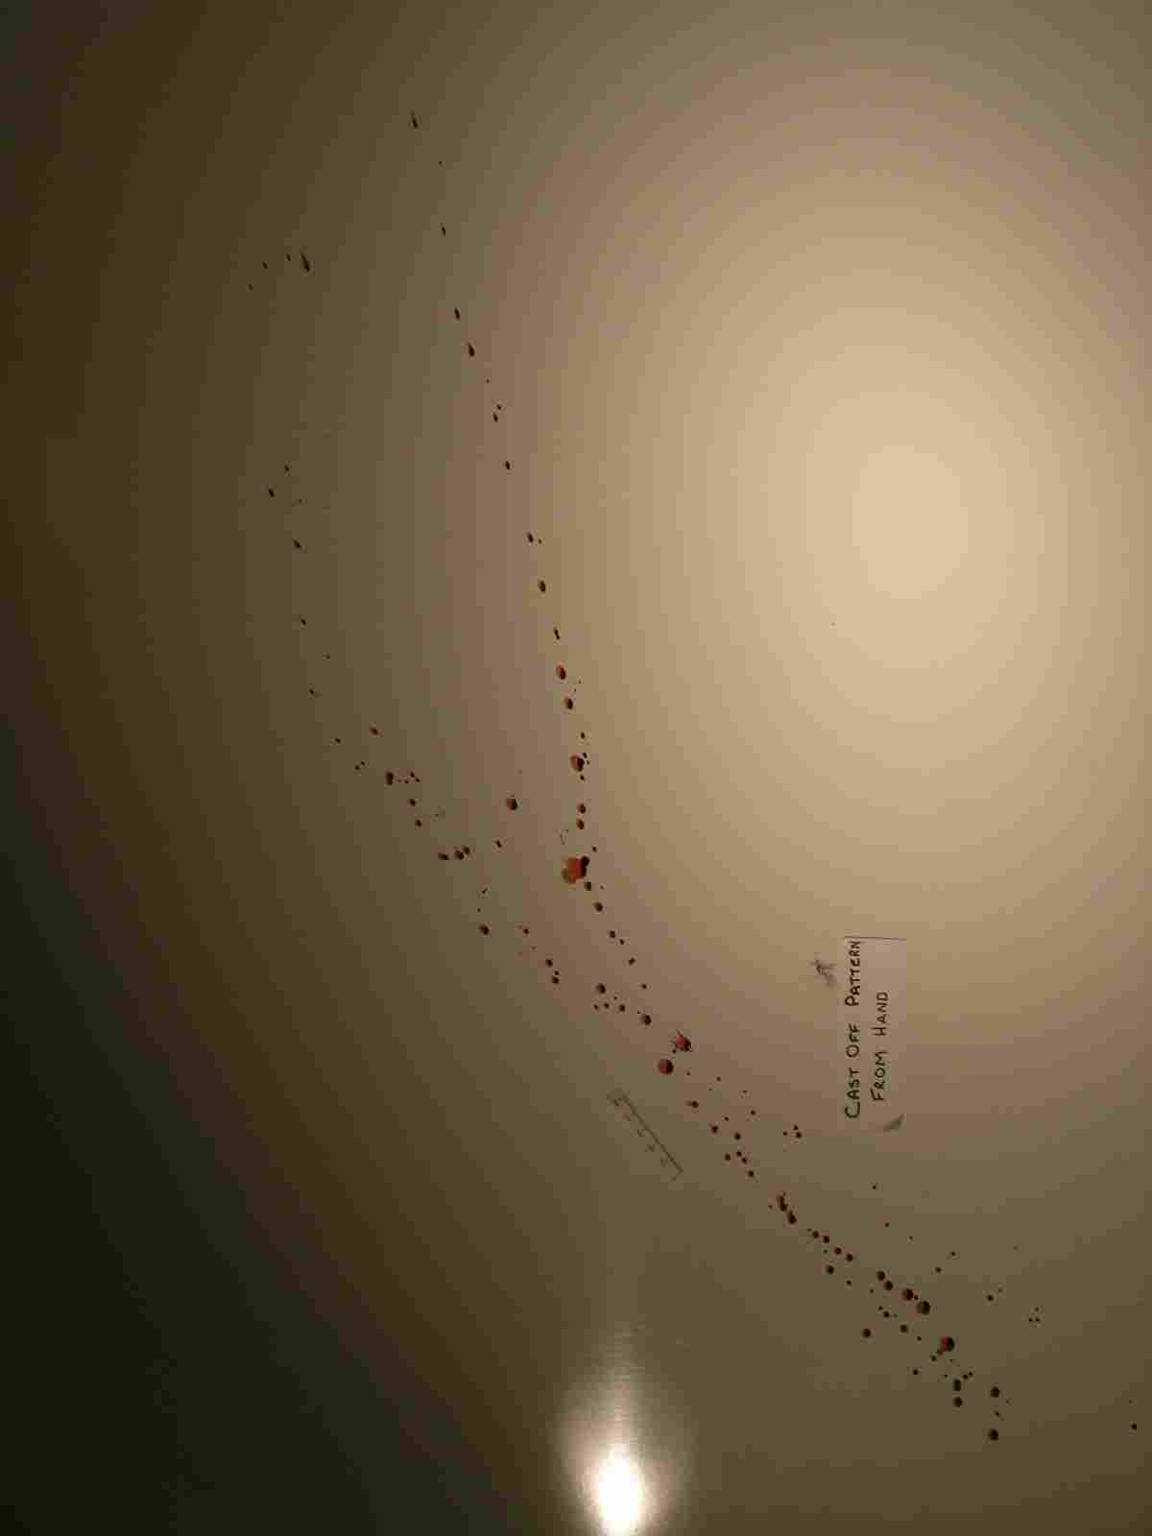
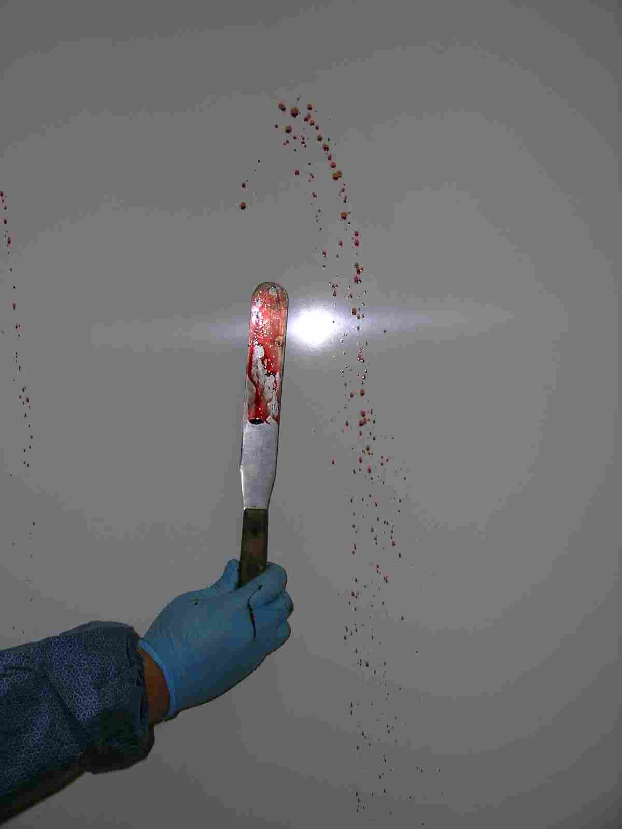
Cast off patterns

Slide 4
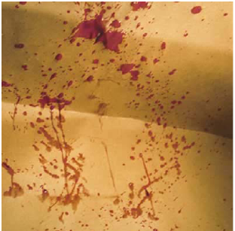
Projected – Medium Velocity
These type of spatters are normally smaller than those from low-velocity droplets
Blood is typically traveling between 5 -25 feet per second

Slide 5
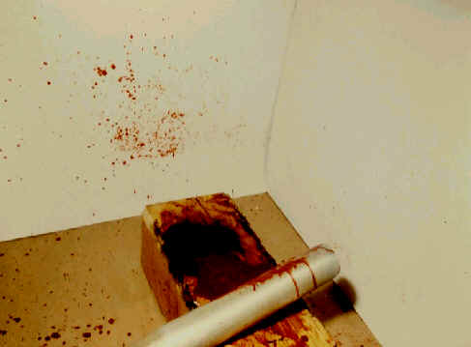
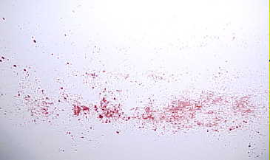
Medium Velocity Impact (MVI)
Impact velocity of 5 to 25 feet/sec.

Slide 6
Medium impact
Medium impact occurs when a force such as a bat is applied.
Image courtesy UWA PhD research student Mark Reynolds.

Slide 7
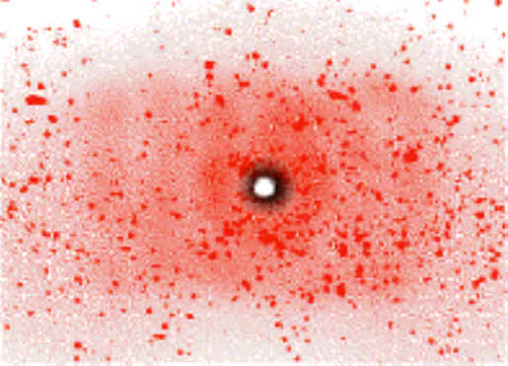
Projected – High Velocity
High velocity blood spatter occurs when a strong, explosive force projects blood in a aerosolized spray
Usually produced by a gunshot
The very small drops of blood are in a mist and do not have much horizontal movement (less than 5ft)
Blood is traveling 100 ft/sec or more
Gunshots result in back spatter (where bullet enters) and forward spatter (where bullet exits)

Slide 8
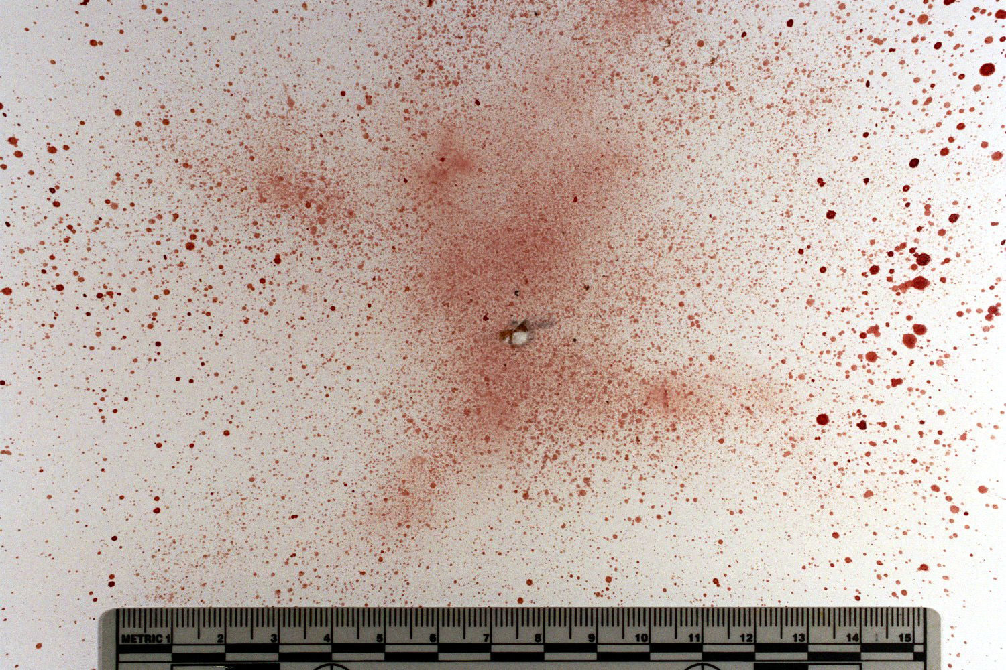
High impact - fine mist of droplets
Image courtesy Stuart James, February 2007

Slide 9
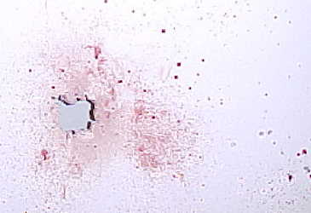
High Velocity Impact (HVI)
Stain size 1 mm in size and smaller. Mist like appearance.
Impact velocity of 100 feet/sec and greater.

Slide 10
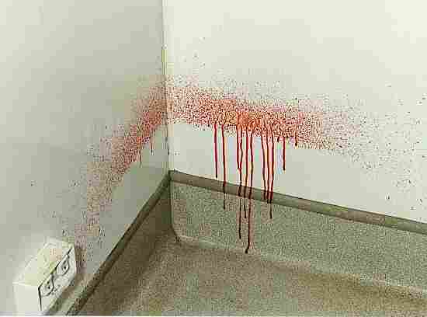
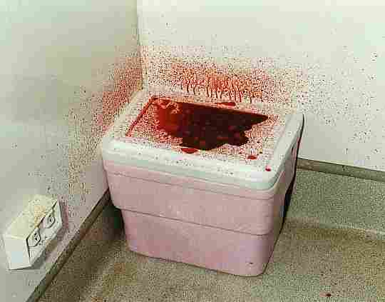
Voids

Slide 11
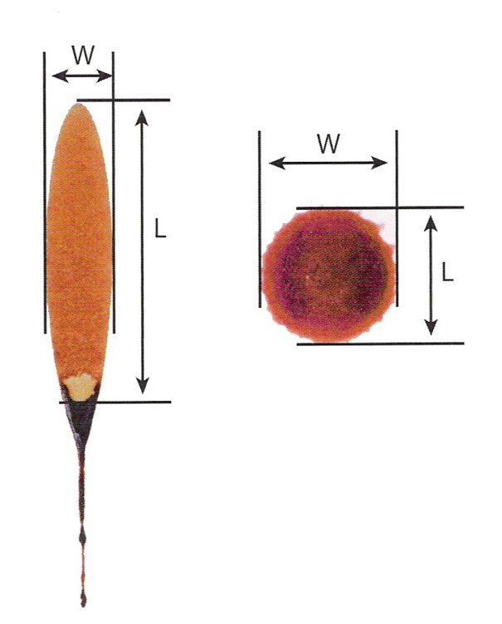
Determining Direction of Blood
The angle can be determined mathematically.
Width/Length, then take the inverse sin (sin⁻¹).
This number is the impact angle (90 = perpendicular to surface; <10 at a sharp angle)

Slide 12
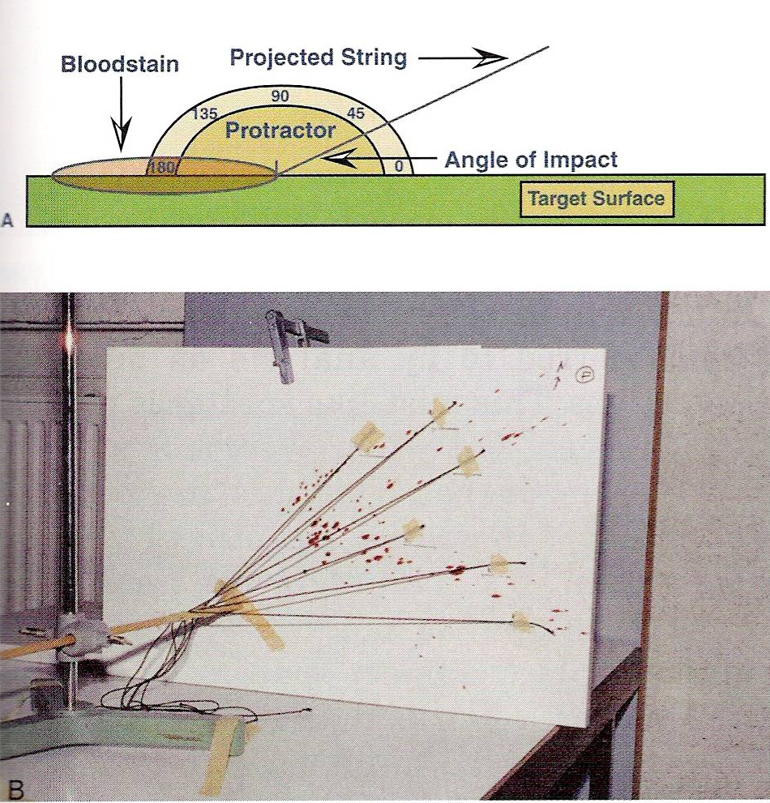
Determining Direction of Blood
For each blood drop, a string can be guided back to the point of origin.

Slide 13
Blood Spatter
If more than one drop (from spatter) results, the point of origin can be determined
This is a 2-dimensional point of origin.
It is possible to determine the 3-D point of origin

Slide 14
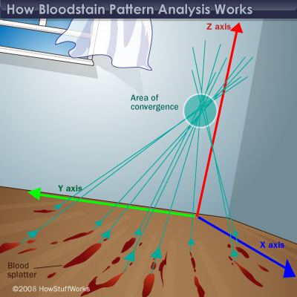

Slide 15
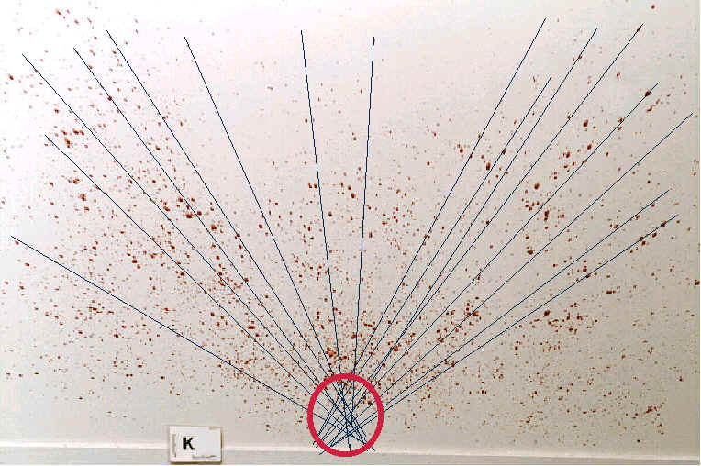

Slide 17
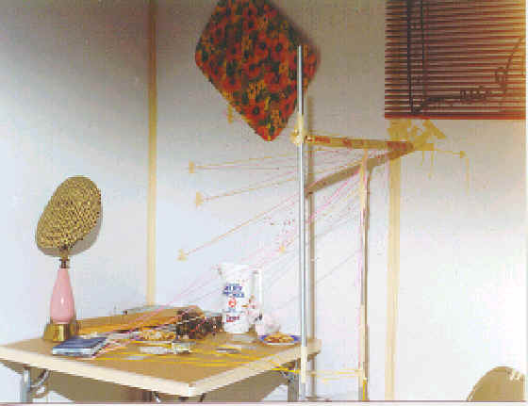

Slide 18
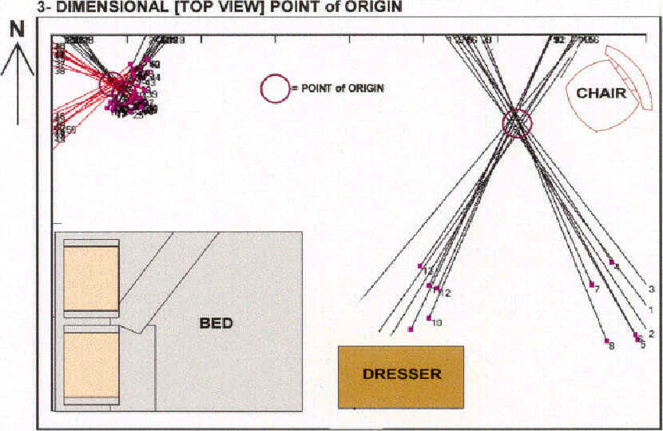

Slide 19
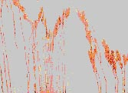
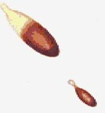
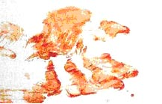
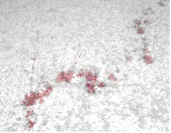
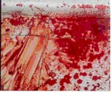
Blood spatter Analysis
passive drops
arterial gushes
splashes
smears
trails
pools

Slide 20
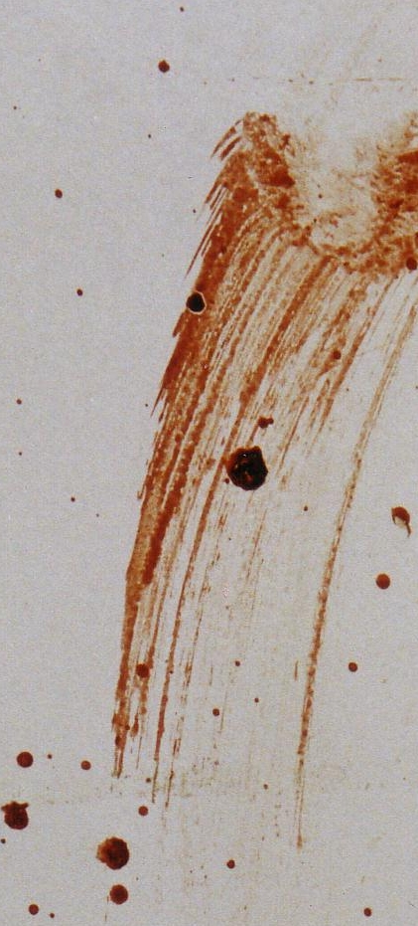
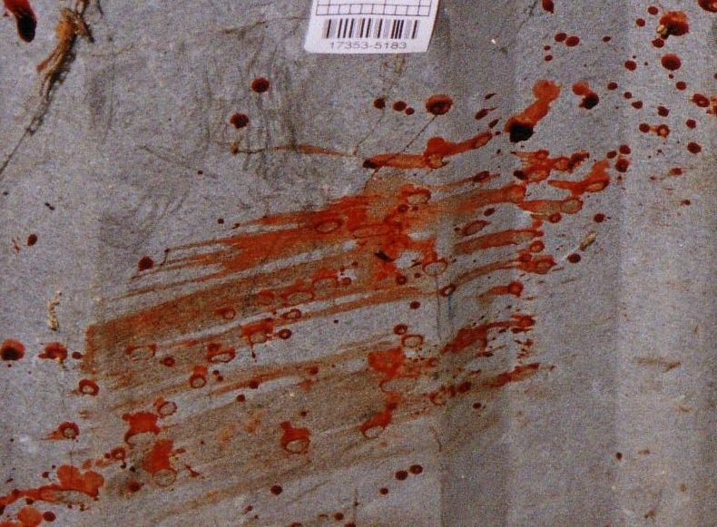
Contact stains Swipe vs wipe

Slide 21
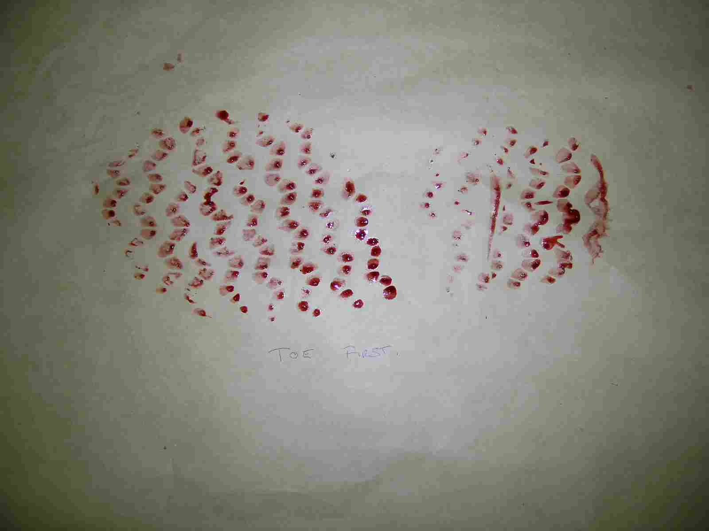
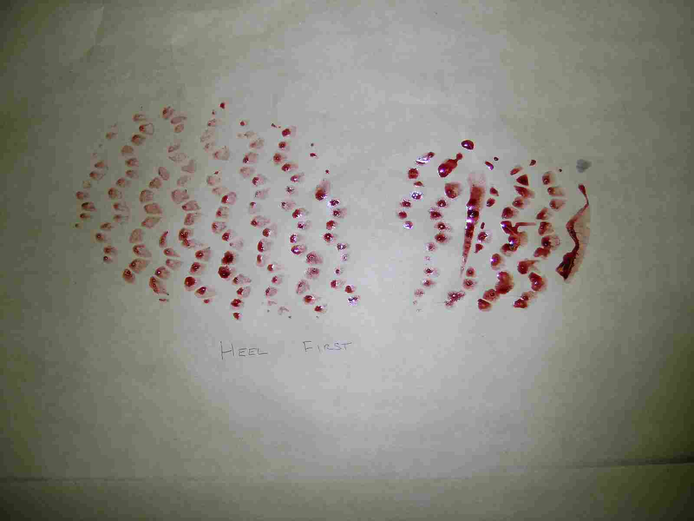
Advancing or retreating??
Toe first
Heel first

Slide 22
Presumptive Tests for Blood Determination
Kastle-Meyer color test—a mixture of phenolphthalein and hydrogen peroxide; the hemoglobin will cause the formation of a deep pink color if blood is present
Hematest® tablet—reacts with the heme group in blood causing a blue-green color
Luminol test—reaction with blood to produce light

Slide 23
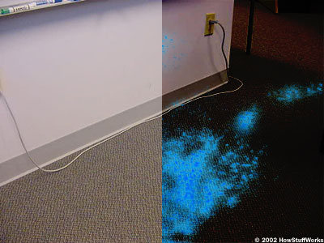
Luminol
The chief catalyst (esp. in old blood samples) is iron.
Can test large areas at once.
Does not degrade DNA or blood antigens

Slide 24
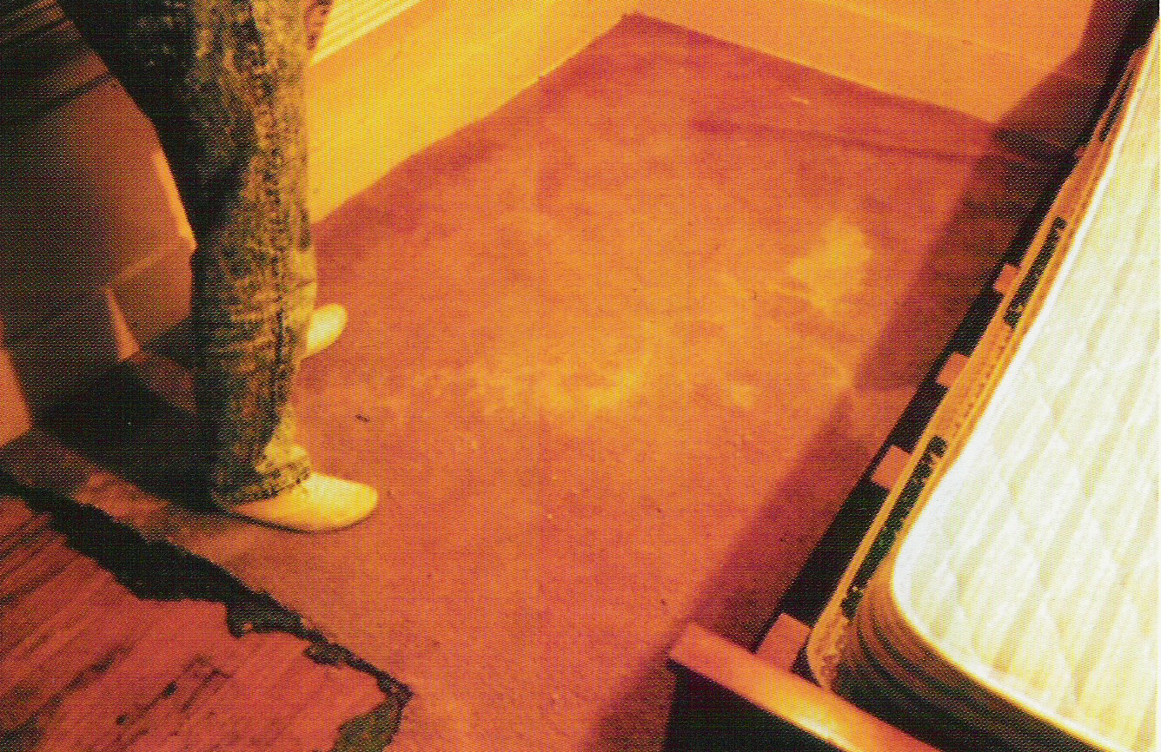
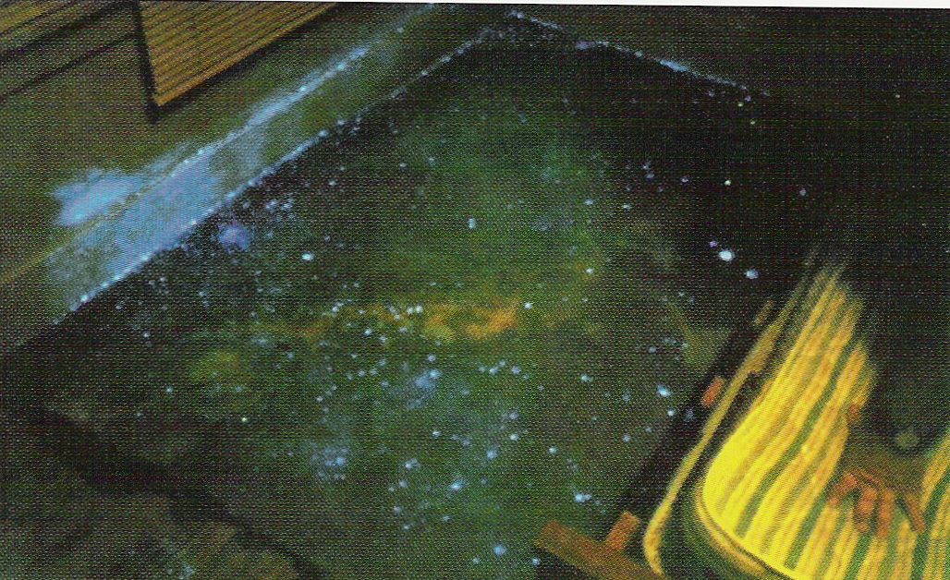
Luminol

Slide 25
More About Luminol
Luminol also fluoresces in the presence of copper or an alloy of copper, horseradish and certain bleaches.
If a crime scene is thoroughly cleaned with a weak bleach solution, residual bleach will cause the entire crime scene to fluoresce, effectively camouflaging any organic evidence such as blood.
http://en.wikipedia.org/wiki/Luminol

