Slide 1
Blood – a Liquid
Blood is nothing more than a liquid
As such, it behaves in predictable ways (fluid dynamics)

Slide 2
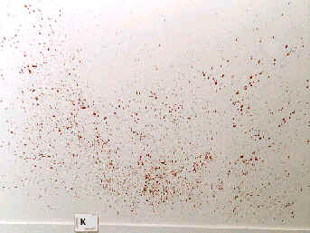
Conditions Affecting Shape of Blood Drops
Size of the droplet
Angle of impact
Velocity at which it left its origin
Height
Texture of the target surface

Slide 3
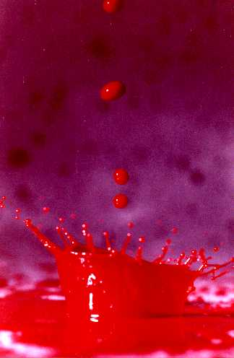

Slide 4
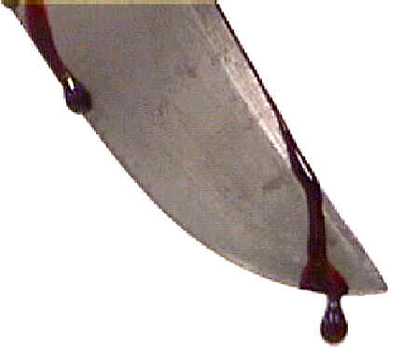
passive or gravity drop

Slide 5
Determining the Distance Blood Falls
Drops form circle when hitting surface
Size depends on speed of blood drop
Faster drop = larger diameter
Higher distance = larger diameter
However, size of drop also depends on the volume of the drop. Volume depends on object blood originated from (needle = small; bat = large)

Slide 6
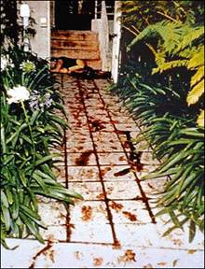
Blood Spatter
Since the volume of blood in a drop is generally unknown…
It is not possible to establish with a high degree of accuracy the distance that a passive blood drop has fallen

Slide 7
Bloodstain Terminology
Angle of impact—angle at which blood strikes a target surface.
Bloodstain transfer—when a bloody object comes into contact with a surface and leaves a patterned blood image on the surface
Backspatter—blood that is directed back toward the source of energy
Cast-off—blood that is thrown from an object in motion
Directionality—relates to the direction a drop of blood traveled in space from its point of origin

Slide 8
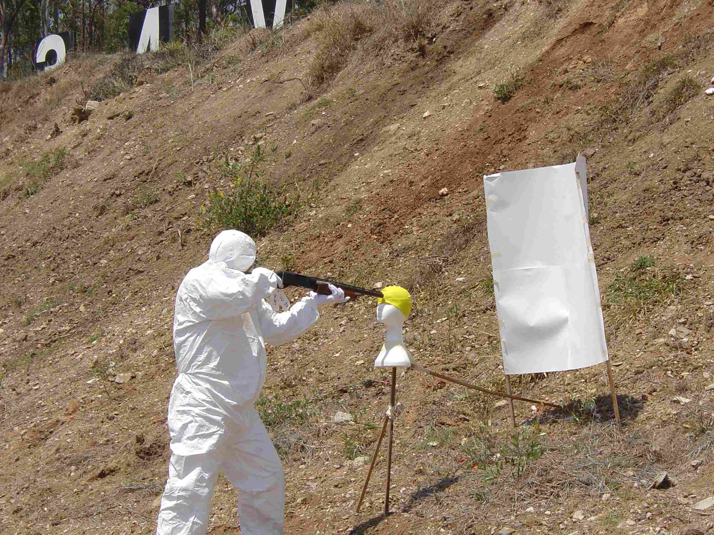
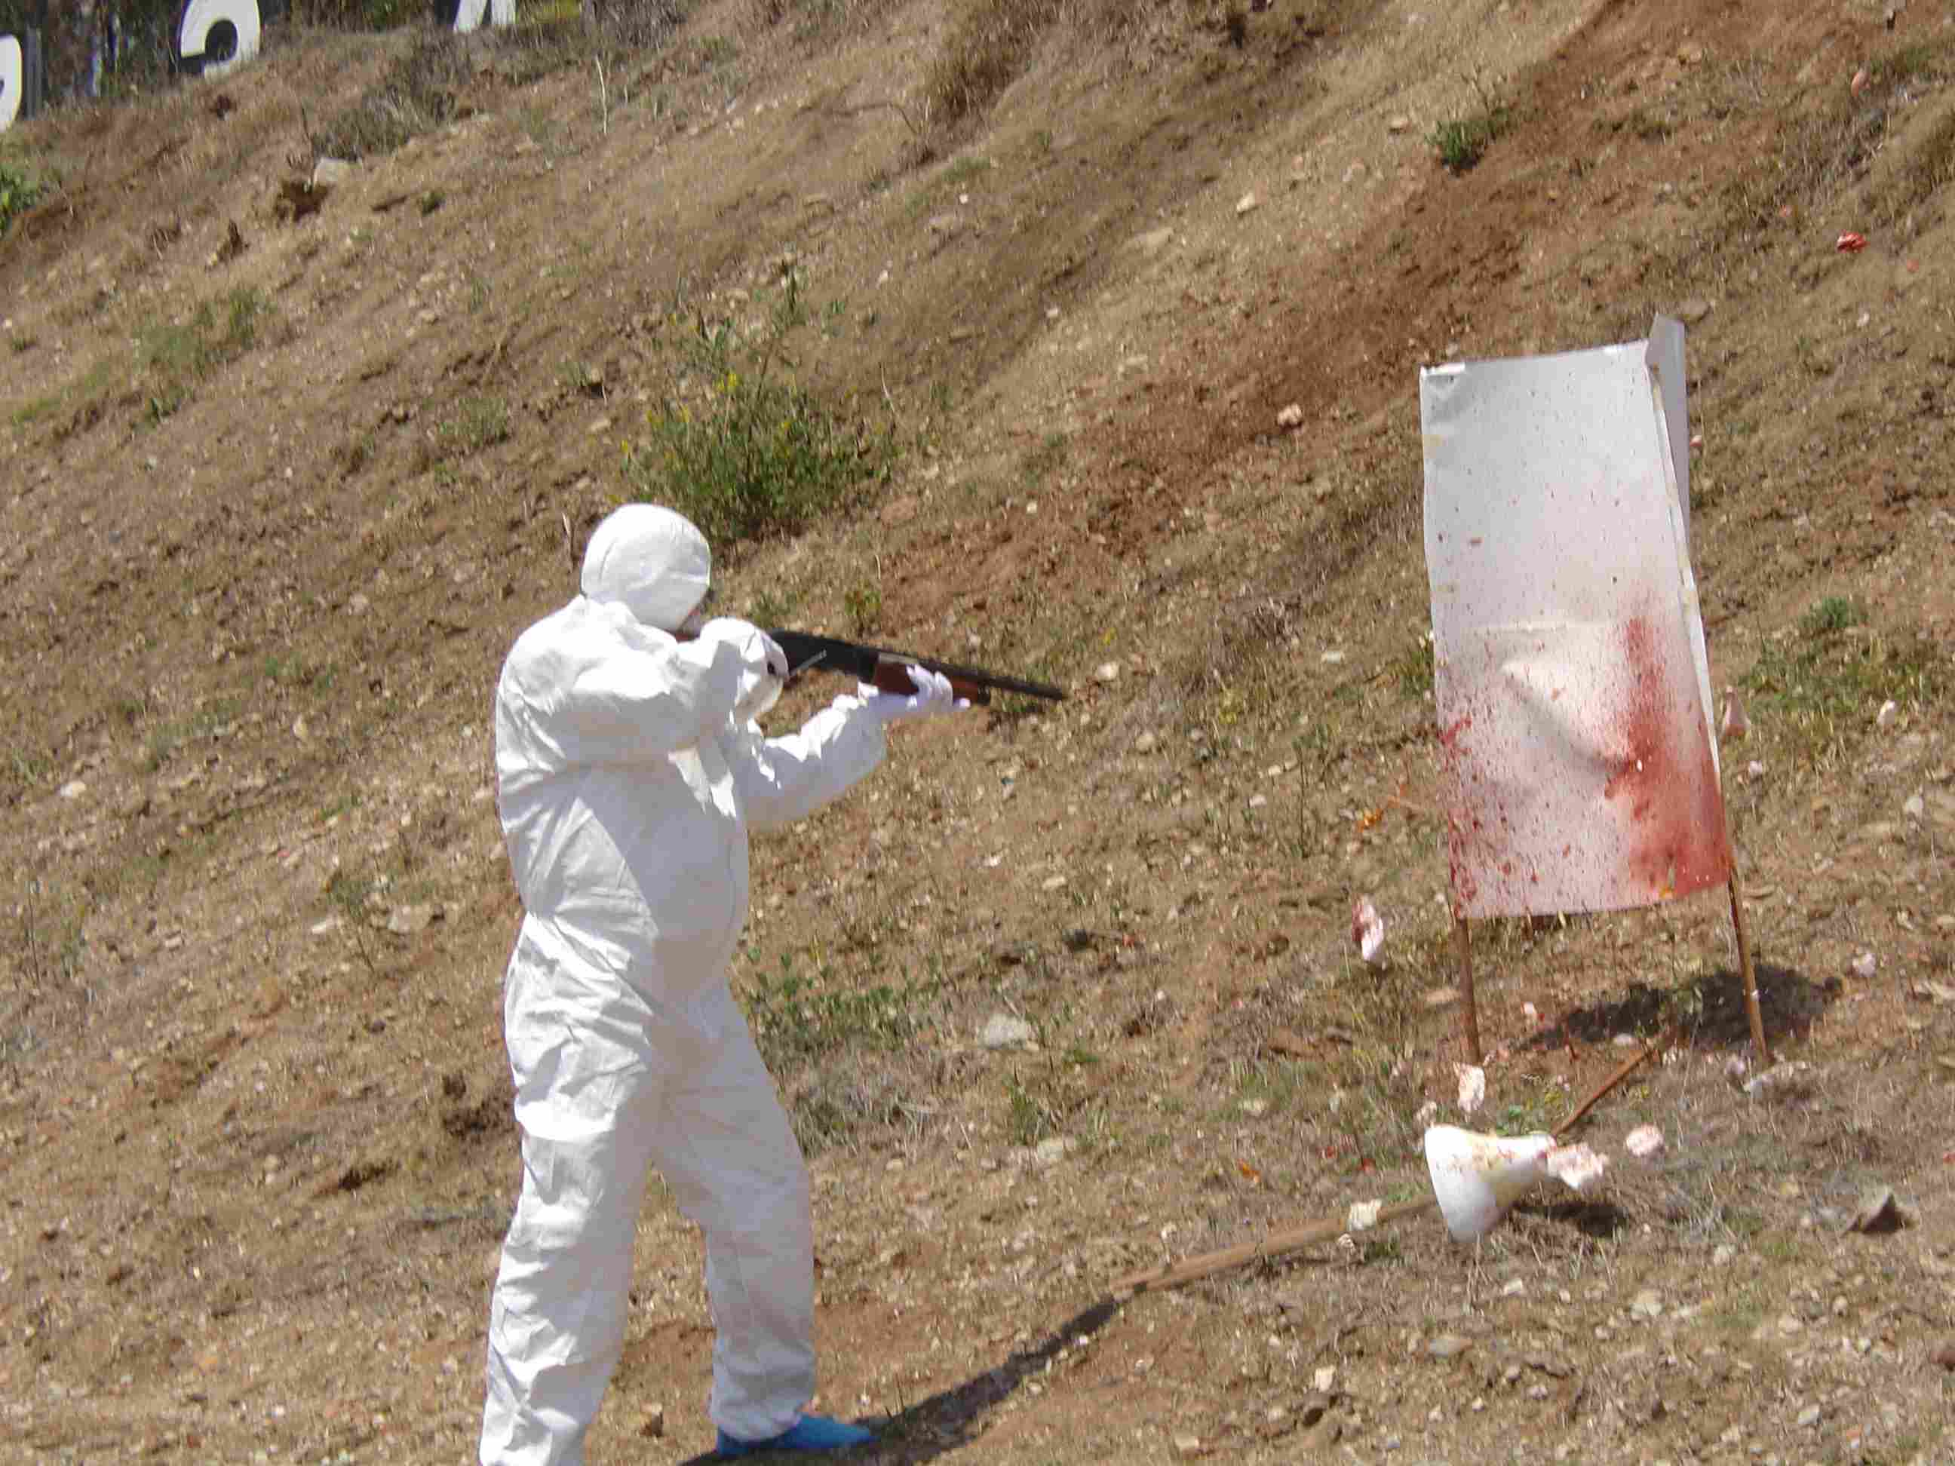
Forward Spatter

Slide 9
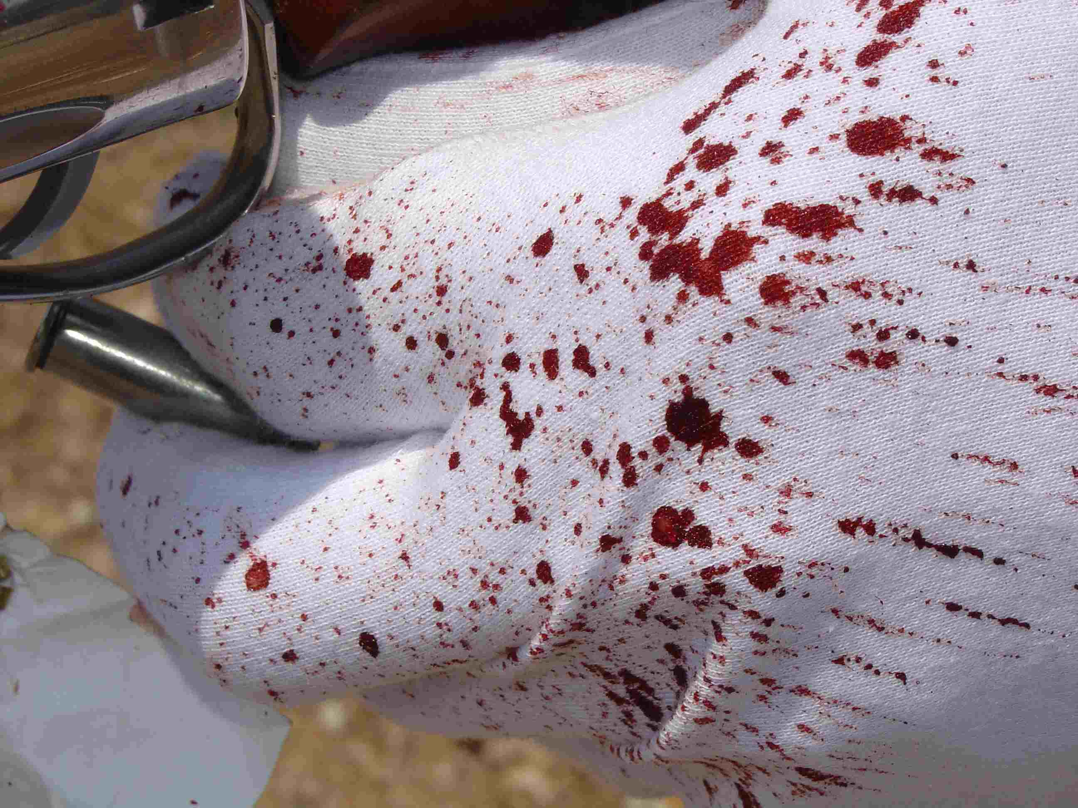
Back spatter

Slide 10
Drying Time
Drying begins at periphery and proceeds inward
Drying time is affected by
Surface type
Amount of blood
Climatic conditions
Skeletonization
Partially dry stains leave a ring that outlines original spatter
The drier the stain, the less skeletonization shown

Slide 11
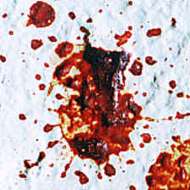
Surface and Blood Spatter
The type of surface the blood strikes affects the amount of resulting spatter, including the size and appearance of the blood drops.

Slide 12
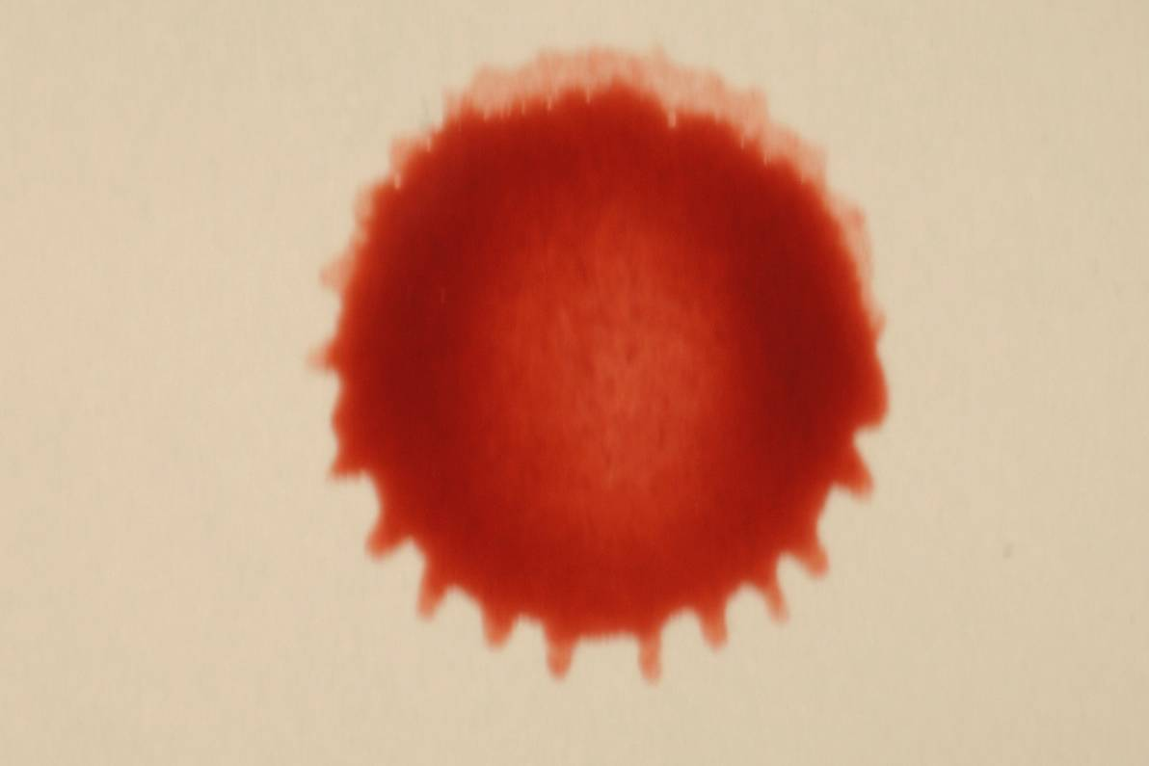
Blood Spatter
When a drop hits at an angle other than 90º, it will form a tear drop shape on the surface it hits
Narrow end of a blood drop will point in the direction of travel.

Slide 13
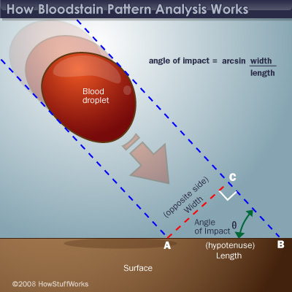

Slide 14
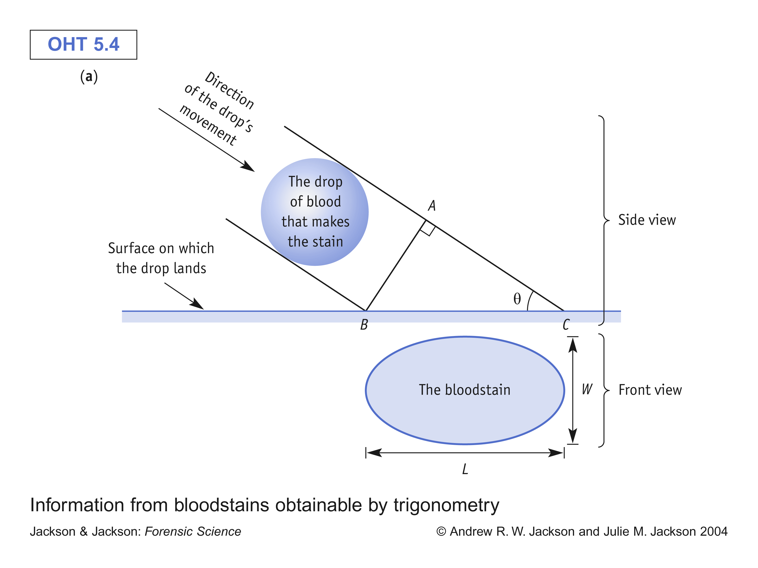
sin θ = W / L
W
L
The closer you get to a drop
falling vertically, the more
the drop should have W=L
sin θ = 1 → θ = 90°
Drop is a circle!

Slide 15
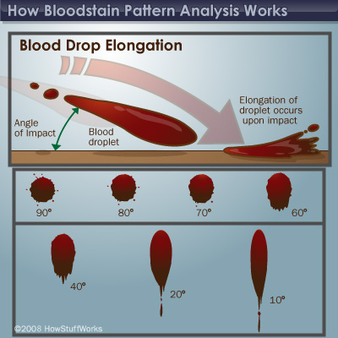

Slide 16
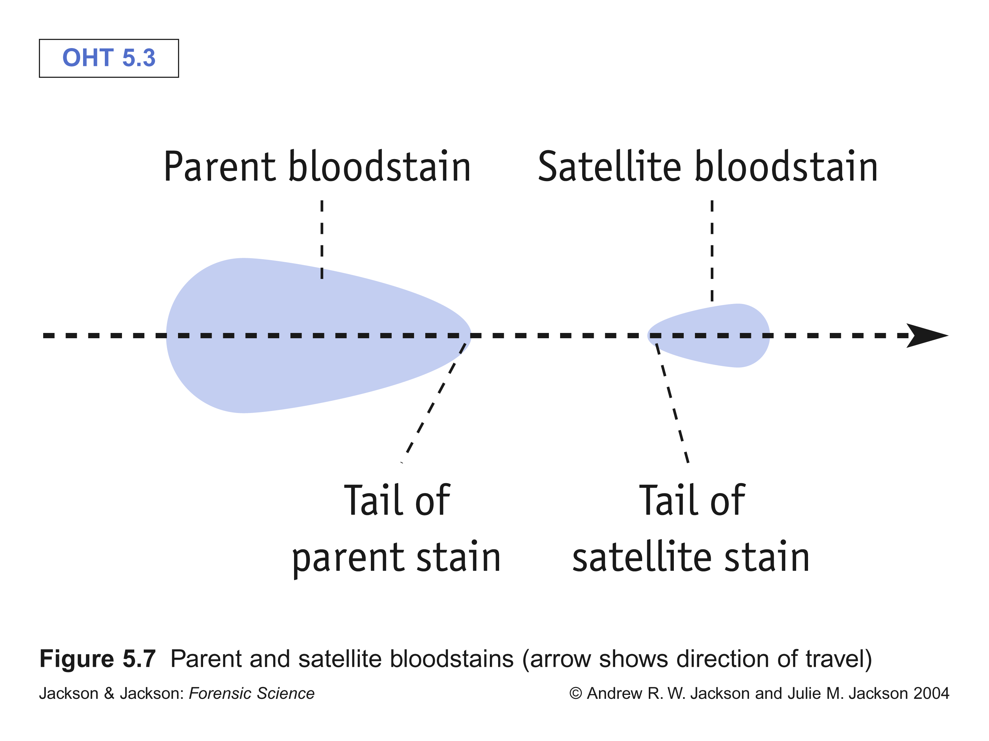
Direction of Blood
one exception!
tail points in
direction of
travel

Slide 17
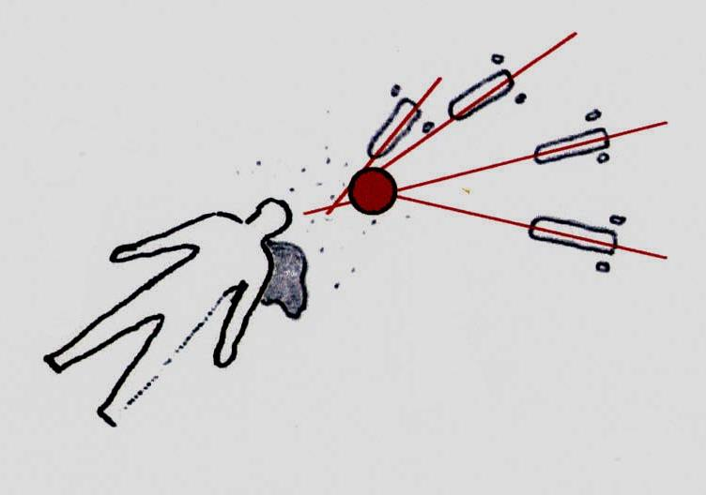
Blood Spatter
Passive: gravity is the only force involved
Projected: created when a blood source is subjected to an action or force, greater than the force of gravity
Arterial gush
Low velocity (cast off spatter)
Medium velocity cast off spatter (beatings)
High velocity spatter (gunshots)

Slide 18
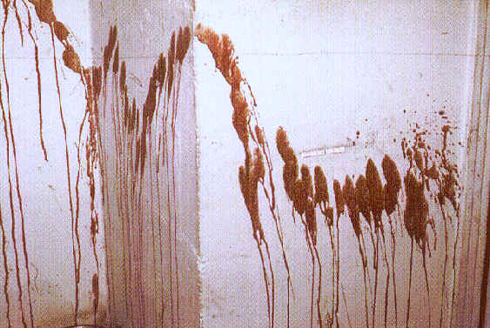
Projected – Arterial Spray
Arterial Spurt / Gush: Bloodstain pattern resulting from blood exiting the body under pressure
Large volume projected from arterial pressure

Slide 19
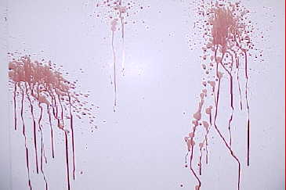
Arterial spurt

Slide 20
Projected – Cast Off Low Velocity
Cast-off Stains: Blood released or thrown from a blood-bearing object in motion
Usually found on ceilings – formed by the upstroke of a weapon containing blood (bat, crowbar, etc)
Number indicates number of blows, plus one

Slide 21
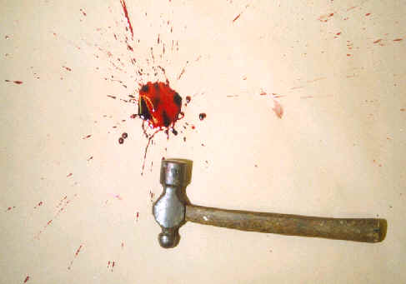
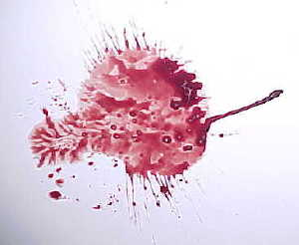
Low Velocity Impact (LVI)
Relatively large stains 4 mm in size and greater. Impact velocity up to 5 feet/sec

Slide 22
Low impact
Low impact is really blood under the influence of gravity - it just falls.
Image courtesy UWA PhD research student Mark Reynolds.

